Slide 1
Building Relationships and Community Through Crew
Matt Bernstein
9th Grade Social Studies Teacher, Casco Bay High School bernsm@portlandschools.org

Slide 2
Learning Targets
I can explain the connection between Crew and homeplace.
I can reflect on my own practice to consider how to build homeplaces for all students.

Slide 3
Agenda
Homeplace Visualization Activity
Definitions and Background Information
How does Crew help build community and homeplace?
Connection: Commonalities
Reflection: Courageous Conversation on Homeplace in School
Joy: World’s Greatest Fan
Wrap-Up and Q&A
Notes:
All activities come from ones I do with students/with crew

Slide 4
Home

Slide 5
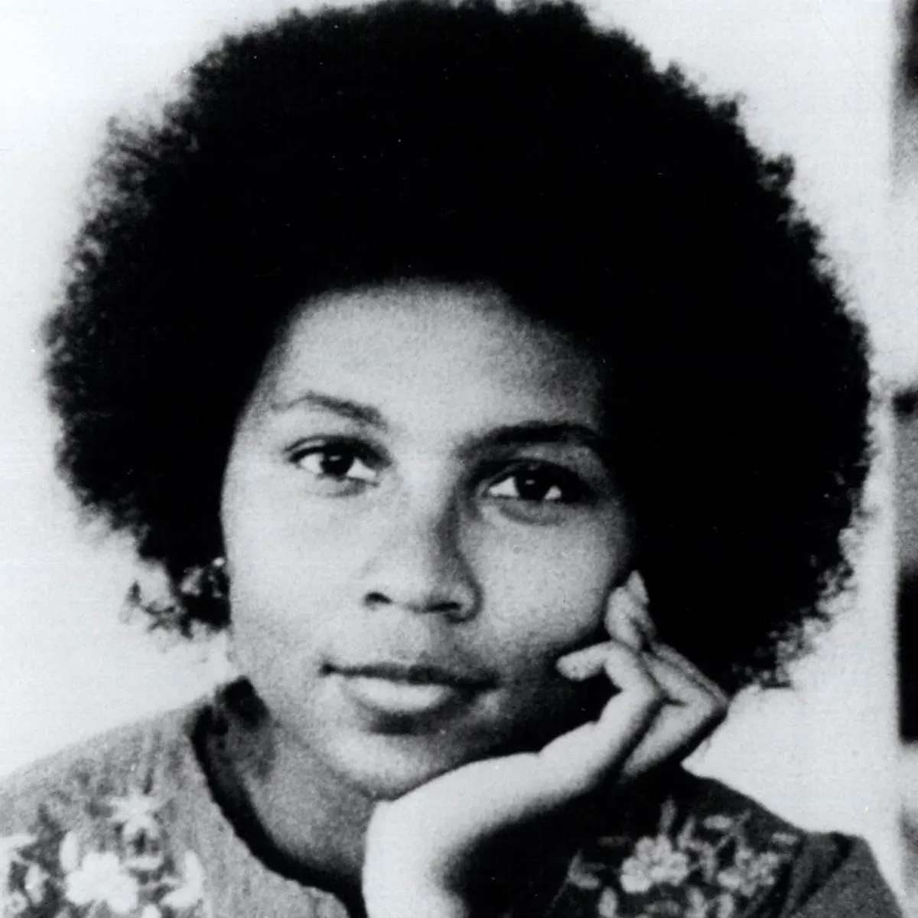

Slide 6
Homeplace: A place or community where “souls are comforted, nurtured, and fed”

Slide 7
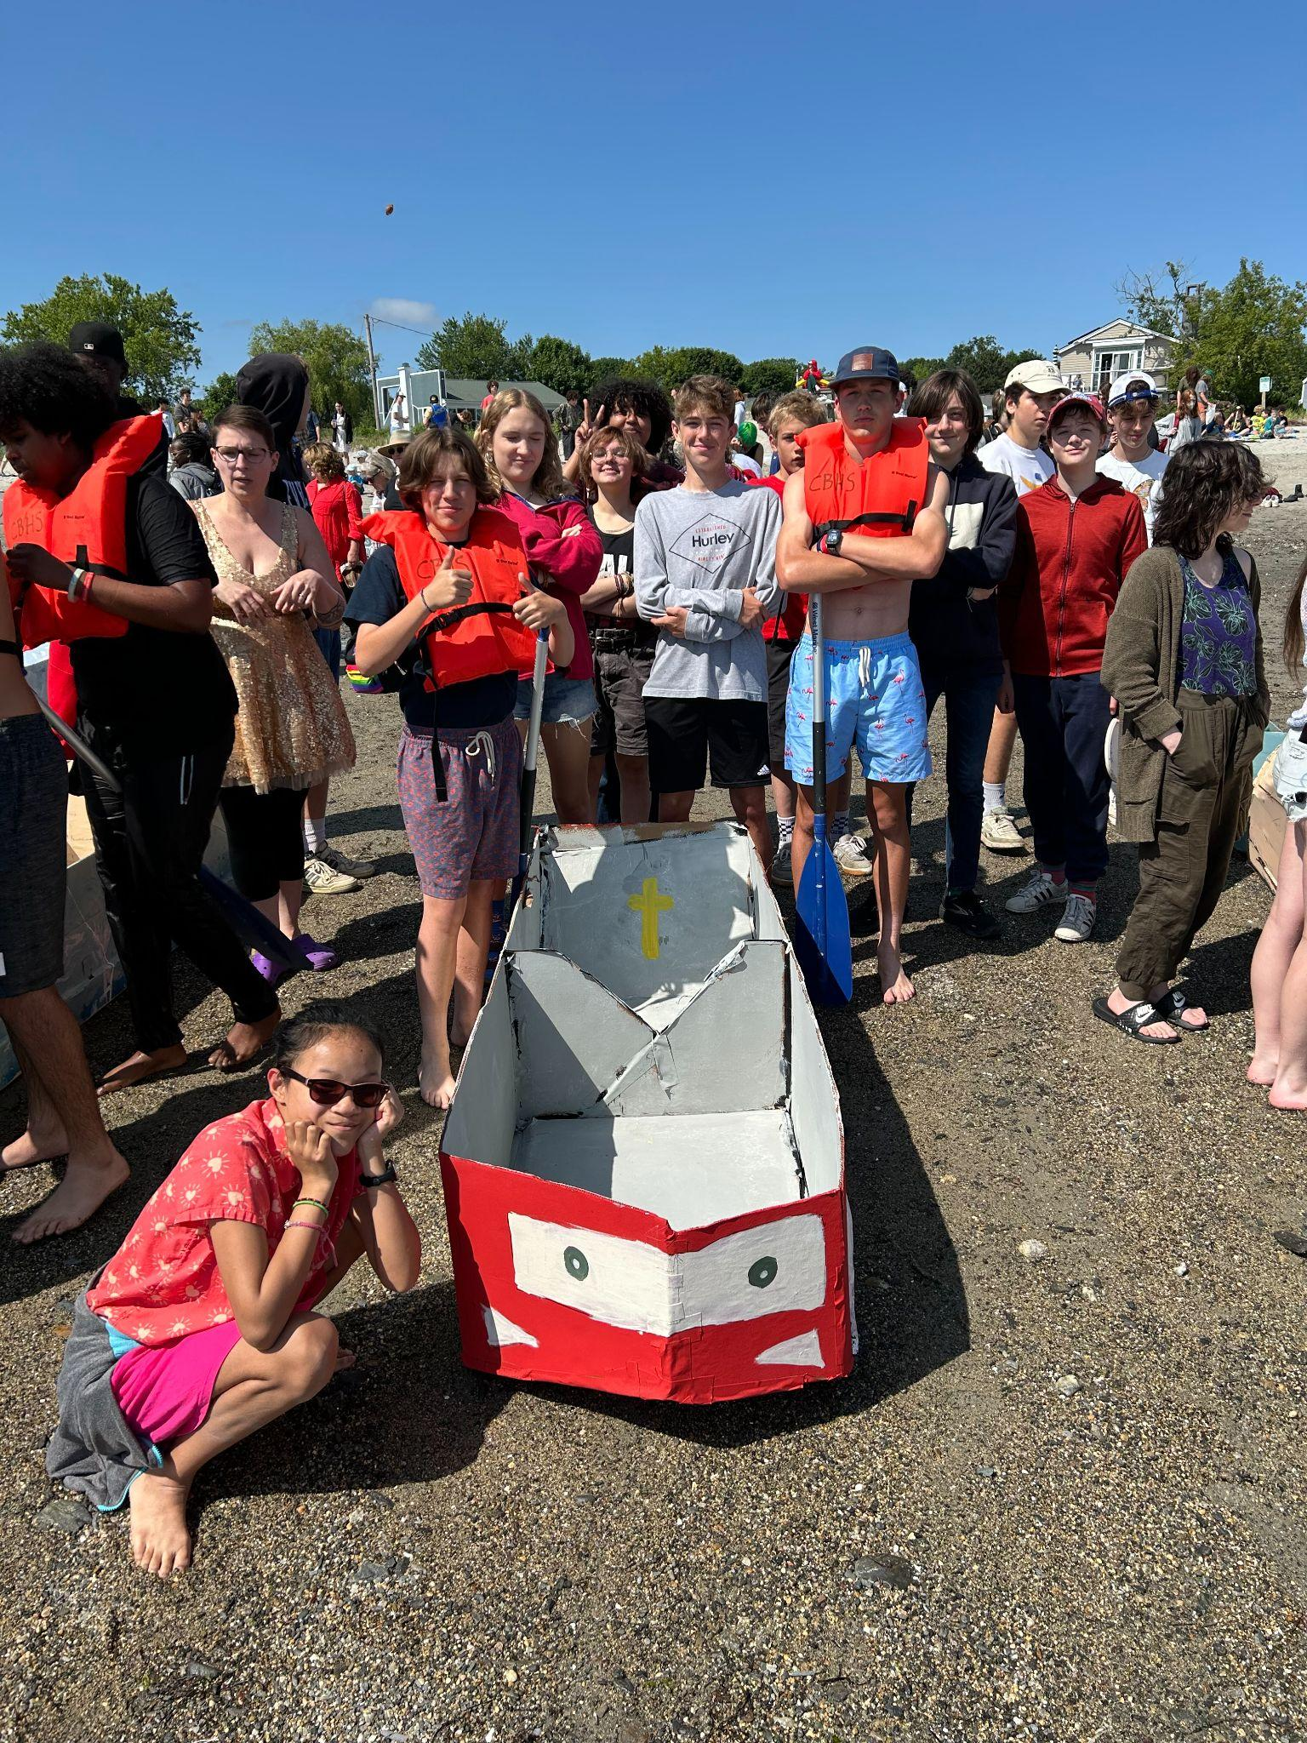
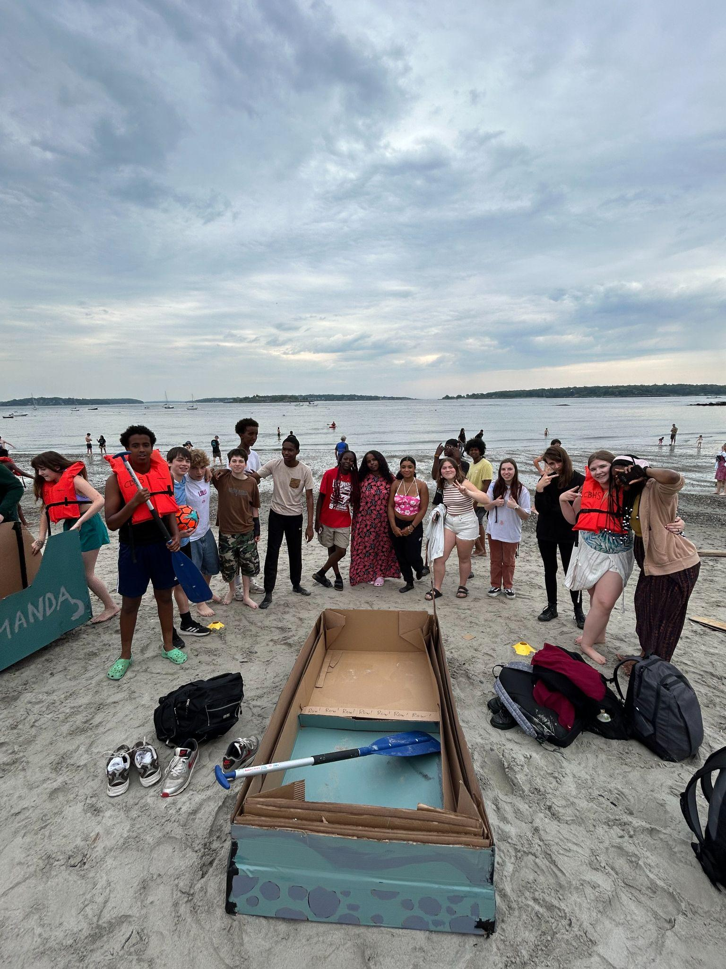
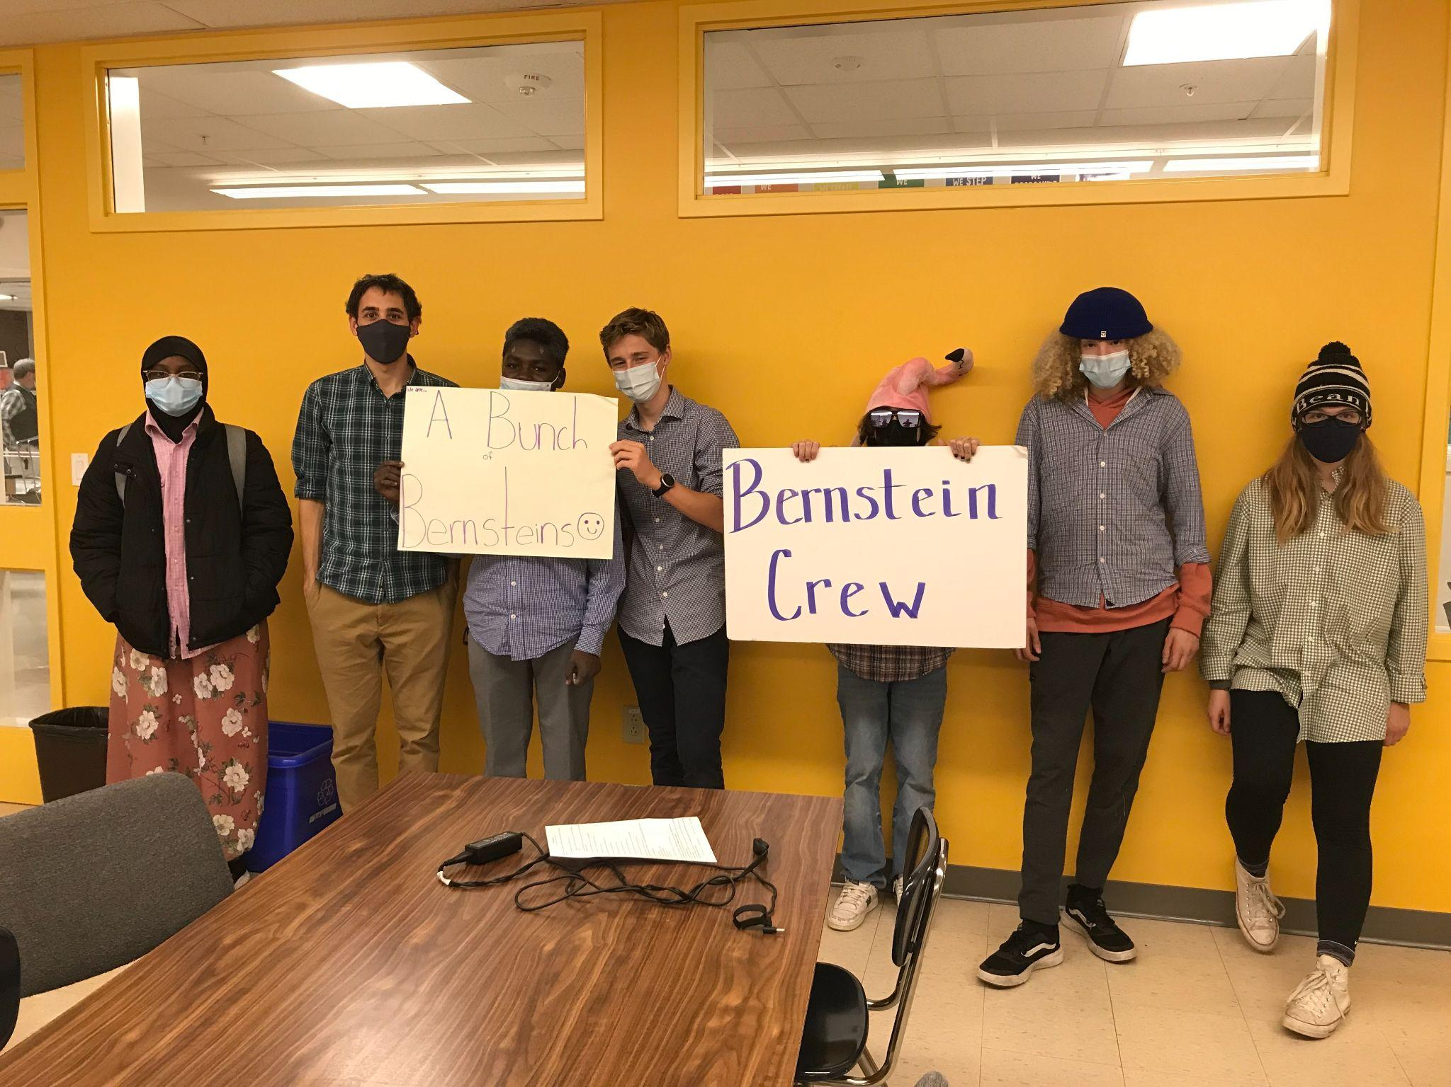
What is Crew?

Slide 8
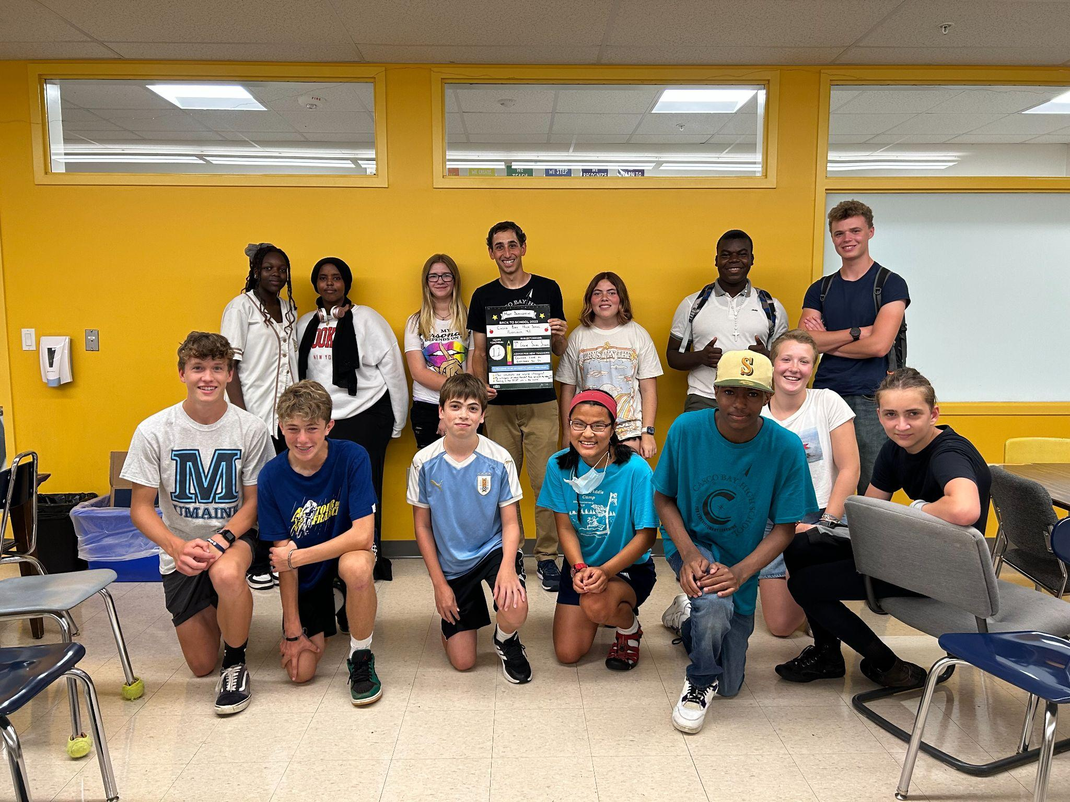

Slide 9
What does a week in crew look like?
Monday - 30 minutes | Tuesday - 30 minutes | Wednesday - 35 minutes | Thursday- 30 minutes | Friday - 1 hour
Cabinet Bulletin Check-Ins | Academic Check-Ins Movement Breaks Courageous Conversations or Other School-Wide Initiatives | Crew Lunch Directly following crew lunch, we attend school meeting with our crew | Crew Connections | Fun Friday
Notes:
There is no actual typical week in crew because we have to be responsive, but this is the general structure

Slide 10
How does Crew help build community and homeplace?
Connection
Reflection
Joy

Slide 11
How does connection help build homeplace?

Slide 12
Courageous Conversation Norms
1. Be attentive and willing to engage in a serious conversation
2. Be respectful
3. Be “raggedy” : Share what you honestly feel without being rude or offensive, but also without censoring yourself.
4. One speaker at a time and listen carefully to those speaking
5. Assume best intentions
6. Agree and disagree with ideas, not people
7. Step up, Step Back : Step up and actively participate and share, step back so that you are not dominating the air time.
8. Lessons leave. Stories stay. Any personal stories that are shared during the conversation should not be shared outside of crew (unless the person who’s sharing the story decides to do so again).

Slide 13
Discussion Questions
Was school a homeplace for you as a student? Why or why not?
Do you think there is a connection between relationship building and student success? Why or why not?
What elements of your current practice do you feel connect to homeplace and relationship building?
What is an element of your practice that you hope to introduce or deepen in order to build relationships and homeplaces for all students?

Slide 14
Synthesis
One thing I heard in today’s conversation that I want to remember is…

Slide 15
How does reflection help build homeplace?

Slide 16
How does joy help build homeplace?

Slide 17
Scan here for a list of crew activities!

Slide 18
Thank you for being here and for all you do!
Please feel free to contact me at bernsm@portlandschools.org

