Slide 1
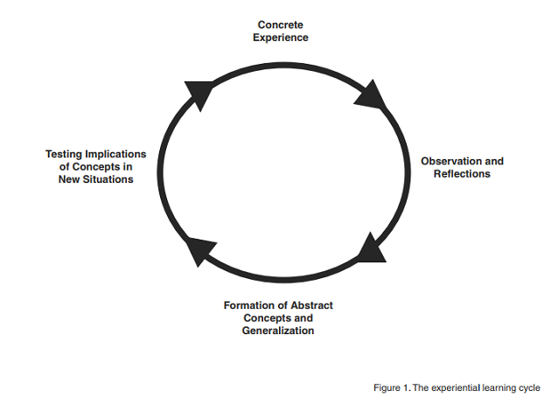
Public Health Practicum Experiences for Graduate Students: Is it Working?
Titilola Balogun, MBBS, DrPH, Sharla K. Willis, DrPH, Richard E. Parent, Ph.D., Brianna Parsons, Ed.D.
College of Graduate and Professional Studies
Research Question
Methods and Analysis
Limitations and Resulting Actions
How do recent MPH graduates and their preceptors perceive and describe the practicum experience?
This was a qualitative case study with a cross-sectional design that used an online survey to ask recent MPH graduates and their preceptors open-ended questions about the practicum experience.
The survey was administered through REDCap. Data were saved to an Excel file and uploaded to ATLAS.ti software for analysis. We used open coding, in vivo coding and thematic analysis to analyze the data.
In their responses to our open-ended questions, many alumni did not sufficiently describe the competencies they attained at the sites or explain how the practicum prepared them for public health work. This was particularly so for those who were unable to find a site that aligned with their interests.
After the survey, in order to improve the practice experience and ensure that competencies are met by the field experience, we:
Incorporated information from the study into the design of an applied practice experience course that meets new CEPH guidelines.
Updated the planning process for the applied practice experience by involving preceptors in discussing the competencies before students commence the field work.
Modified the assignments in the course to focus solely on public health skills.
Introduction
In October 2016, the Council on Education for Public Health (CEPH) released a set of competencies for schools and programs of public health in which graduates of MPH programs are expected to be proficient. ¹
Whereas few studies have looked at students’ perceptions of their competency attainment in other fields such as psychology and nursing, ²⁻³ little is known about the perceptions of public health students and preceptors on the applied practice experience, or how preceptors feel about their ability to mentor students.
As a program that trains the future public health workforce for the U.S and other countries, it is important to demonstrate that our MPH graduates have the required training to make them competent public health professionals.
Results
Alumni Responses
Response rate: 22%
Clearly described a positive experience at their sites: 66%
Indicated that 120 hours was sufficient to complete the assigned projects: 79%
Alumni currently employed in public health who reported that the practicum prepared them for their current jobs: 62%
Preceptor Responses
Response rate: 23%
Valued professionalism, preparedness, fresh perspective and reciprocal learning, and engagement.
“[The student] was enthusiastic, had done her research on the topic and brought considerable insight to the project. . . Her perspective was invaluable in the development of the project.”
Conclusions
Overall, alumni and preceptors had a positive experience with the practicum. The next phase of this project will determine whether the updates to the course have any impact on the practice experience as well as the acquisition of public health competencies.
Literature and Theoretical Underpinnings
Experiential Learning Theory
Experiential learning is “the
process whereby knowledge is
created through the
transformation of an
experience”. ⁴
MPH students acquire knowledge, practical experience and self-awareness through their work in the field. The practicum requires students to complete a 120-hour internship with a local public health organization. Hands-on practice and reflection allow for the development of professional skills needed by the public health workforce.
References
Council on Education for Public Health. CEPH criteria rollout redux. 2016 Revised Criteria Web site. https://ceph.org/criteria-revision . Published November 17, 2016. Updated 2017. Accessed May 5, 2017.
Wakimoto DK, Lewis RE. Graduate student perceptions of eportfolios: Uses for reflection, development, and assessment. Internet High Educ. 2014;21:53-58.
Liou S, Chang C, Tsai H, Cheng C. The effects of a deliberate practice program on nursing students' perception of clinical competence. Nurse Educ Today. 2013;33(4):358-363.
Kolb AY. The Kolb learning style inventory–version 3.1 2005 technical specifications. Boston, MA: Hay Resource Direct. 2005;200:72. —Version 3.1 2005 Technical Specifications.
From Kolb, 2005 (4)
Acknowledgements
Grant funding from the Center for the Enrichment of Teaching and Learning (CETL) supported this research.

