Slide 1
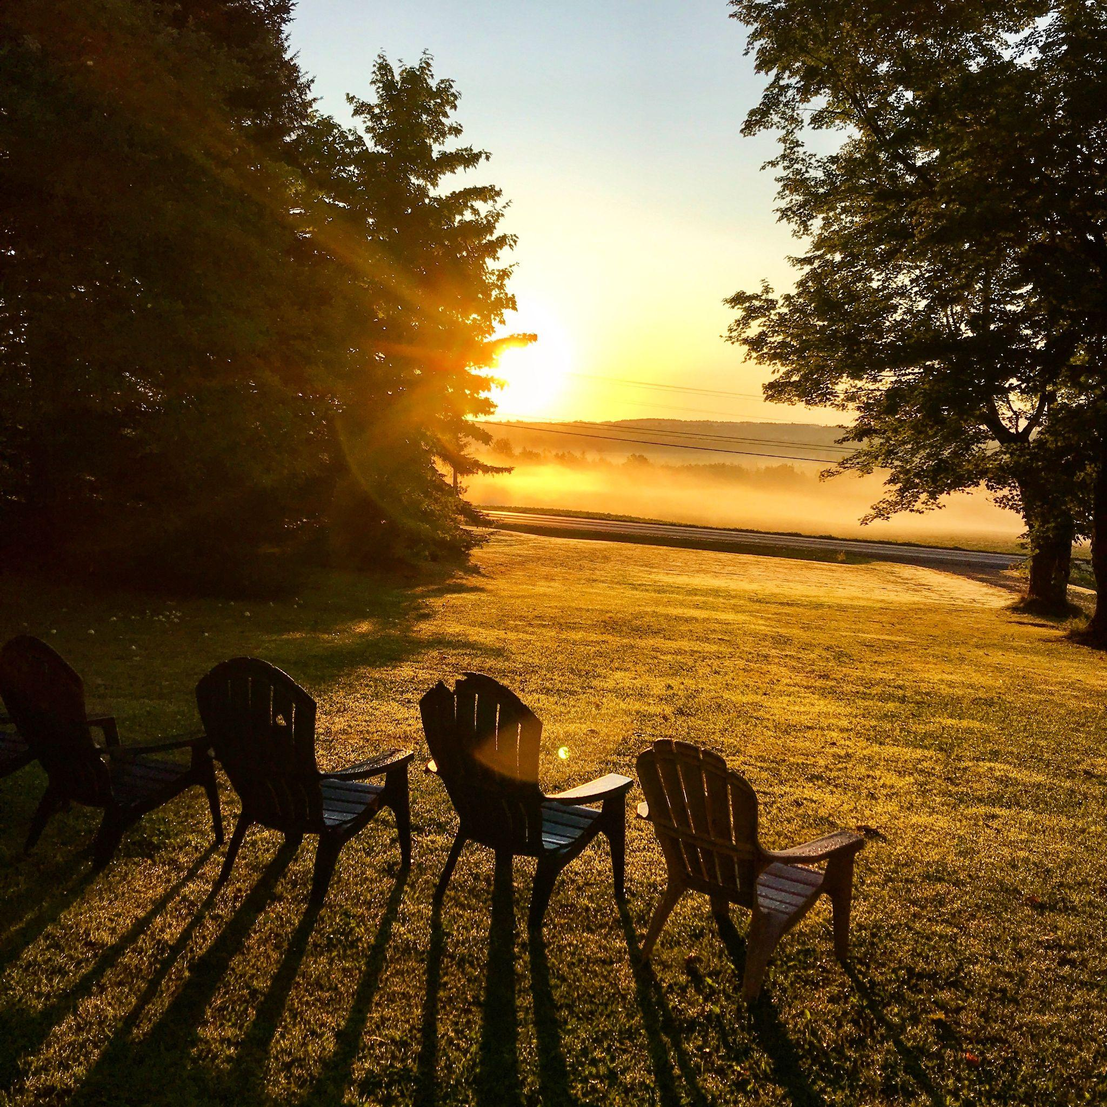
Self-Care in the Aftermath of
Pandemic
Wanda Anderson

Slide 2

Wanda Anderson
Wanda Anderson, MSW, LCSW, is a native of Northern Maine. She is an undergraduate of University of Maine at Orono and graduate of the University of Hawaii with her MSW in 1990. She has since worked as an administrator, advocate, clinician, and educator. She has been a faculty member at the University of New England, MSW Program since 2003. Wanda is the Assistant Director of the MSW Program and has presented extensively on Social Work Ethics, to include: Rural Social Work, Safety, Ethical Decision Models, and Ethical Supervision. She has resided in Georgia, South Carolina, Nevada, Hawaii, Augusta and Portland prior to moving back to Northern Maine. After 40 years in social work and 21 years at UNE Wanda will retire in December of 2024.

Slide 3

Pandemic/When the World Shut Down
Lost 1.1 million persons
Locked in our homes
Isolated
And asked to pivot into the unknown
Work online (and work when the world felt like it was out of control)

Slide 4

Acknowledge a new world
The world has changed
We are different
We have changed as teachers and social workers and caregivers
The world as we knew it changed

Slide 5

Break out group (10 mins)
Where were you (or at what moment) when you realized the world (Pandemic) would change….. all we had ever seen or believed who be turned upside down?
-Name one fact or image that has stayed with you in sharp detail
-Name on thing that you still laugh about today

Slide 6
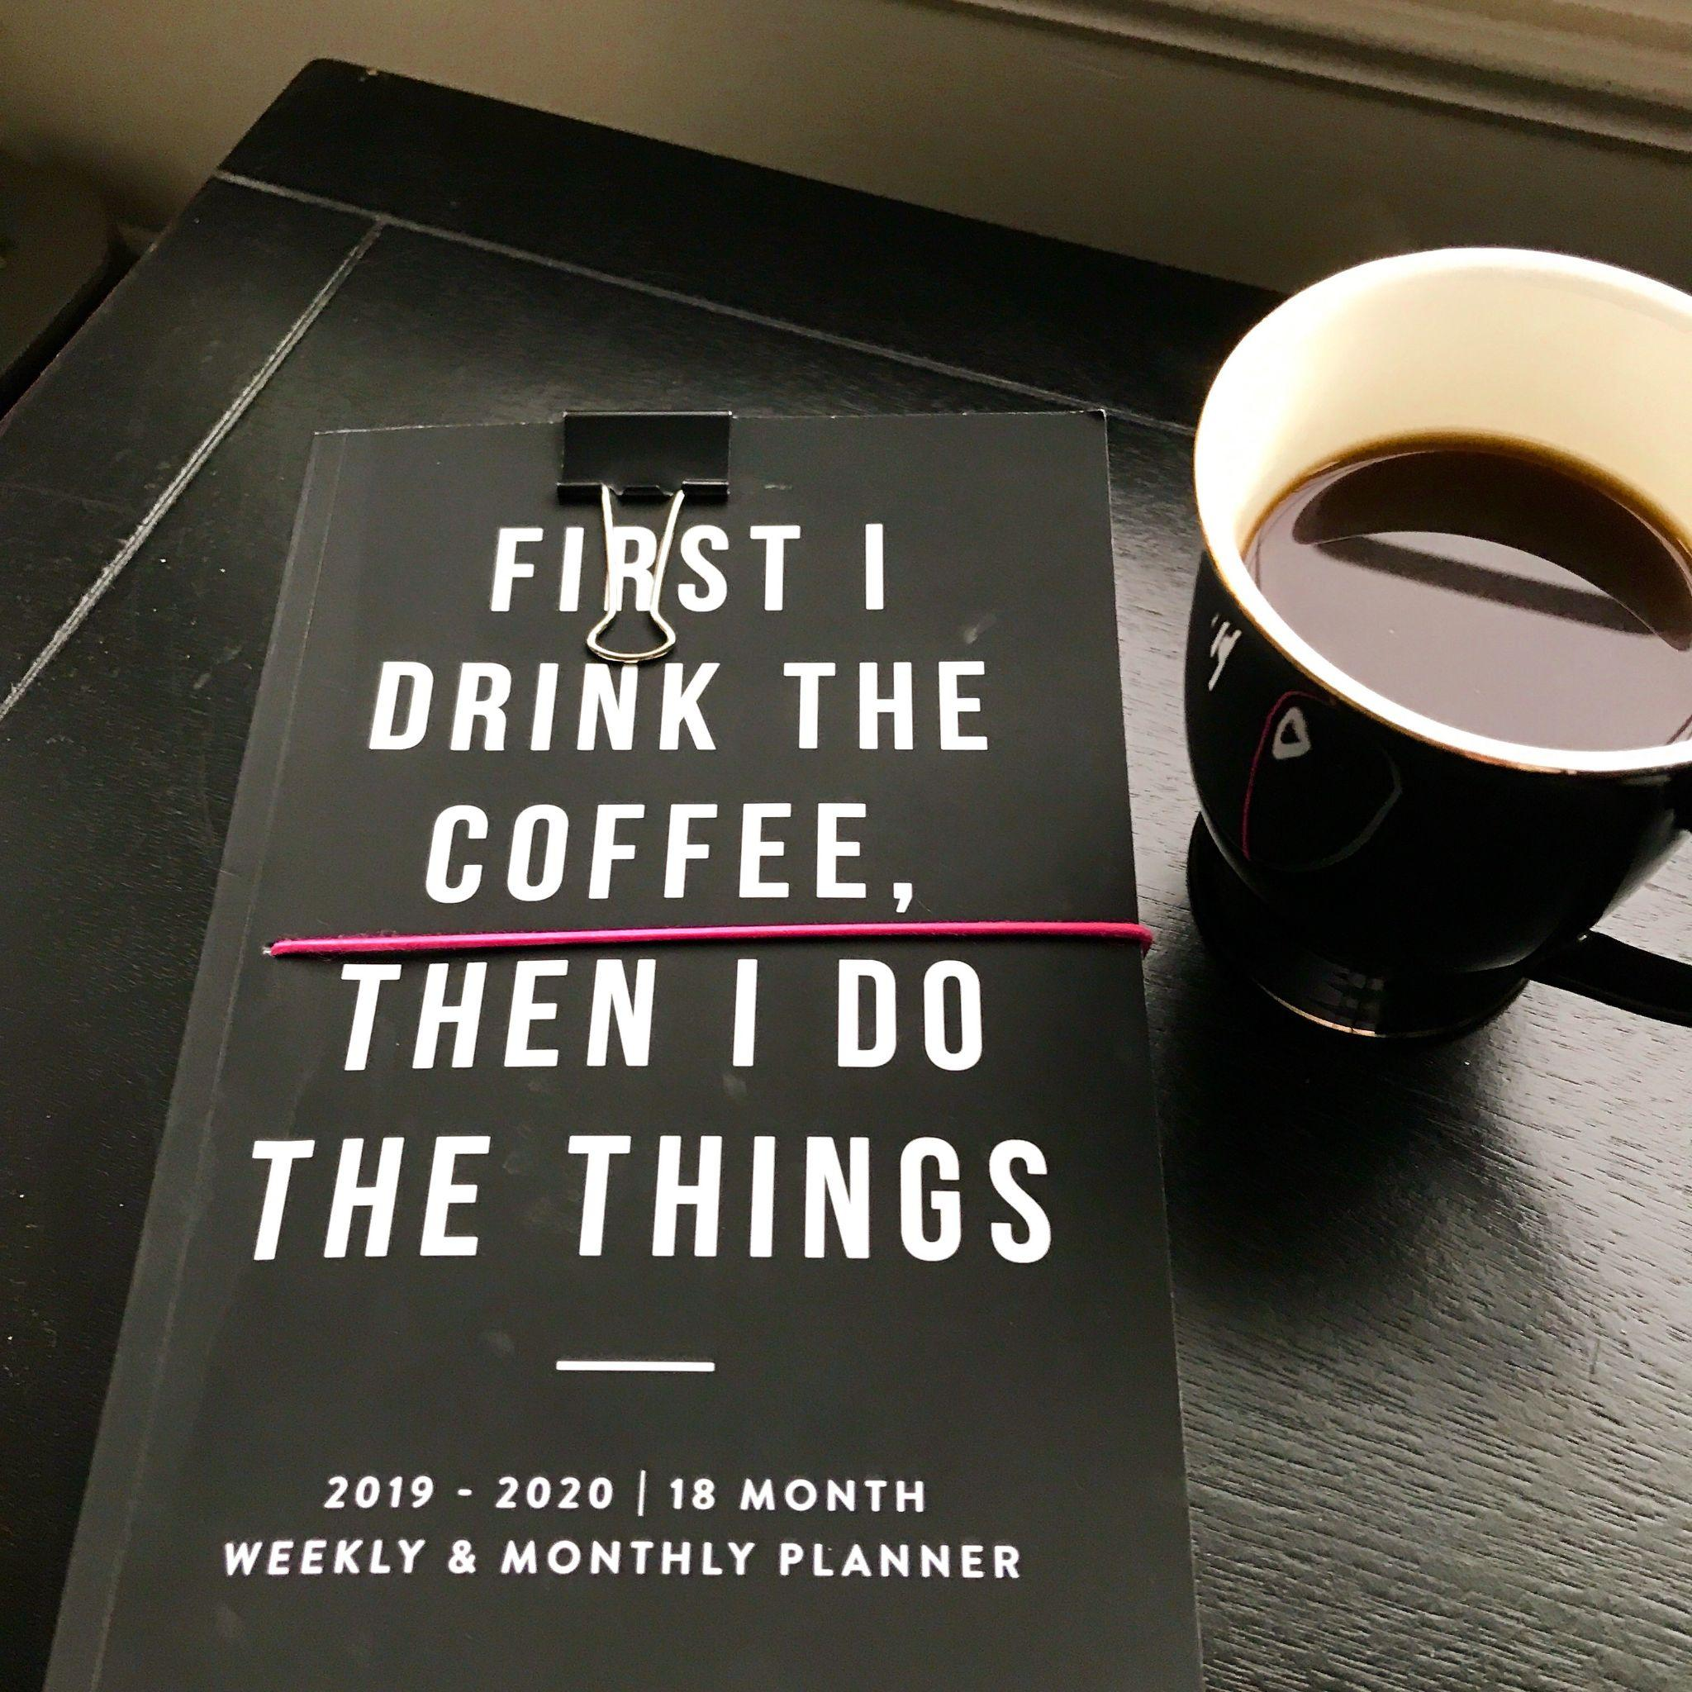
Then to Now
Okay it sucked
We did adapt/did our best
And we SURVIVED
And NASW added Self-care as part of our professional code
What now?

Slide 7
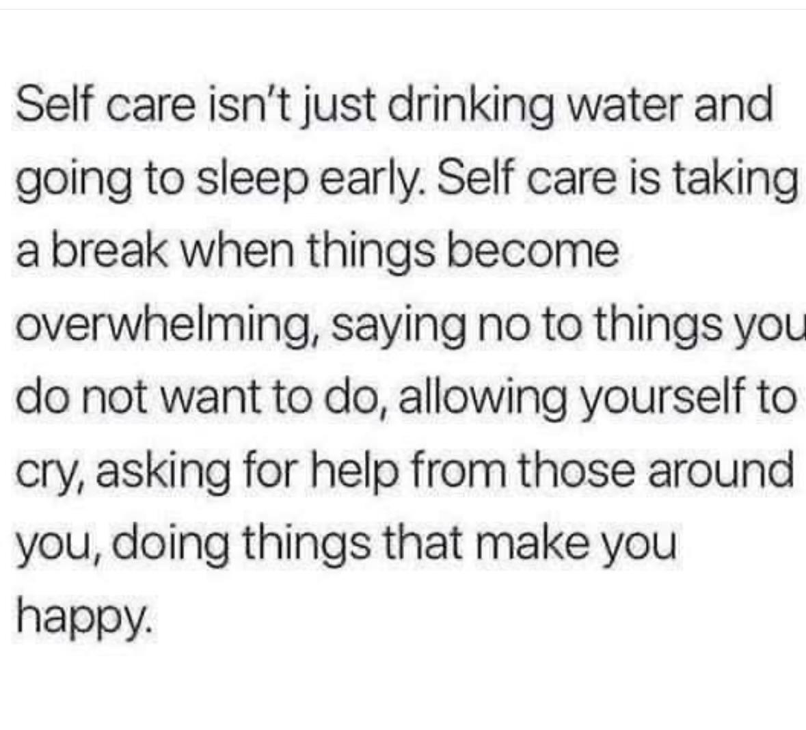

Slide 8
“Hard Seasons and Wild Hearts” Brene Brown
So, I did the only thing I knew how to do — got tough. Bear down and don’t let people down.
Armored and broken is not a good combination,
Whatever I was doing was the opposite of giving over to anything — it was simply: Fight’s on!
For the past five years, I’ve been doing new research on mental toughness, and, if there’s one thing I’ve learned, it’s that some people can tap into a pool of hard-won resources, including compartmentalization, tenacity, and toughness, for a limited amount of time, but, if they can’t shift down and pull out of that way of being — if they can’t get back to that strong back, soft front, and wild heart — the consequences can be deadly.
What the hell? I thought I knew this. I research this stuff. Why couldn’t I see it?
It turns out that I do know it. I do have it in me. But, over the past few years, I’ve slowly become separated from myself and from my knowing and, most importantly, from my spirituality. And it wasn’t the pain that pulled me away from all of these touchstones, it was the fear of feeling pain and the fear not being able to make everything OK
I get the sense that I’m still in Act II — the long, messy part of all stories where we watch the protagonist try to solve problems without being vulnerable and asking for help. It’s the part where surrender is the only path to triumph. And, as Sarah Lewis once shared with me on the podcast, it’s not the surrender of giving up, but the surrender of giving over.
We’ve been working on adding an entire new content library to brenebrown.com, called The Awkward, Brave, and Kind Edit (The ABK Edit).

Slide 9
The Now Complicated World
Does it have to be all or nothing?
The Pandemic was terrible and can we recognize good came from Pandemic as well

Slide 10
How as your day?
Well I had a flat tire and had a spare and AAA changed it. I was late getting to work but caught up. The air conditioner was too low so I was cold all day. I did not have a spare sweater to put on. I went out for a nice lunch with 3 colleagues then could not find parking when I arrived back at the office and parked in a no parking zone. I did get a parking ticket and it was $25.00. This afternoon there was an email that I will move up a step on the payscale next month and will receive a 10% increase.
Can I just say my day was nice, challenging, frustrating and exciting.

Slide 11
Pre self-care and Post self-care
Challenging
Not a priority
Even a bit laissez faire
Just moving forward and taking breaks
Still believed “BE STRONG”
Overwhelmed
No time
Trying not to drown
No real chance to slow down or reassess
Tired of “BEING STRONG”

Slide 12
Self-Care: How do we care for OURSELVES
Self: /self/noun
a person's essential being that distinguishes them from others, especially considered as the object of introspection or reflexive action.
Care: the provision of what is necessary for the health, welfare, maintenance, and protection of someone or something.
"the care of the elderly"
serious attention or consideration applied to doing something correctly or to avoid damage or risk.
serious attention or consideration applied to doing something correctly or to avoid damage or risk.
"he planned his departure with great care"

Slide 13
What is SELF
Selfishness lacking consideration for others; concerned chiefly with one’s own personal profit or pleasure.
Selfless is the opposite of selfish. If you’re selfless you think less about yourself and more about others- you’re generous and kind. Being selfless is similar to being altruistic- another word for giving to others without looking for personal gain.

Slide 14
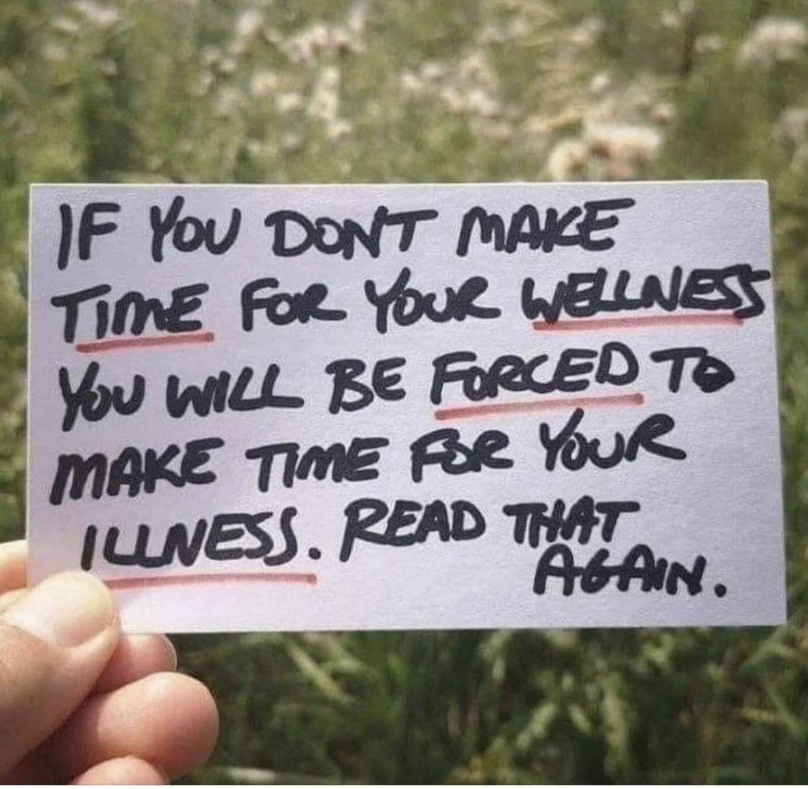

Slide 15
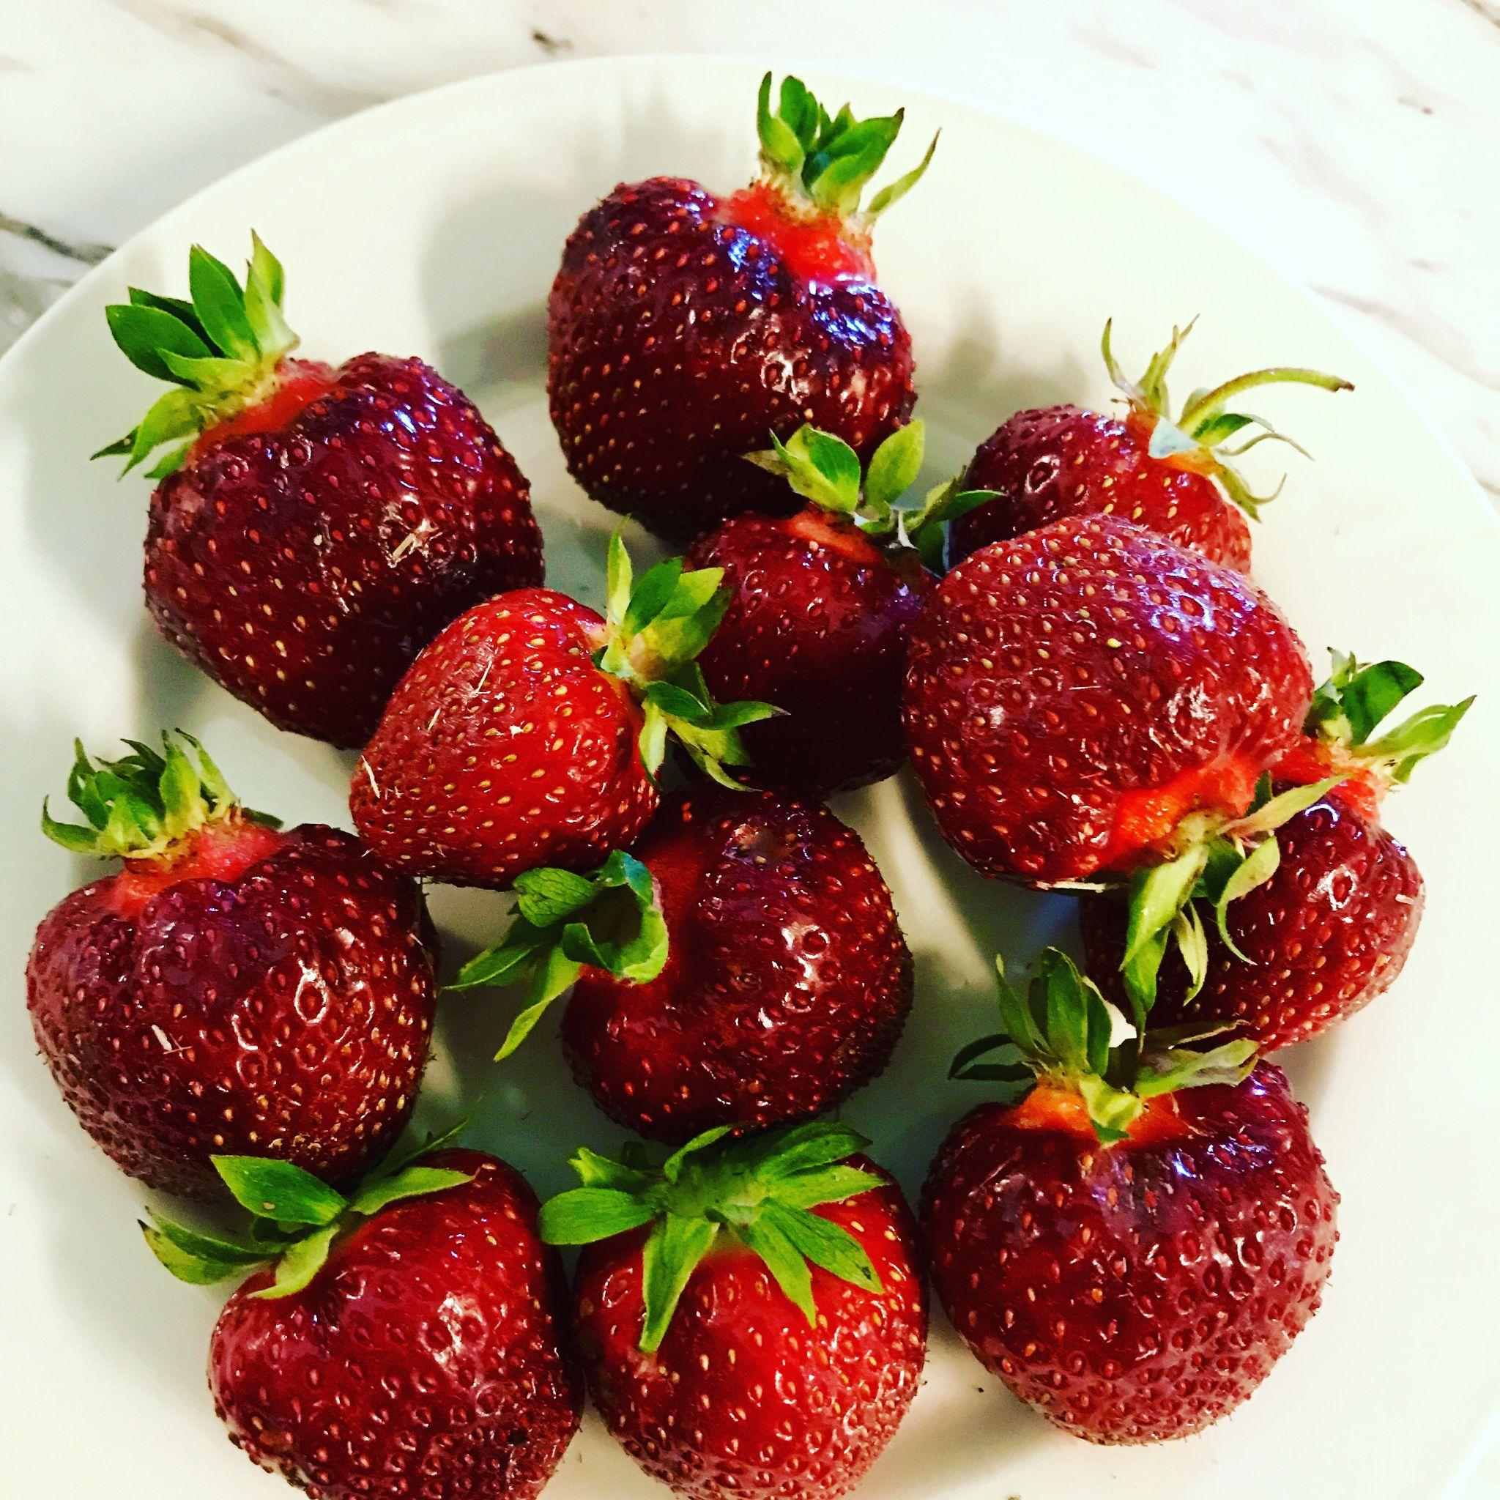
Self-care in three phases
-transitions (to and from work)
-during the workday (during stressful days)
-during your off-work time (nights, weekends and vacations)

Slide 16
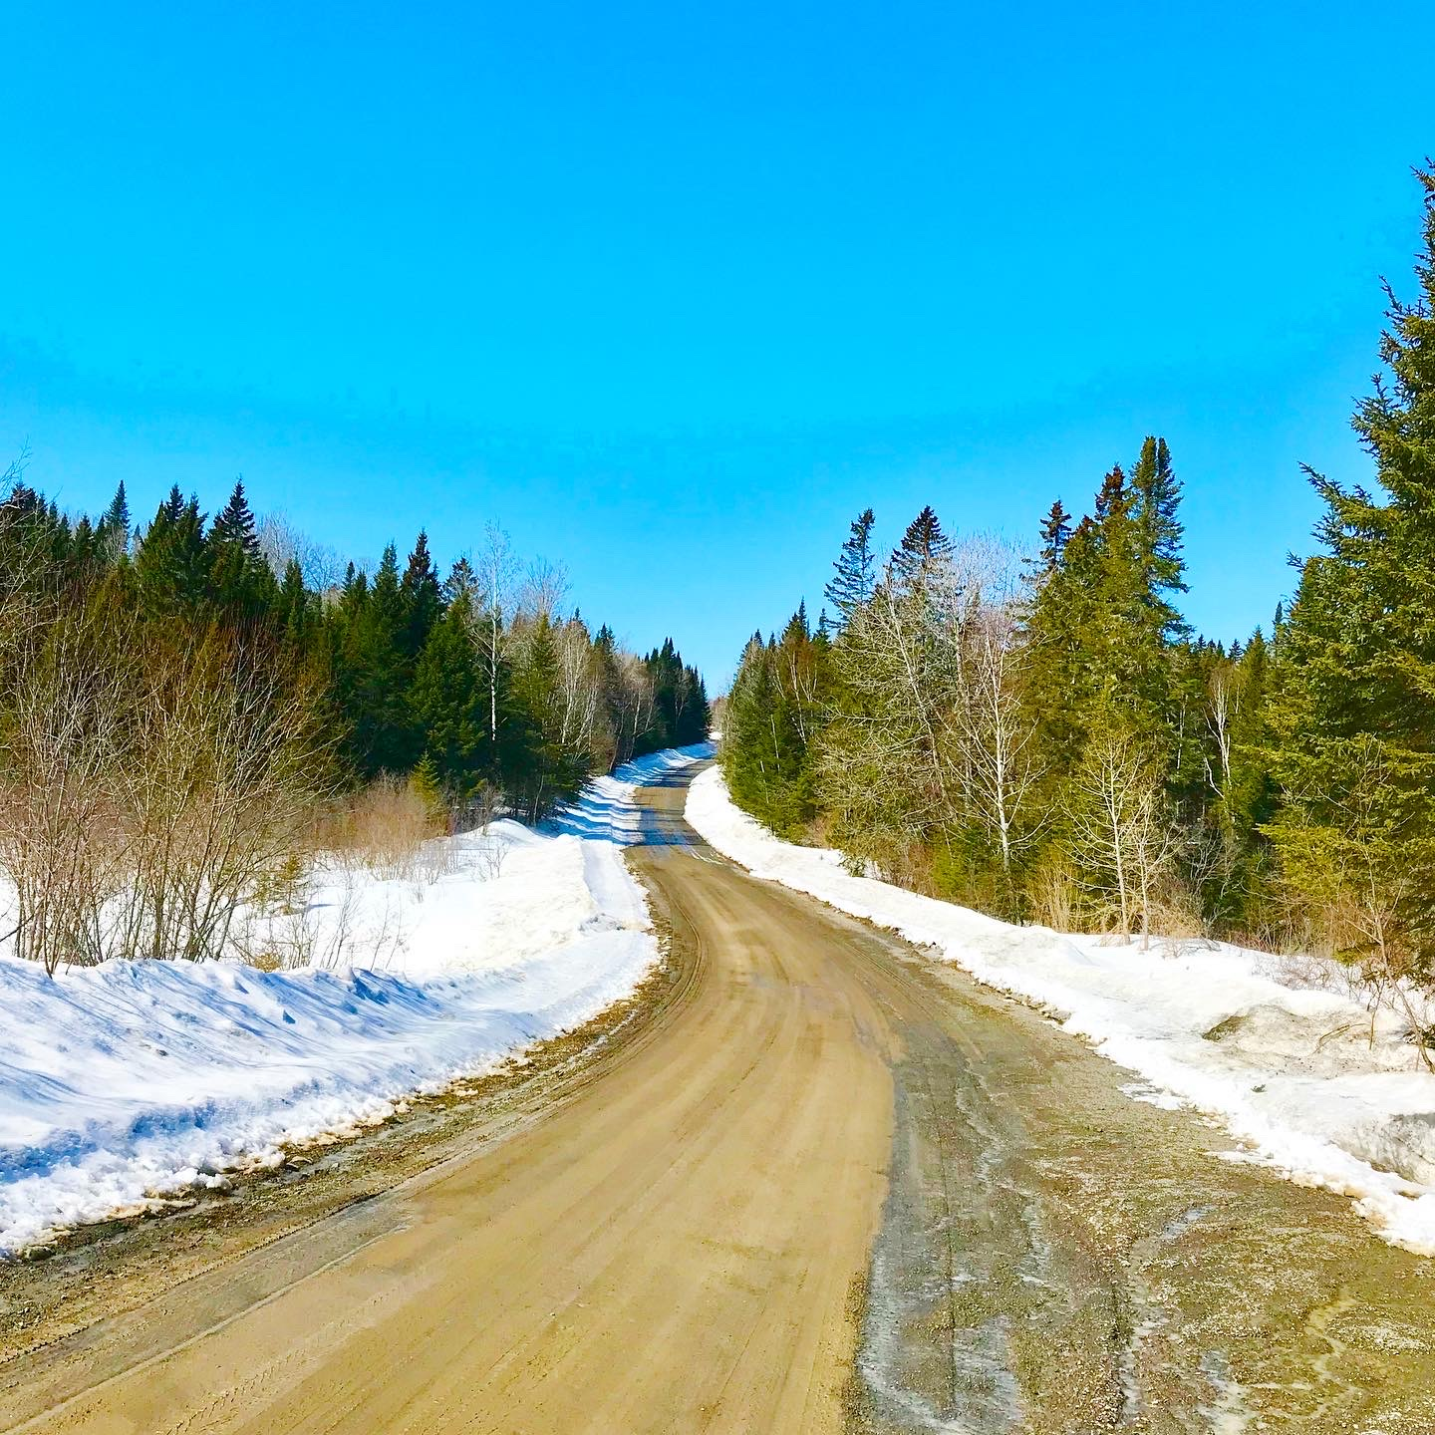
Transitions (to and from work)
How do you enter work and leave home
How do you leave work and enter home
Transitions are important

Slide 17
During the workday (during stressful days)
Before a difficult meeting
After a angry call
Do take breaks/lunch
Stop to breathe

Slide 18

During your off-work time (nights, weekends and vacations)
How to plan what you need (not just family)
Do we spend free time (being busy)

Slide 19
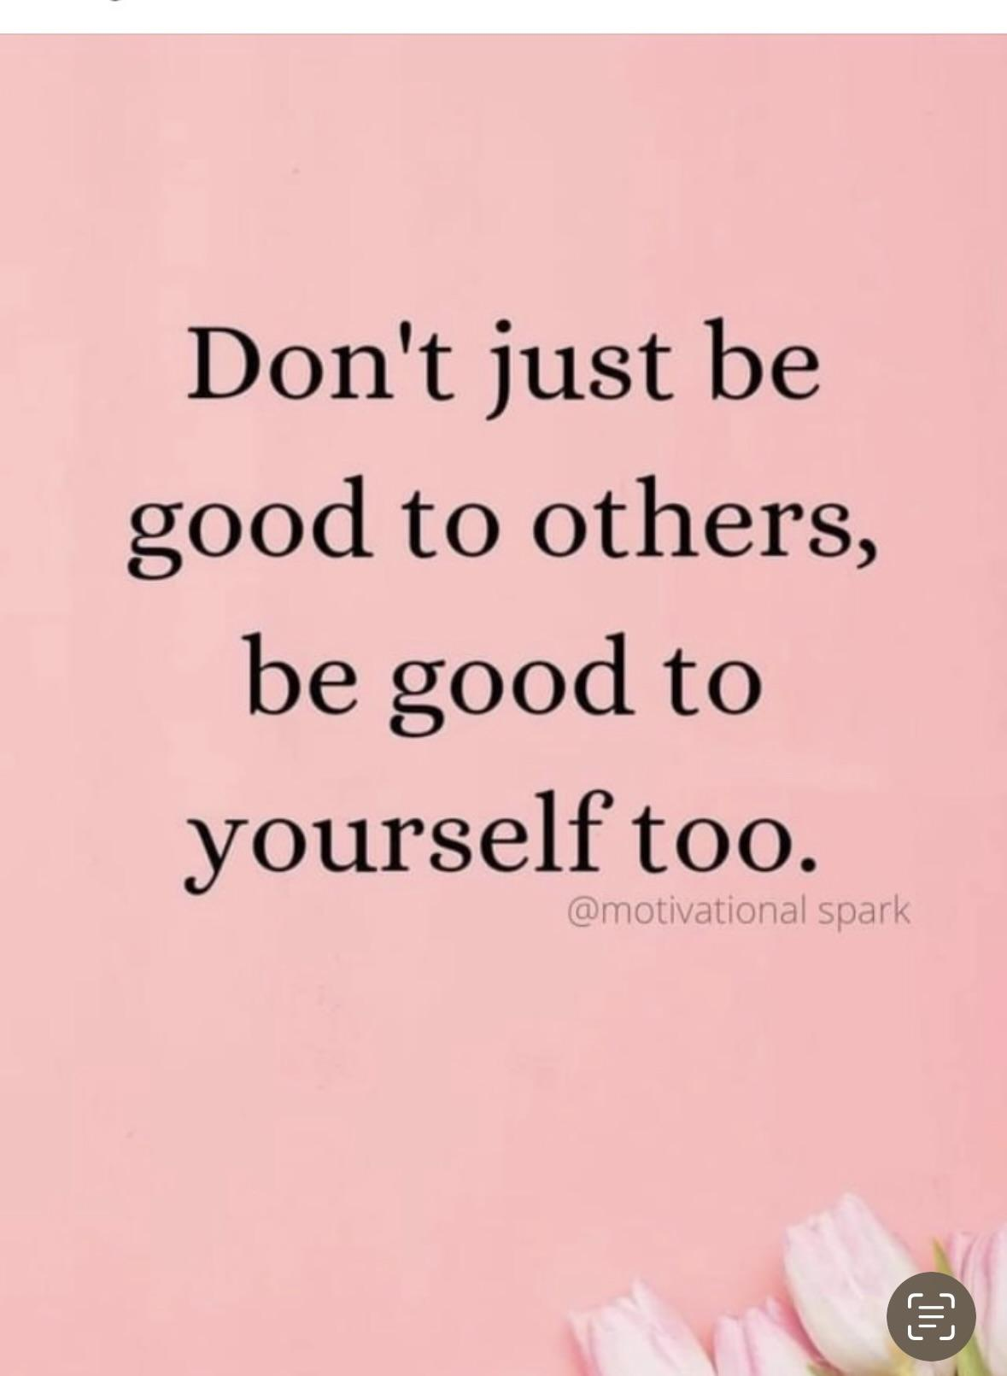

Slide 20
Small groups
Pick one of the three:
Which are you best at
-transitions, during work, off work times?
Which are you struggling the most with (ie…leaving work at work?)
Share in small groups

Slide 21
Self-Care Strategies
1. Acknowledge Your Limitations
2. Maintain Boundaries
3. Practice Intentional Body Awareness
4. Take a Recess
5. Have a Support Group
6. Regulate Through Calming Activities
7. Laugh — Or Cry!
https://www.kvc.org/blog/self-care-for-social-workers-seven-steps-to-avoid-burnout/

Slide 22

Reality
Have you reflected on your self-care
How do you measure this?
Do you have a plan?
How will you care for yourself moving forward?
How do you build in grace for yourself (and others)?

Slide 23
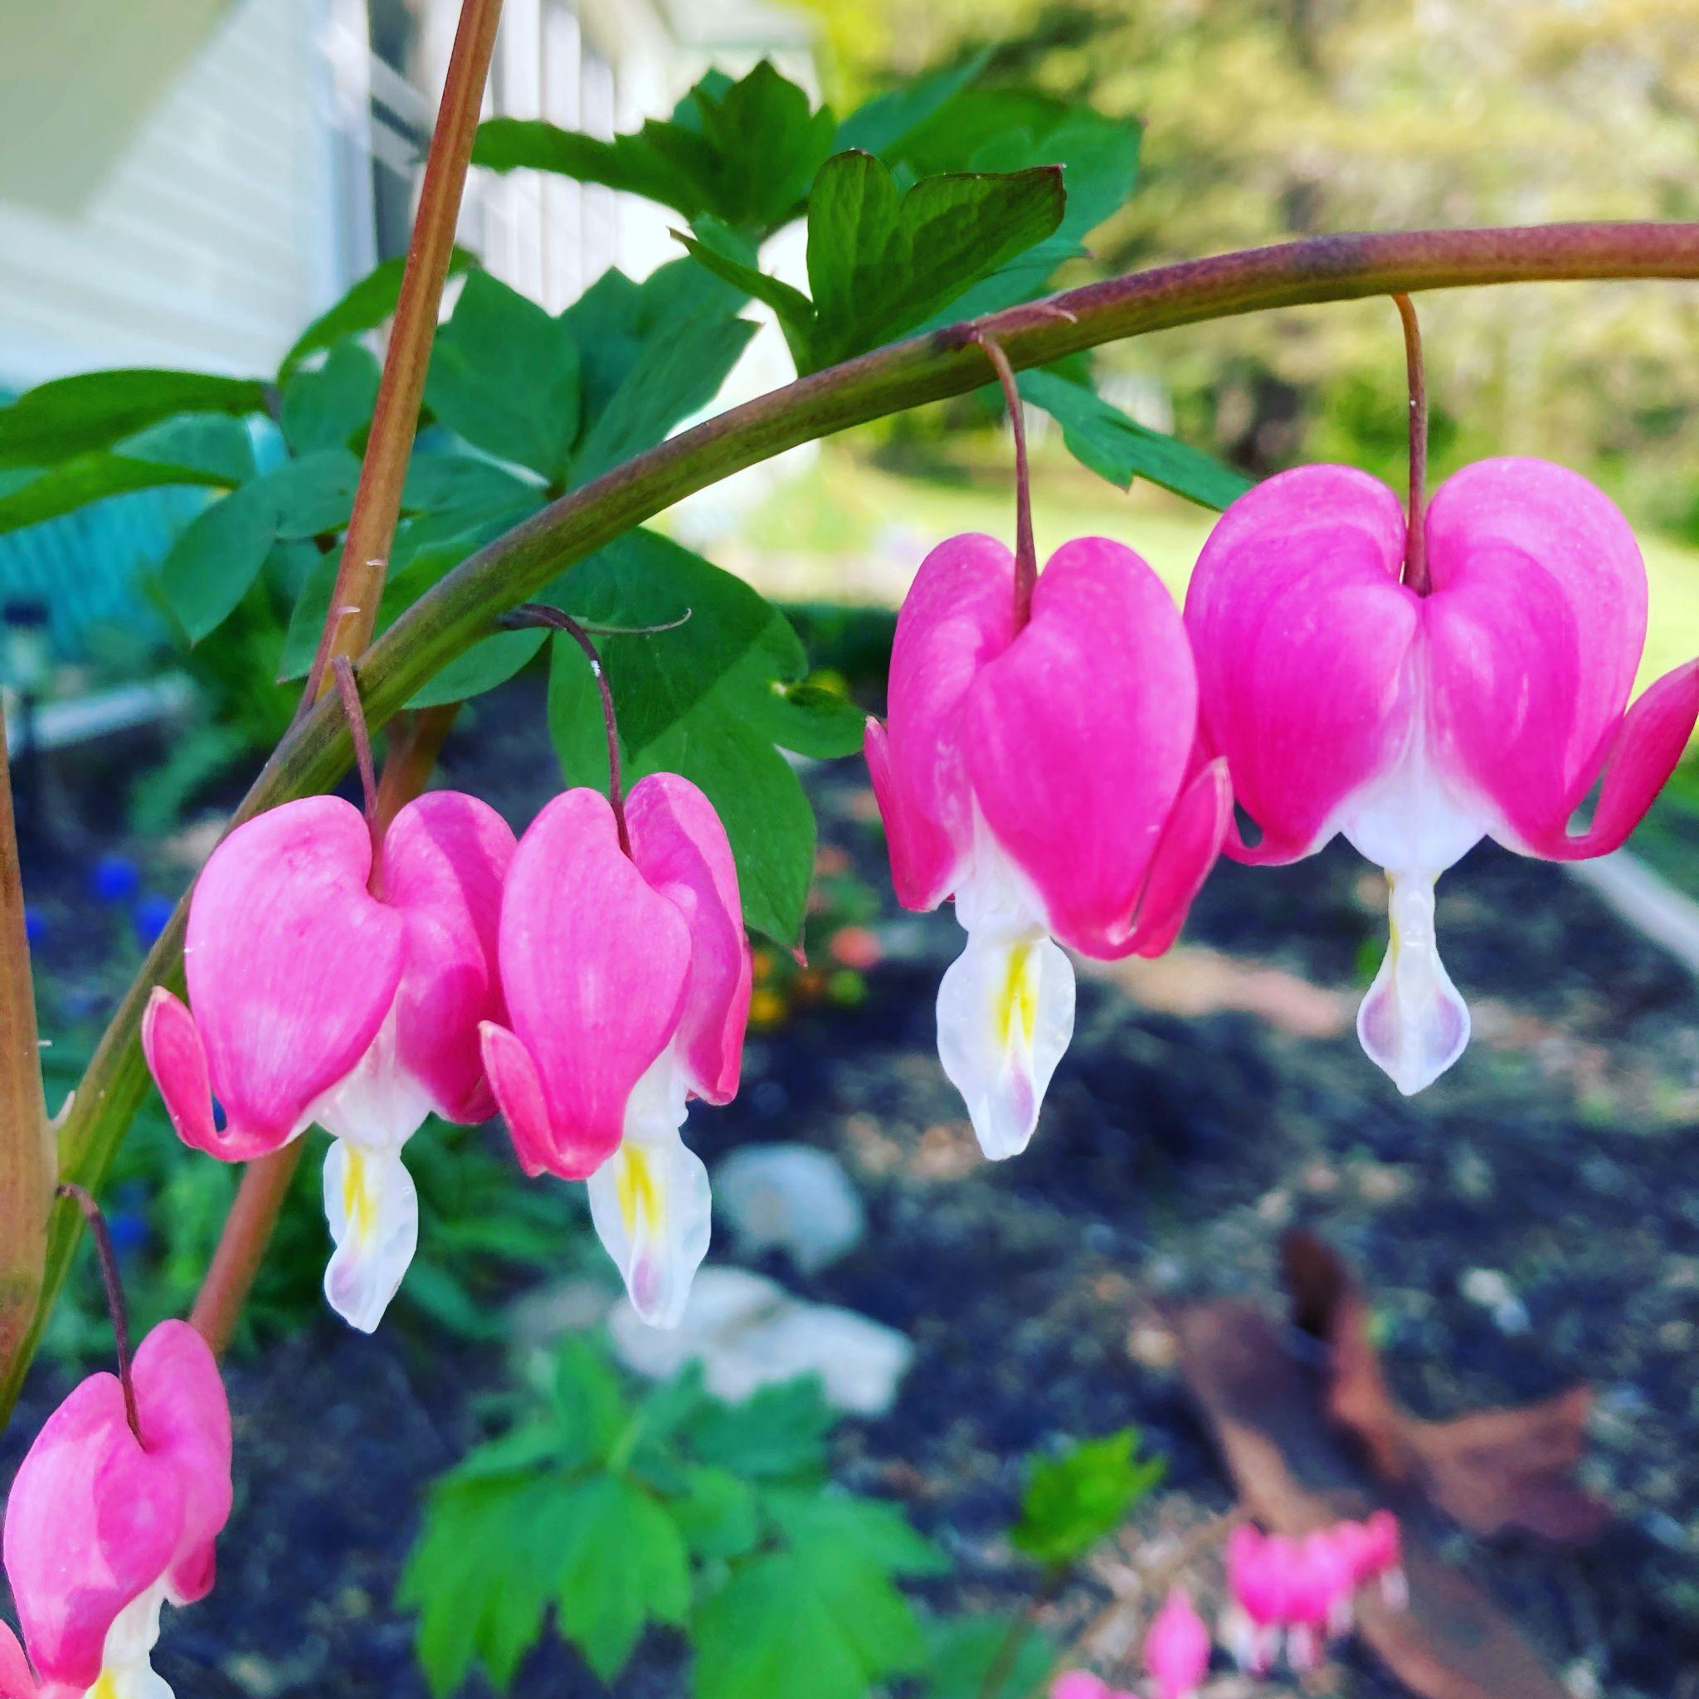
I Love You
How many times have we said this to someone, our children our moms- have you ever said this to yourself
What do you say to yourself? That was stupid, why did I say that, why can’t I do better?
What if we talked to ourselves the way we talk to others whom we LOVE?

Slide 24
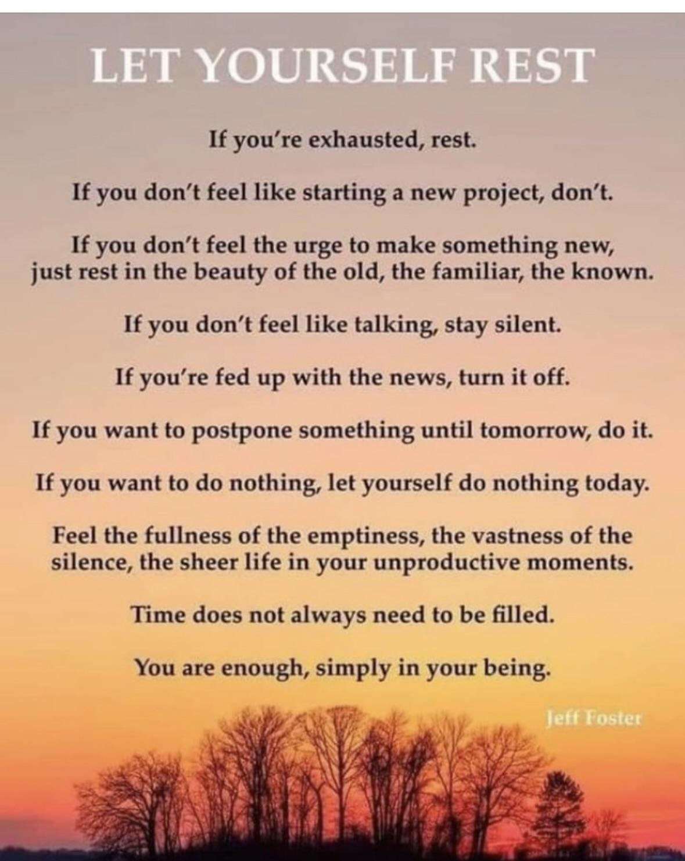

Slide 25
Take away
Self-care is how we care for our-selves
What we put into our bodies
What we put into our minds
How we treat our bodies
How we talk to ourselves
How we allow others to treat our bodies and our minds

Slide 26
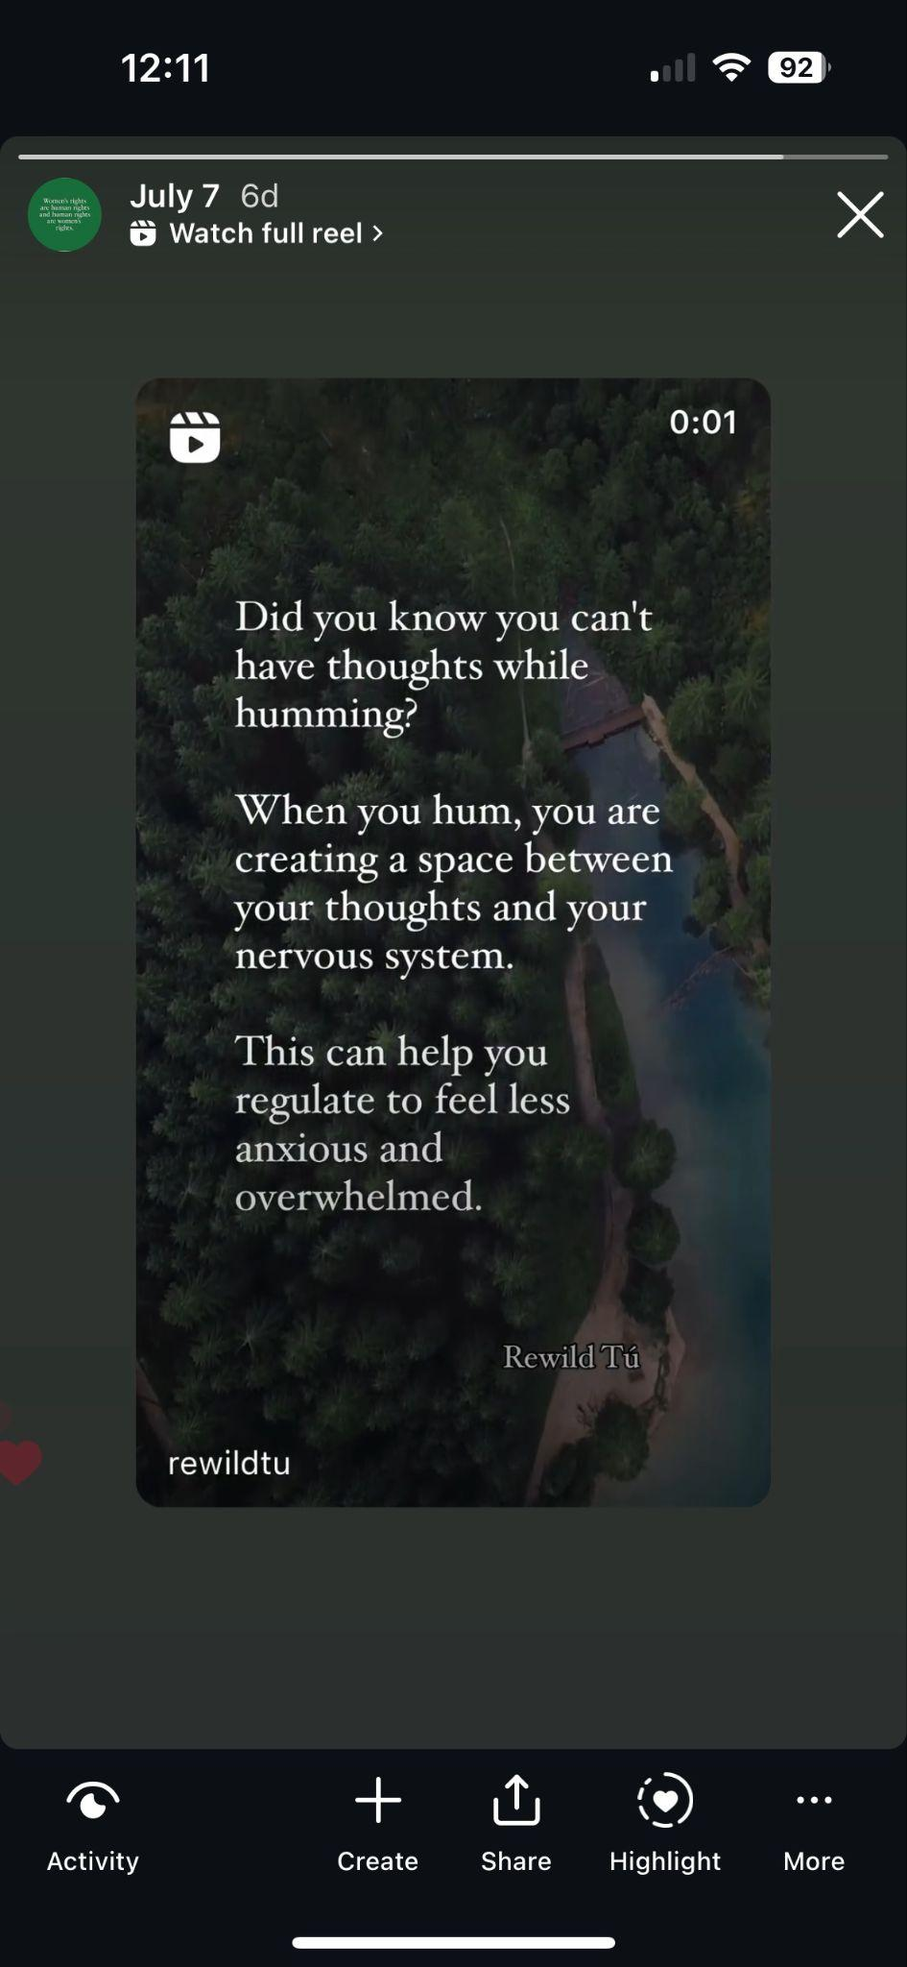
One item
What is one thing you can take away
from this workshop today!

Slide 27
Thank you

