Slide 1
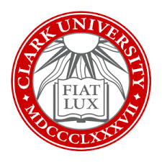

Here, Now: The Transformative
Power of Mindfulness &
Contemplative Education
Jessica Bane Robert
of the Barred Owl Retreat
and Clark University

Slide 2

  We will…
  Discuss What Mindfulness Is &
  Why We Should Care
  Experience Some Practices and Benefits
  Learn Practical Tools & Strategies for Application.

Slide 3
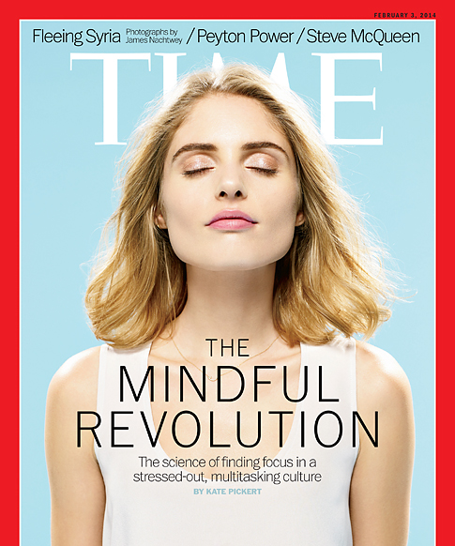
Mindfulness Revolution
In 2003: 52 scientific papers were published on mindfulness
In 2012, that number jumped to 477
2020: 2,808
Clark U, “Mindful Choices”
  Columbia, Amherst, Brown, UCLA, and Carnegie Mellon

Slide 4
The Whole Student
Holistic Core Competencies:
Self-Awareness / Self-Assessment
Self-Reflection
Self-Regulation / Mindful Awareness
Self-Authorship, Capable of Visioning
and Articulating One’s Own Path & Story
Self-Expression, Critical & Creative Thinking
Self-Efficacy, Resilience, Exert Control Over One’s
Own Motivation, Behavior, and Social Environment

Slide 5
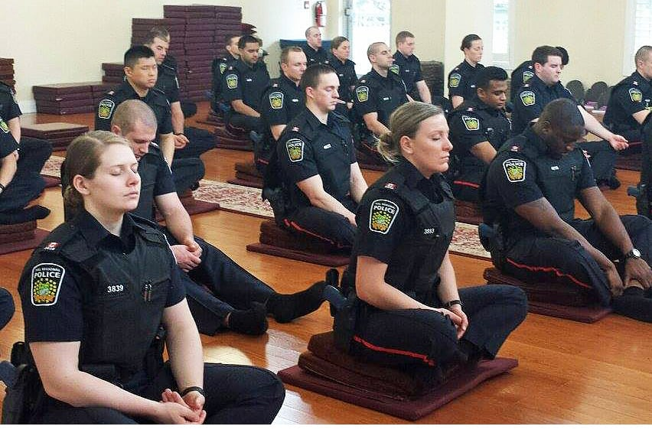

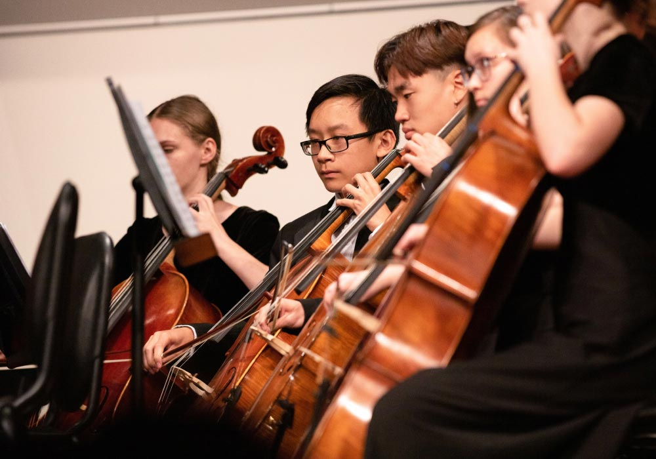
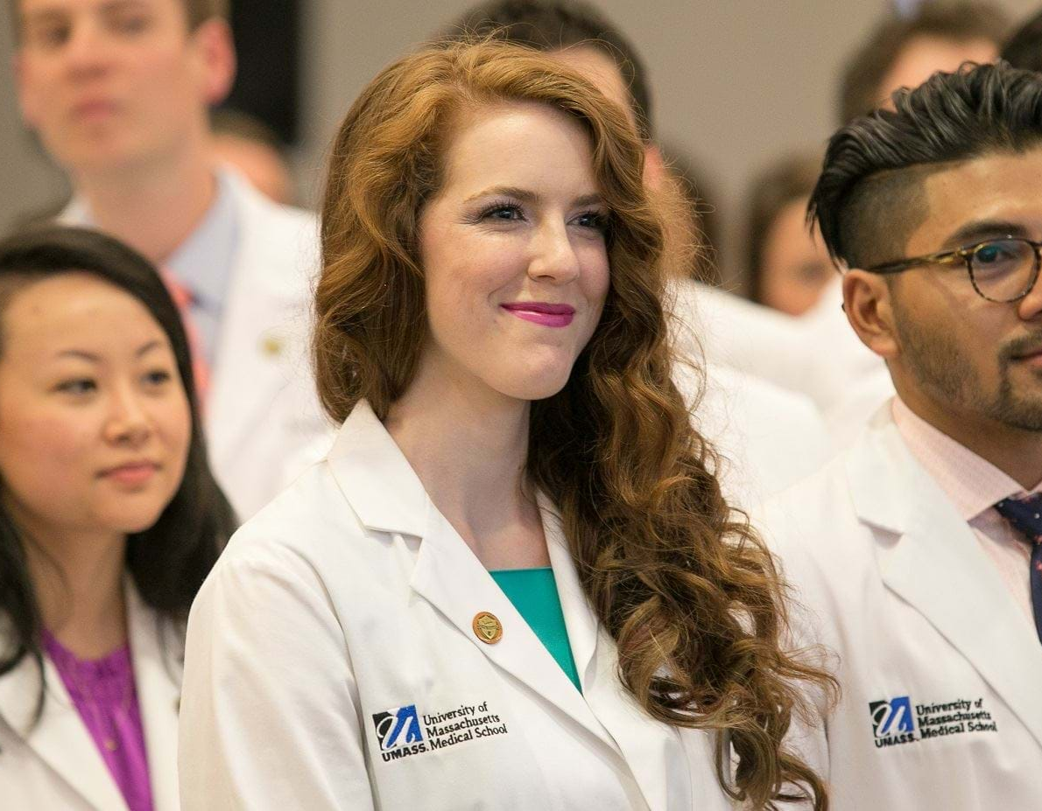
Mindfulness & Meditation are Showing Up Everywhere…
-Corporations
-Military / Police
-Hospitals & Medical School
-Music and Performance Schools

Slide 6
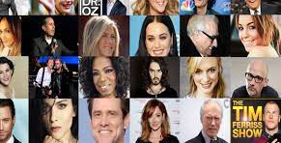
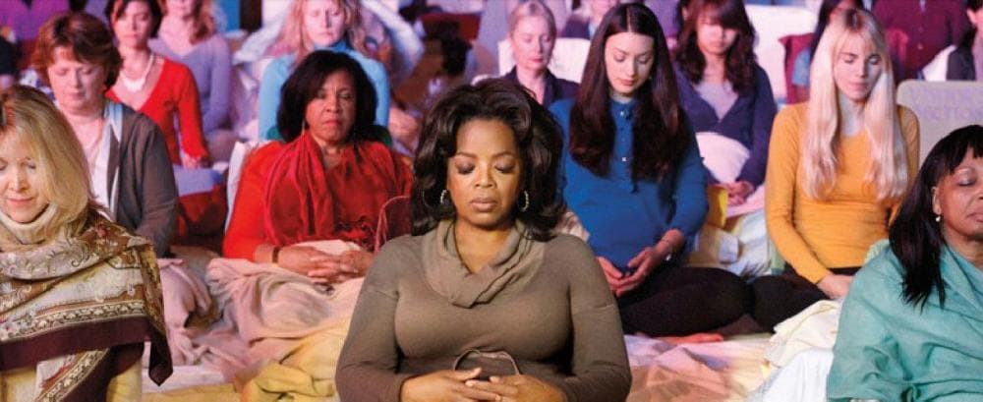
Famous Meditators
ATHLETES: Lebron James, Carli Llyod, Derek Jeter, Steph Curry
MUSICIANS: Beyonce, Taylor Swift, J lo, Lady Gaga, Camila Cabello, Shawn Mendes, Demi Lovato, Miley Cyrus, Katy Perry, 50 Cent, Moby
OTHER FAMOUS FOLX: Will Smith, Steve Jobs, Oprah

Slide 7
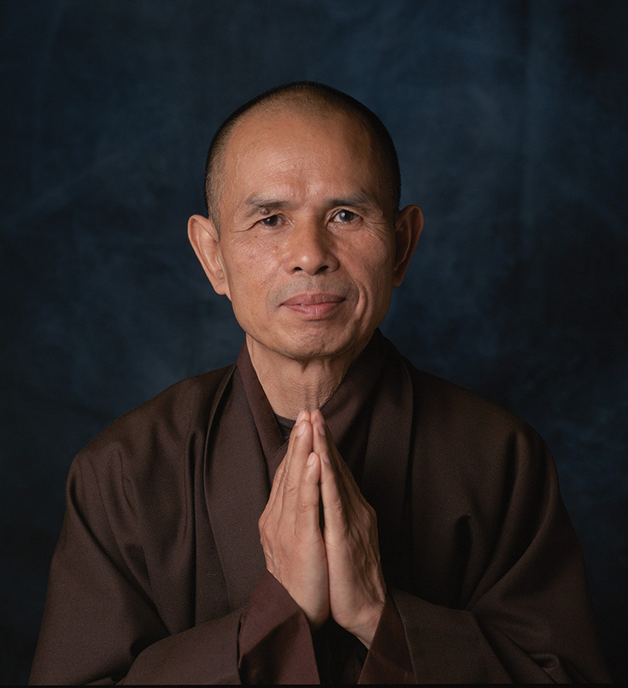
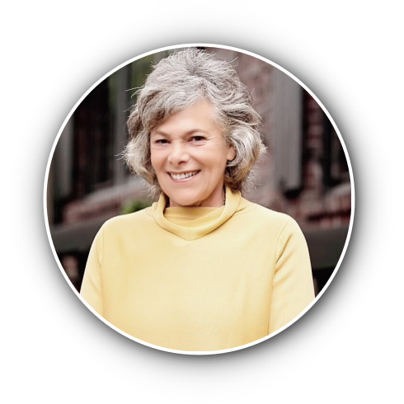
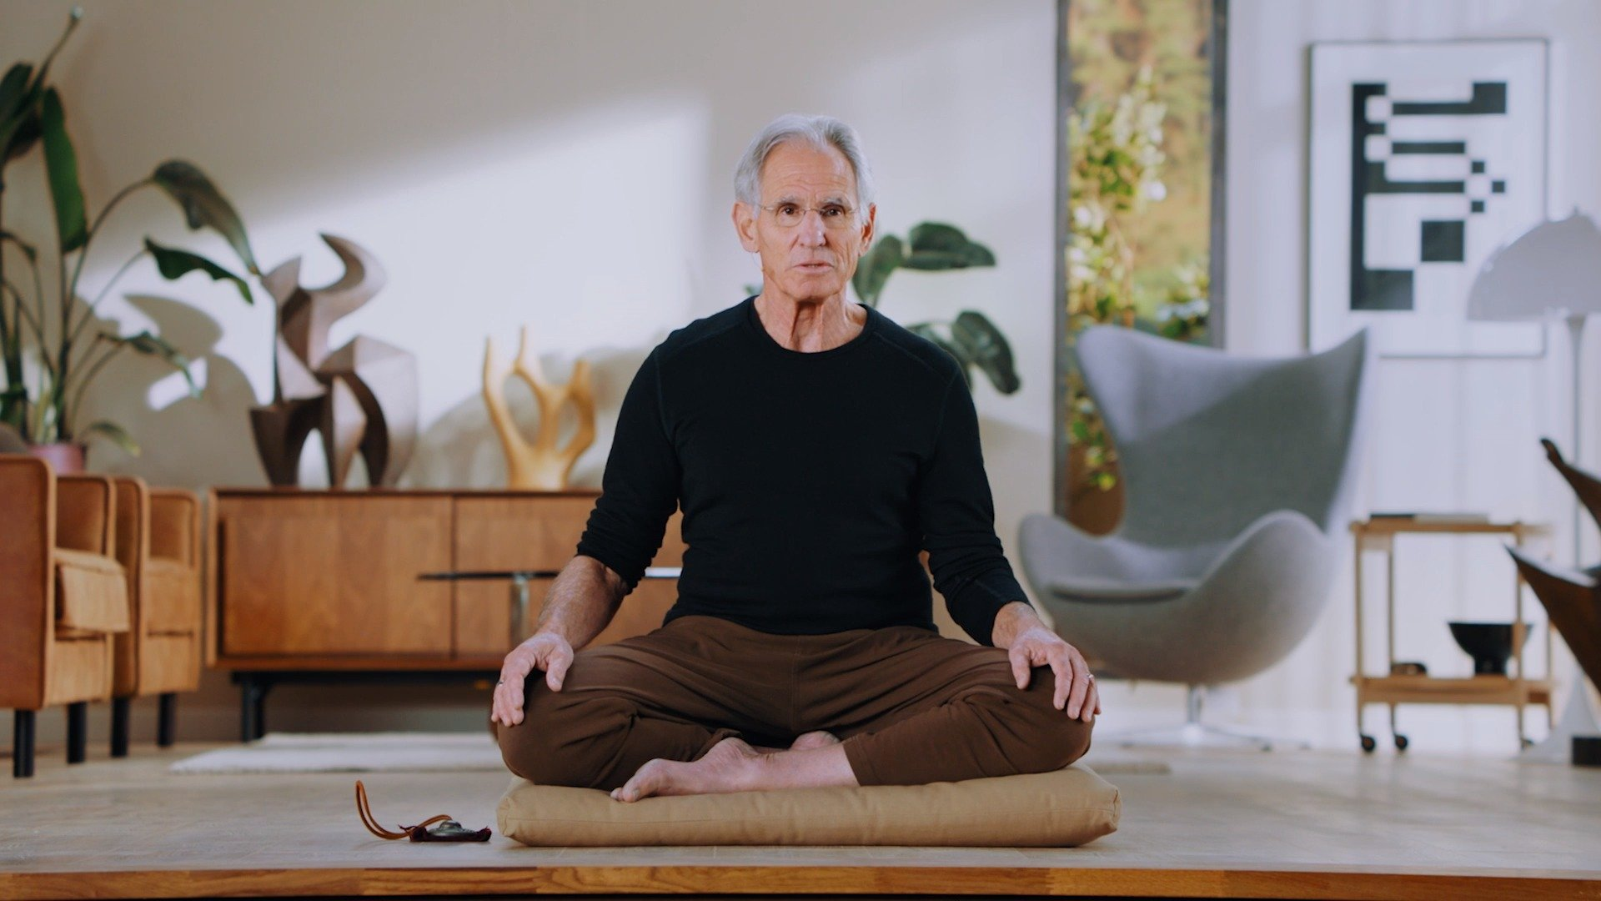
Mindfulness includes two elements:
1. What: present-moment awareness of experiences
2. How: with curiosity, acceptance, openness, and kindness
Thich Nhat Hanh:
Mindfulness shows us what is happening in our bodies, our emotions, our minds, and in the world. Through mindfulness, we avoid harming ourselves and others.
Jon Kabat-Zinn: the awareness that emerges through paying attention on purpose, in the present moment, nonjudgmentally
Ellen Langer: Noticing

Slide 8
9 Essential Attitudes of Mindfulness from Jon Kabat-Zinn
Non-judgment, being an impartial witness, openness
Patience, allowing all to unfold in its own time
Beginner’s Mind, or seeing as if for the first time with curiosity
Trust, in yourself, your feelings, your inner knowing, the wisdom of the universe
Non-striving, no goal but to be and be yourself
Acceptance, allowing things to be as they are
Letting go, the mind develops an attitude of nonattachment, embraces impermanence
Gratitude, holding this attitude can change our well-being instantly
Generosity, giving yourself, and others, gifts like those mentioned above

Slide 9

Why Care? The Benefits.
Mental
enhances neuroplasticity
greater equanimity
happier
less reactive
better self-regulation
greater focus and working memory
reduces stress & rumination
Physical
Social/Emotional
better sleep
pain reduction
improved immune system
decreased blood pressure and inflammation
greater self-awareness and knowledge
greater intuition and spiritual connections to all beings
enhances kindness, compassion, & altruism
better/more active listeners
reduces implicit bias
Spiritual

Slide 10
Students Who Practice Mindfulness…
are better able to cope with stress, have less overwhelm, less reactive.
have more focus and concentration.
have more confidence.
have healthier relationships.
know themselves better—
what they are feeling, what they want.

Slide 11
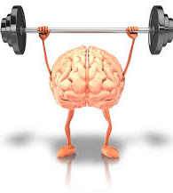
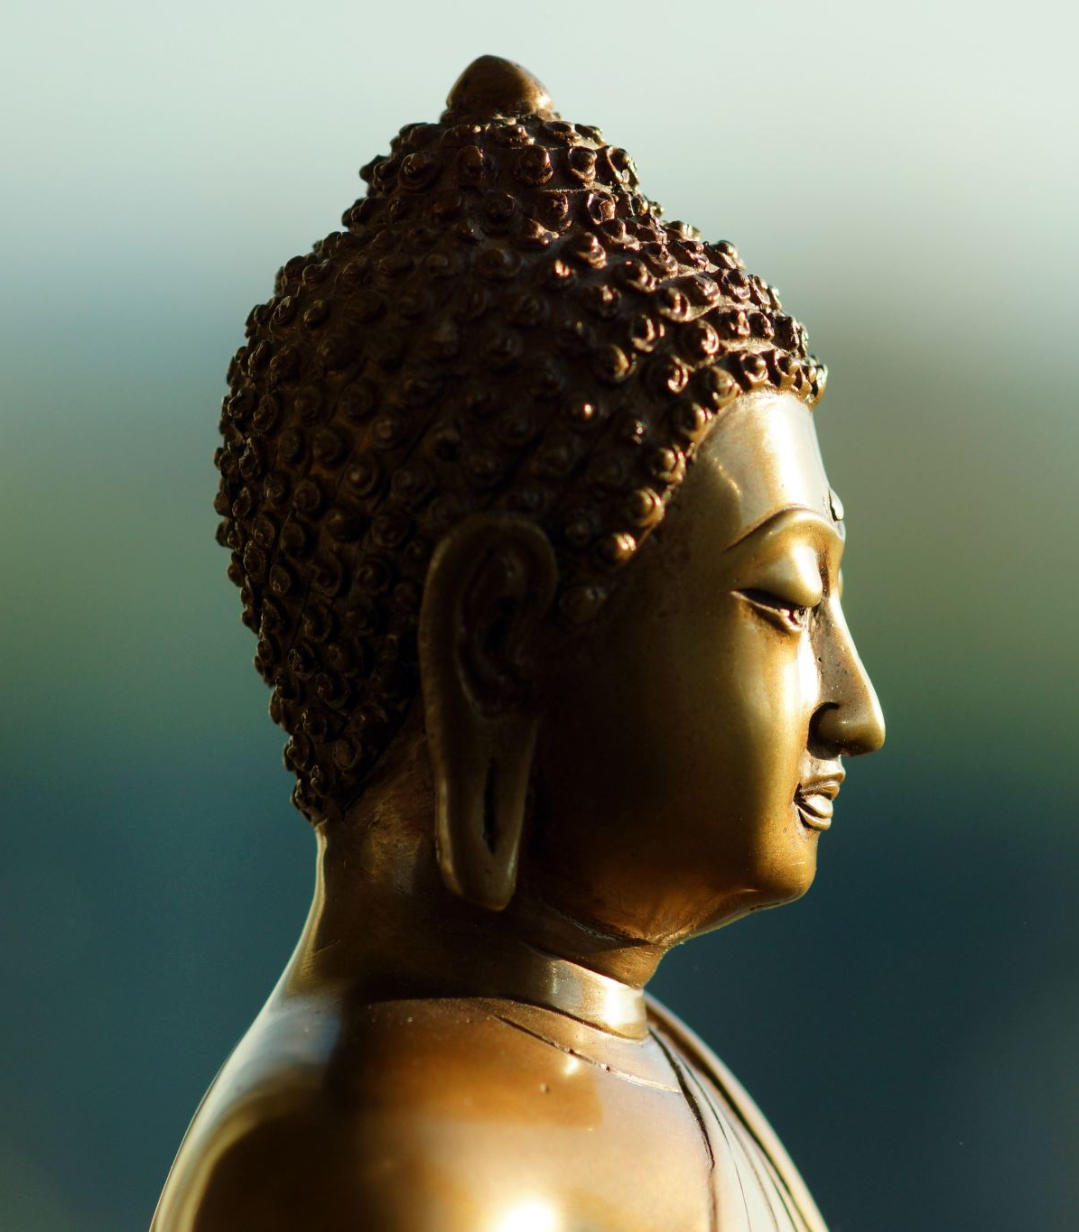
Meditation is a superpower; it’s like lifting
weights for the mind
In Pali, the original language of the Buddha,
the closest word to “meditation”
is bhavana = development through mental training
A wandering mind = an unhappy mind

Slide 12
Tools & Practices Of Mindfulness
Meditation & Breathing
Art & Play
Dialogue
Reflective Writing/Journaling
Nature
Movement,
Yoga

Slide 13
The Most Effective Tools and Practices

Slide 14
1. Reflective Writing & Journaling
Self-Awareness
Emotional Intelligence
Emotional and mental wellbeing
Better relationships
Critical Thinking
Creating greater meaning of our lives and experiences
Enhanced Learning Retention
Improved Communications skills

Slide 15
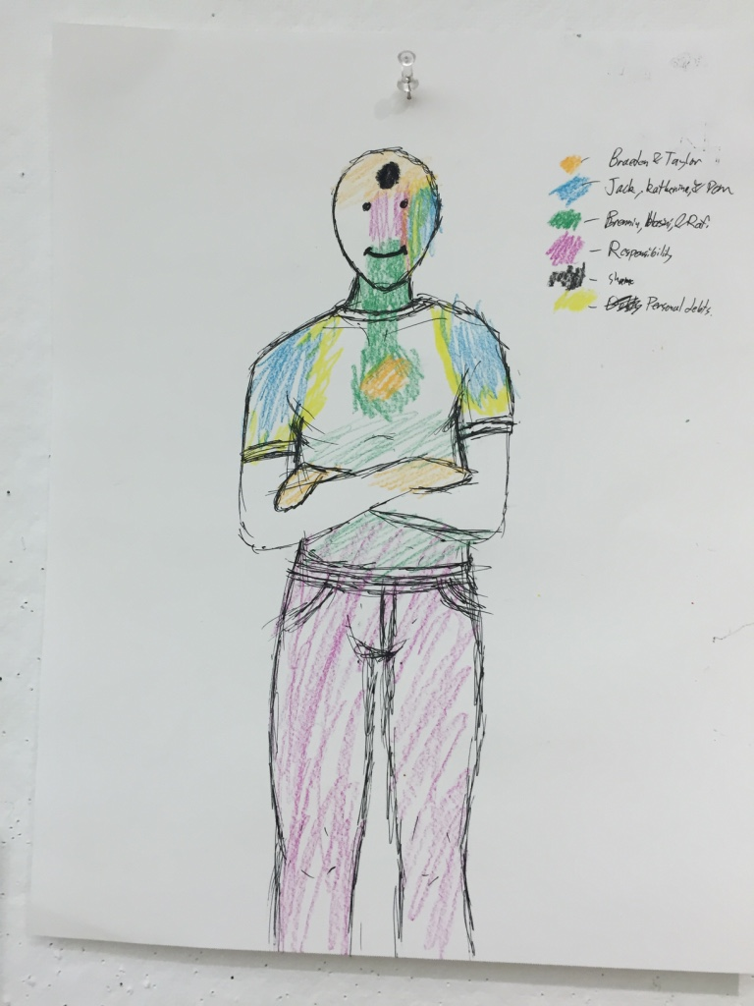
2. Expressive Arts
Using visual arts, music, dance, drama, and writing—to express emotions, thoughts, and experiences.
The focus is on process not product.
Aspects & Benefits:
Emotional Expression: convey emotions and experiences difficult to articulate with words alone.
Creative Exploration: Freedom and experimentation with emphasis on the act rather than result.
Personal Growth: fosters self-discovery, personal development, and healing.
Non-Verbal Communication: provides an outlet for those verbally challenged
Inclusive Approach: all levels focus on experience rather than expertise
Therapeutic Benefits: commonly used in therapeutic settings for stress, anxiety, trauma, etc.

Slide 16
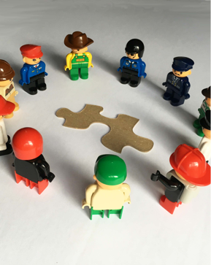
3. Dialogue & Active Listening
Structured, group conversations, respectful and inclusive, that foster a safe environment, open communication, and mutual understanding.
DIALOGUE AGREEMENTS:
Speak in turn, avoid crosstalk
Listen without judgement, to understand not to persuade
Be brief and respectful of equal time
Respect the opinions of others
What is said in circle stays in circle
It’s okay to pass

Slide 17
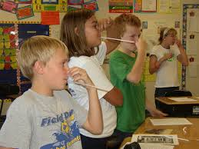
4. Breath, Breathing Techniques
This primary tool is always with us and directly influences the body’s physiological and psychological states.
Serves as an Anchor or Focus Point
Fosters the Mind/Body Connection
Breathing Calms the Nervous System and Reduces Stress
Regulates Emotion by Affecting
the Parasympathetic

Slide 18
5. Meditation & Guided Imagery
Techniques for relaxation and focusing the mind
Relaxation and Stress Reduction
Emotional / Behavioral Regulation
Enhances Focus & Concentration

Slide 19
Obstacles
Time Constraints: Even 1-5 minute practices can be impactful .
Start with morning routine, transitions, end of a lesson reflection.
Lack of Training: Provide PDP Opportunities, Workshops, Retreats,
Online Courses. Professionals must have their own practices.
Student Resistance: Make mindfulness Fun, Engaging, Relevant,
Meet Them Where They Are.
Consistency: Start small, get help with most effective practices and
Trainings.

Slide 20

Thank You. Any Questions?
Jessica Bane Robert
jess@barredowlretreat.com

