Slide 1
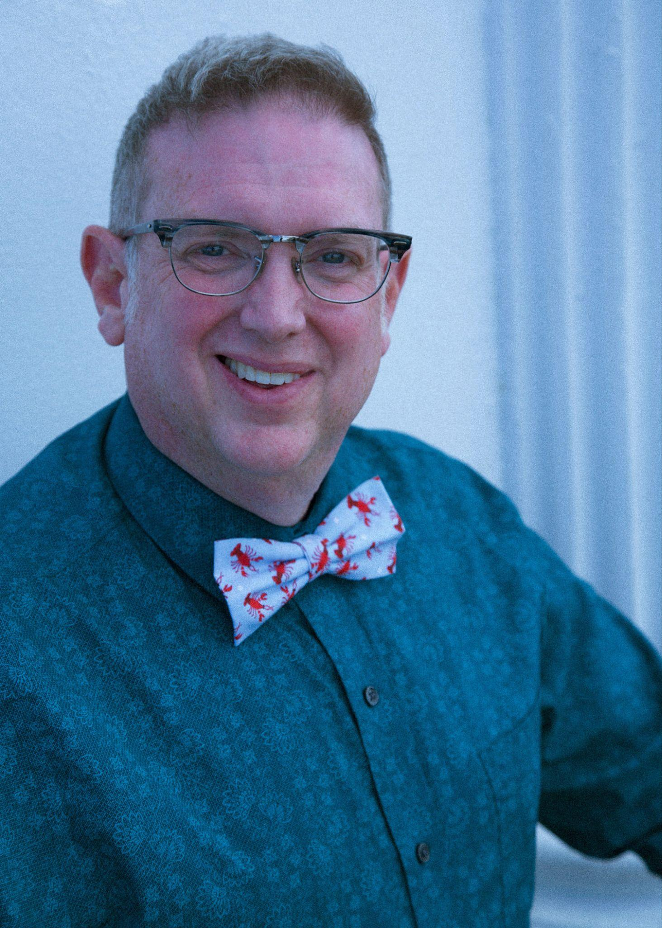
Who’s Doing The Talking?
Joshua Chard, MSEd
Second and Third Grade Looping Teacher
East End Community School, Portland, Maine
2024 Maine Teacher of the Year
Maine DOE Arts Integration Fellow

Slide 2
Today’s Goals
Let’s define and differentiate between equity and equality in the context of education, and explain why equity is essential for addressing diverse student needs.
Let’s explore structured student discourse strategies that promote equitable participation and give voice to all students.

Slide 3
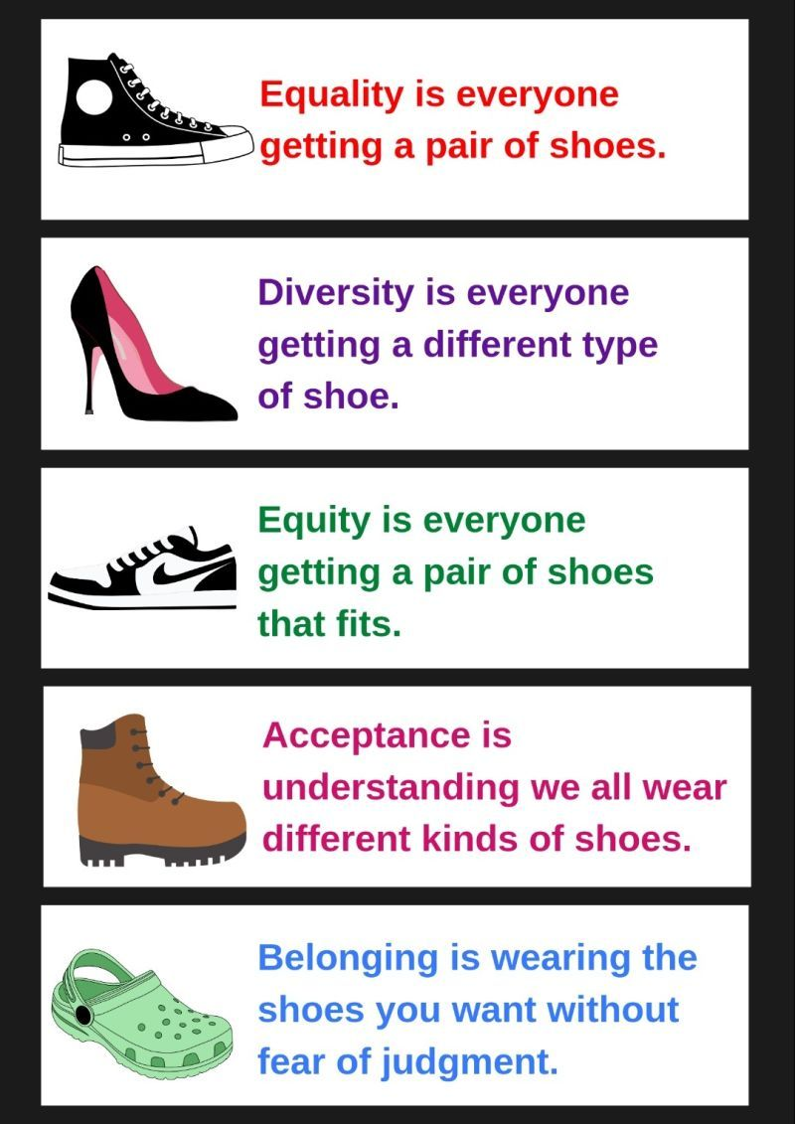

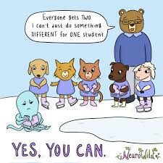

Turn and Talk: Which of these graphics resonates with you? Why does it resonate? How does it relate to what you are already putting into practice?

Slide 4
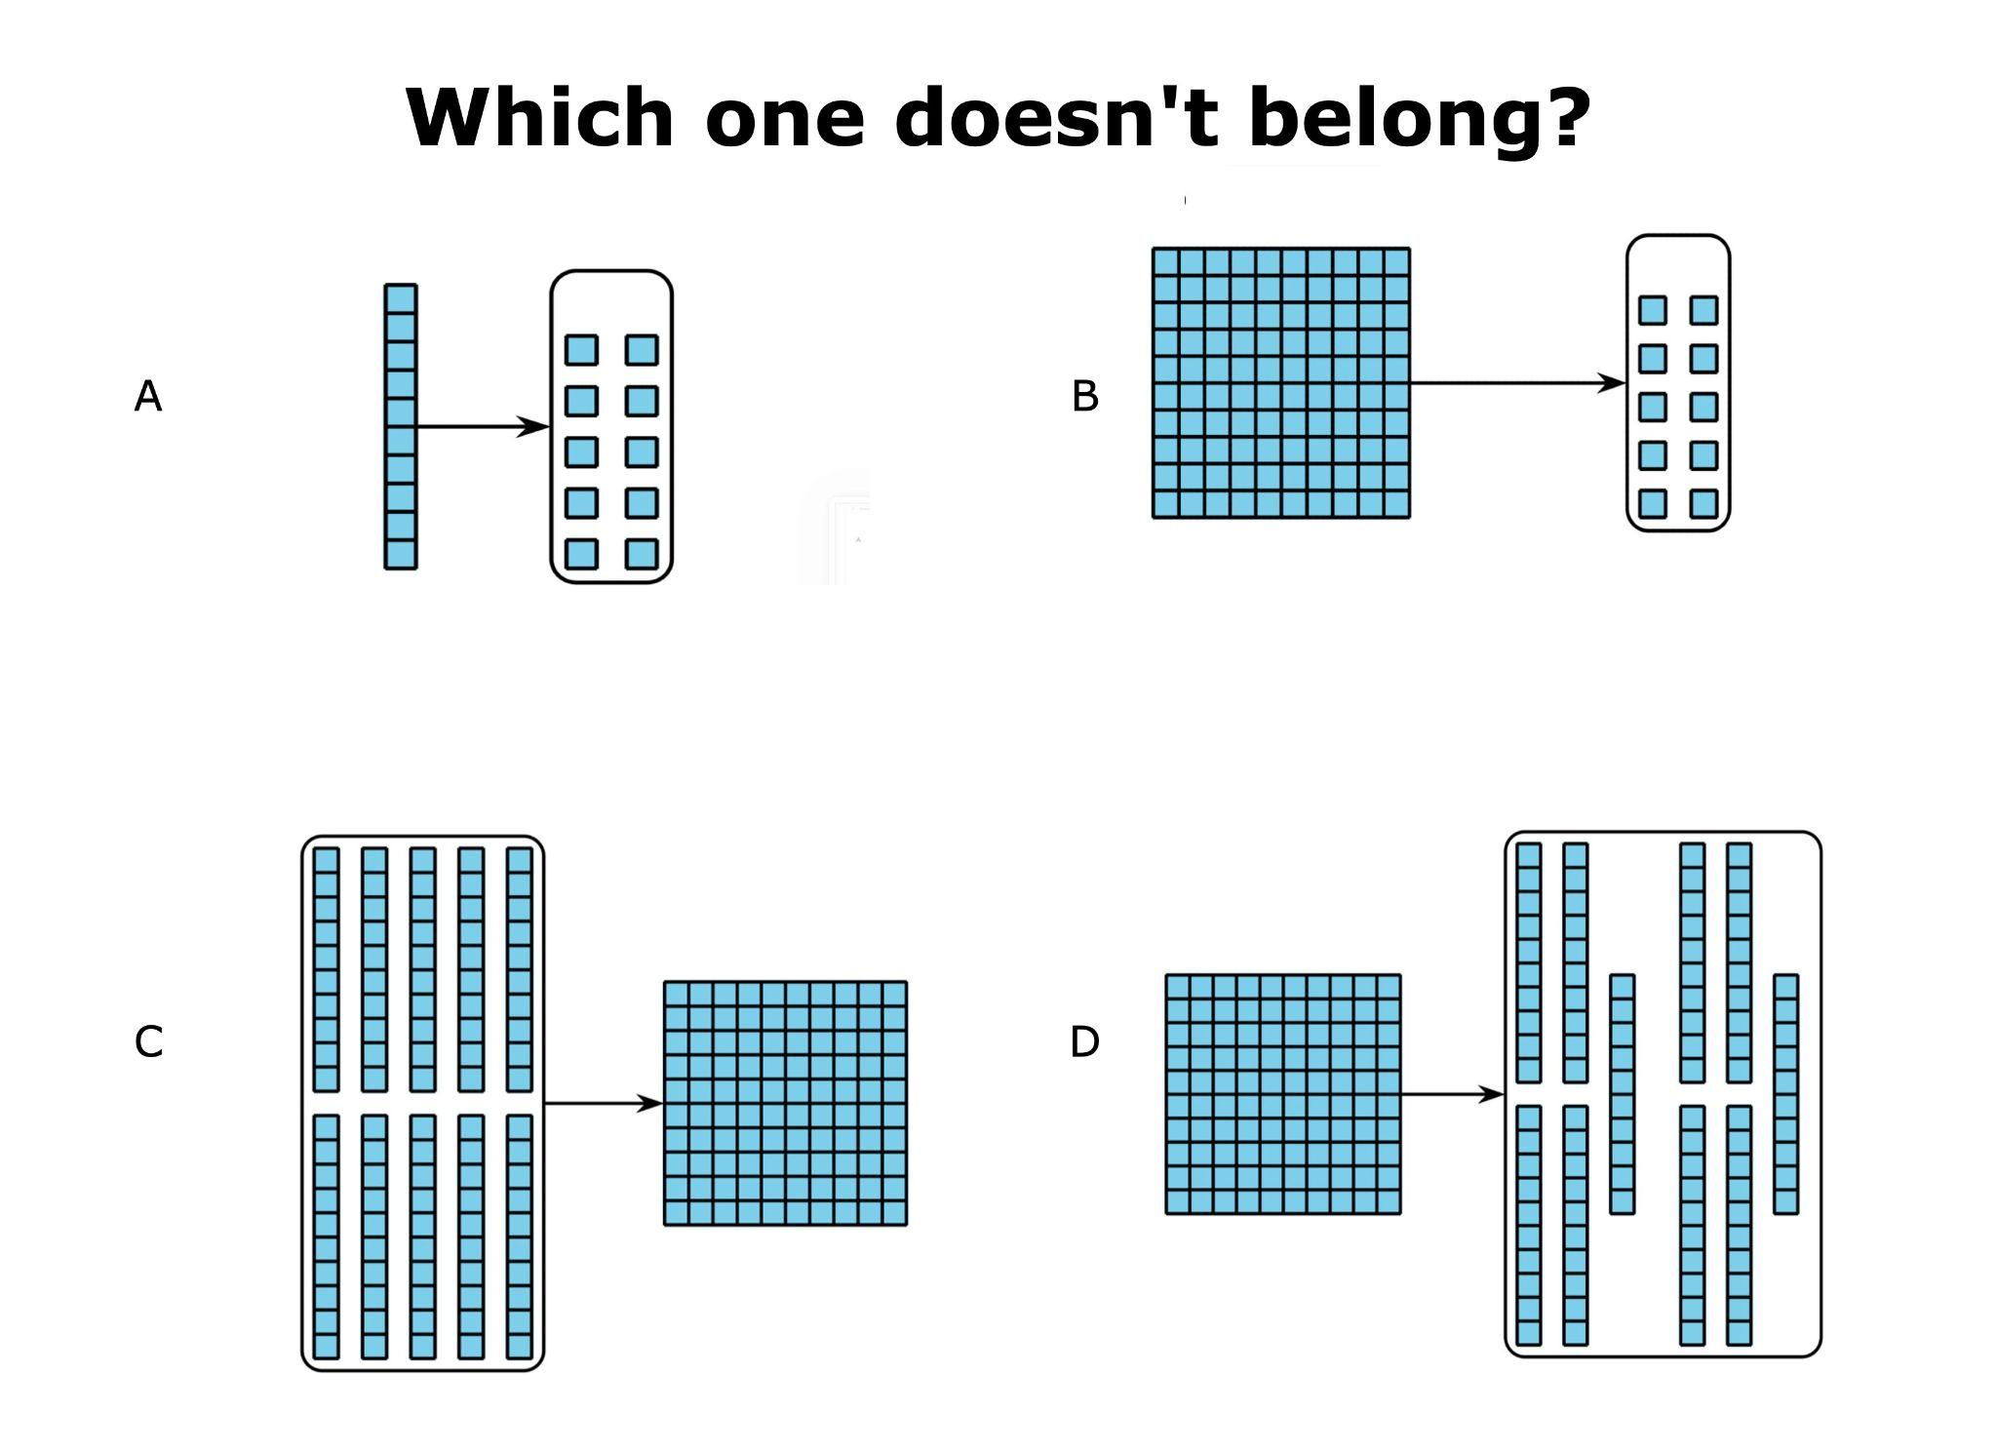
Protocol: Which One Doesn’t Belong?
Low floor/High ceiling activity. There is an entry point for every student.

Slide 5
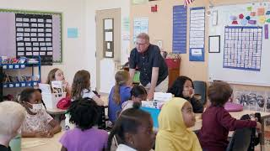
Reflection: What did you notice about teacher voice vs. student voice in this video?

Slide 6
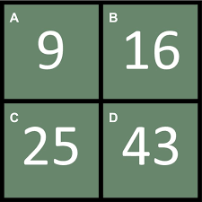

Which one Doesn’t Belong?
Thumbs-up when done.
Pinkie Partner protocol
Me too sign
“I want to add on to what ______ said”
“I have a different idea than________”
“I want to revise my answer.”
“Hearing _______’s idea changed my thinking.”
Spend 5 minutes talking about possible student answers.

Slide 7
When teaching students to work in groups:
Explicitly teach the skill of group work. Model and practice expectations.
Design experiences that are rich in content, while being accessible to all of your learners.
Leverage technology to support students during group work. Translation apps allow beginning ESOL students to access the learning. Emerging writer? Encourage sketching as a strategy to record ideas.
Reflect, reflect, reflect. Name what you observe out loud. Celebrate successes. Make goals for improvement. Make shared feedback a part of your everyday practice.

Slide 8
Back to Back Partner Protocol
Move around the room to form groups of 3, preferably a group of people who you haven’t worked with yet. Stand back to back with your arms crossed. When I give the signal, turn around and introduce yourself. When introductions are complete, I will advance to the next slide and explain the activity.
“What is Happening Here”

Slide 9
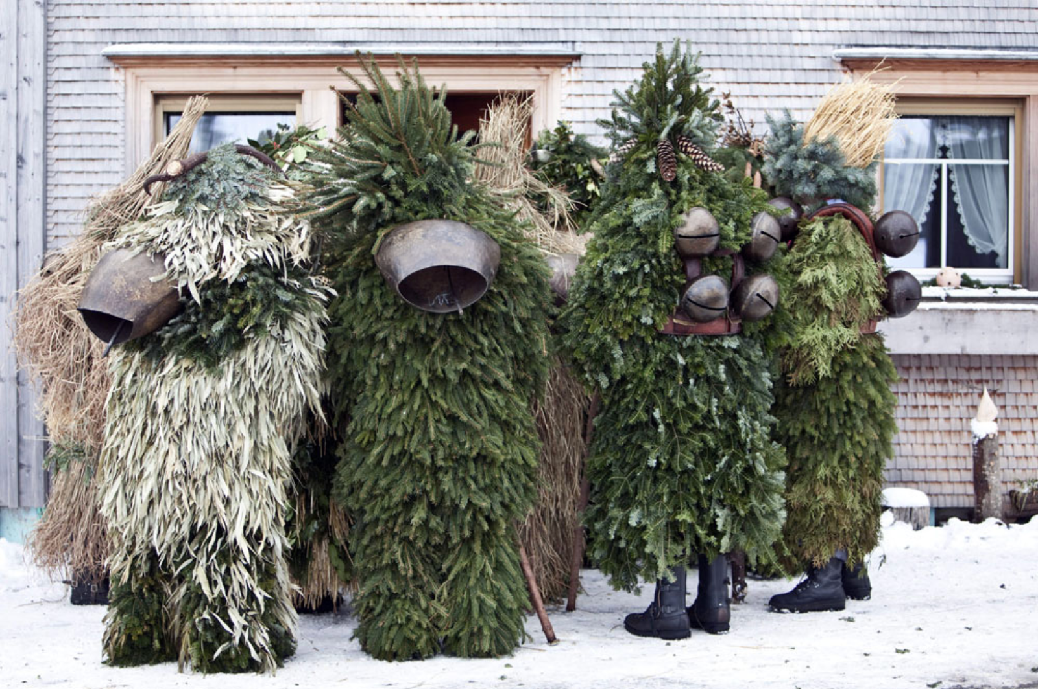
After looking closely at the image below, think about these three questions:
What is going on in this picture?
What do you see that makes you say that?
What more can you find?
Brainstorm ideas. Then develop a short story inspired by what you see. Include a beginning, middle, and end. It doesn’t have to be written down. Choose one group member to share your story. There is no wrong way to do this activity.
"What's Going On In This Picture?

Slide 10
And here is what was actually happening….
The original caption reads:
Equipped with branches of pine trees and cow bells, so-called Silvesterchlaeuse (New Years Clauses) walk from house to house in Waldstaff, Switzerland, to offer their best wishes for the New Year to the farmers of the region. After their singing and dancing performance, the Silvesterchlaeuse receive food, hot drinks or money.
The photographer is Ennio Leanza.
Take 5 minutes of quiet reflection to think about how you might use these images in your classroom.

Slide 11
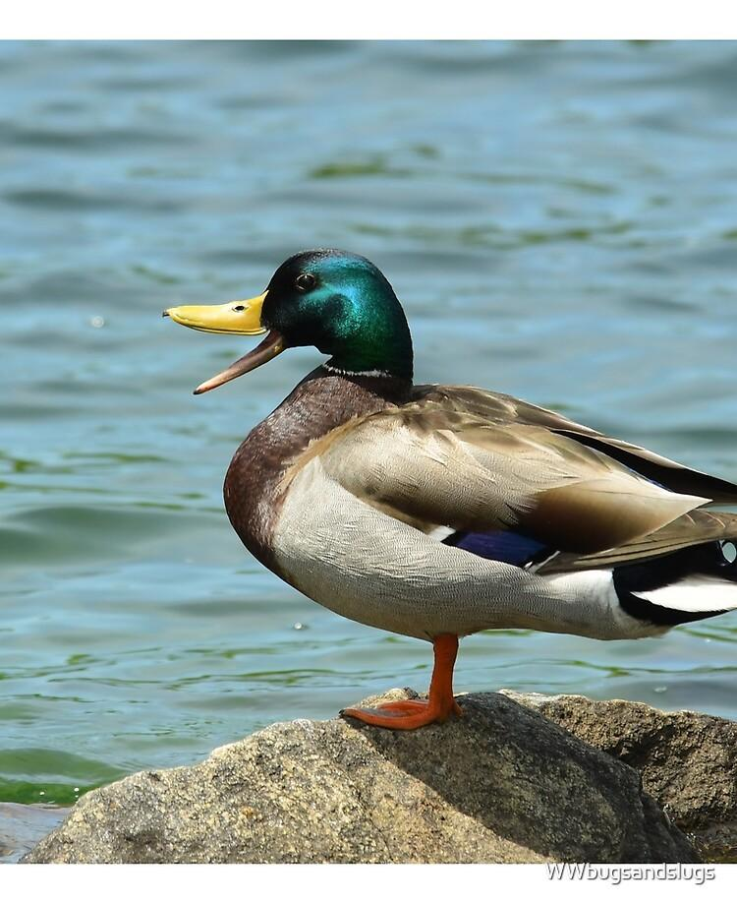
Closing Circle
Everyone get up and form a large circle around the perimeter of the room.
Today’s question is: “If you could go on a trip to anywhere, where would it be and why do you want to go there?”
Take 1 minute of think time to come up with your idea. Only the person holding the Talkative Duck can speak. Pass the duck to the next person. If you don’t have an idea, you may pass.
Reflection question: Every moment with students is precious. What is the value of making time for an activity like this?

Slide 12

Questions

Slide 13
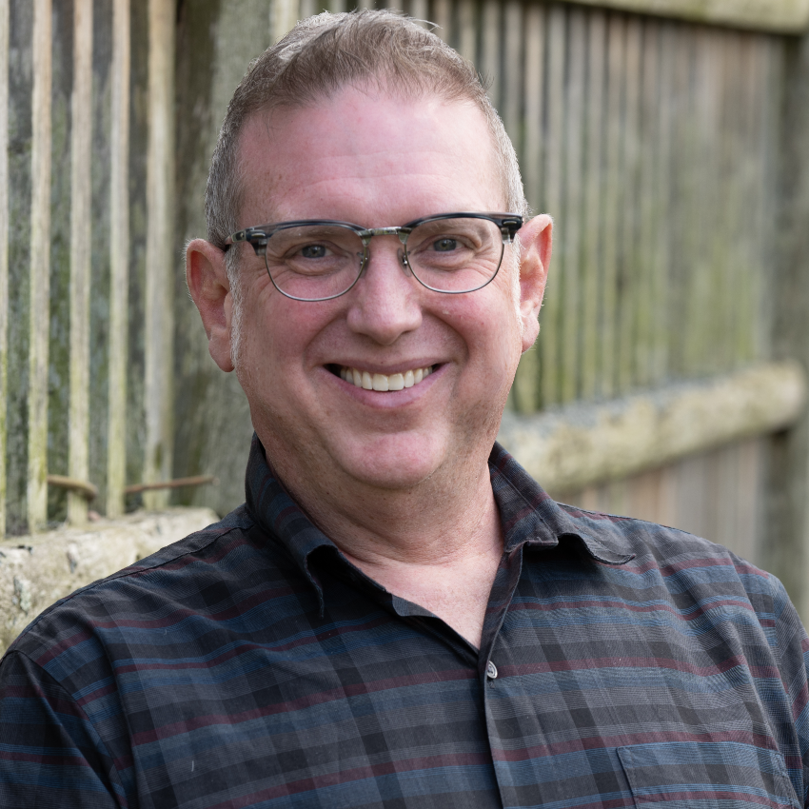
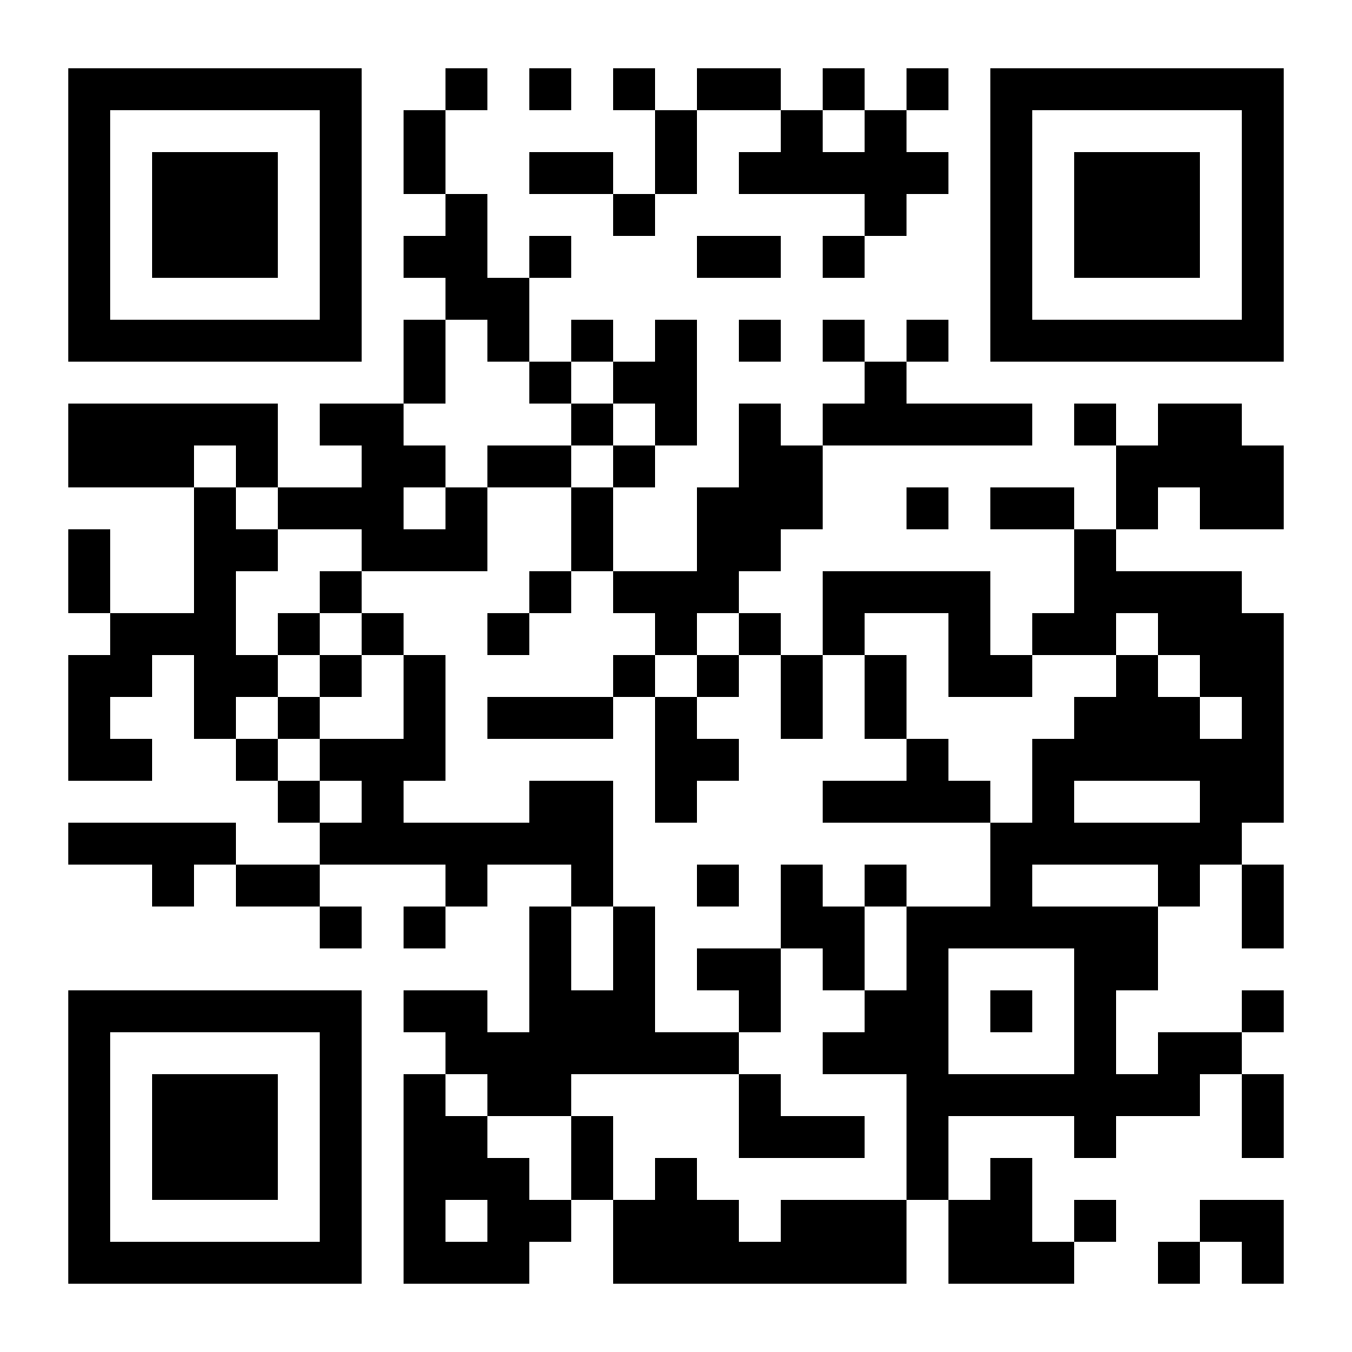
To access today’s slideshow:
Joshua Chard, MSEd
Second and Third Grade Looping Teacher
East End Community School, Portland, Maine
2024 Maine Teacher of the Year
Maine DOE Arts Integration Fellow
Contact Information:
Email: j.chard.maine@gmail.com
Facebook: @Joshua Chard, 2024 Maine Teacher of the Year

