Slide 1



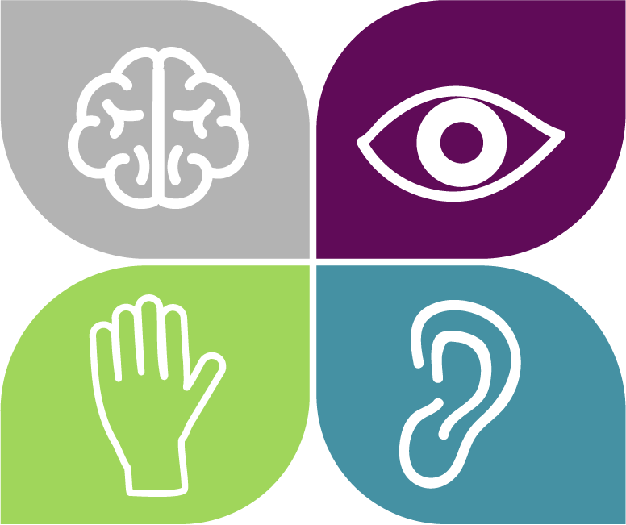
AT Supports for Mental Health
Hillary Goldthwait-Fowles, Ph.D, ATP
@hillary_atp

Slide 2


Mental Health Resources: U.S.
National Alliance on Mental Illness (NAMI):
https://www.nami.org/
Call or text 988 for help when in crisis

Slide 3

Creative Commons License
Assistive Technology for Mental Health © 2026 by Hillary Goldthwait-Fowles, Ph.D., ATP is licensed under Attribution-NonCommercial-ShareAlike 4.0 International.
To view a copy of this license, visit http://creativecommons.org/licenses/by-nc-sa/4.0/

Slide 4

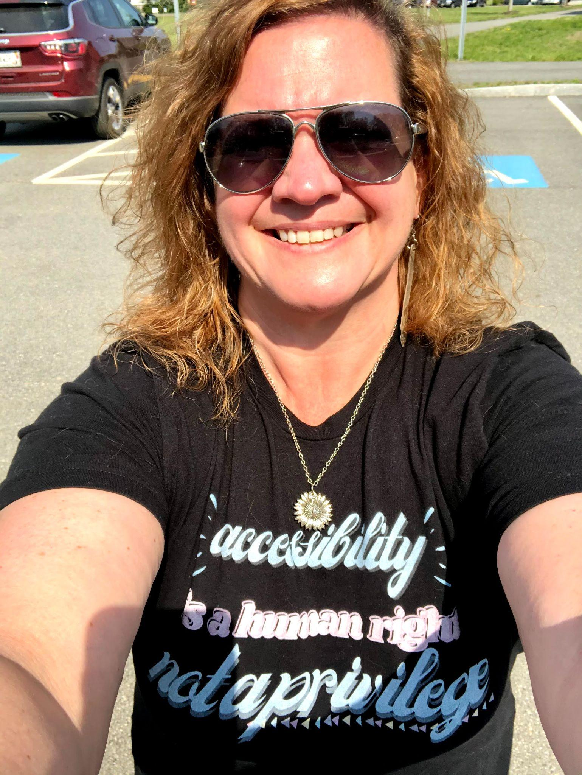
Professional Hillary
Accessibility Accomplice
Instructional Design Specialist
AT Specialist/Consultant
Adjunct Faculty and SME
@hillary_atp

Slide 5
My Accessibility Promise
Captions
Accessible colors/font
Link shorteners and QR Codes
Alt text for images
Reading slides/images for accessibility
Adjust rate of speaking
@hillary_atp

Slide 6
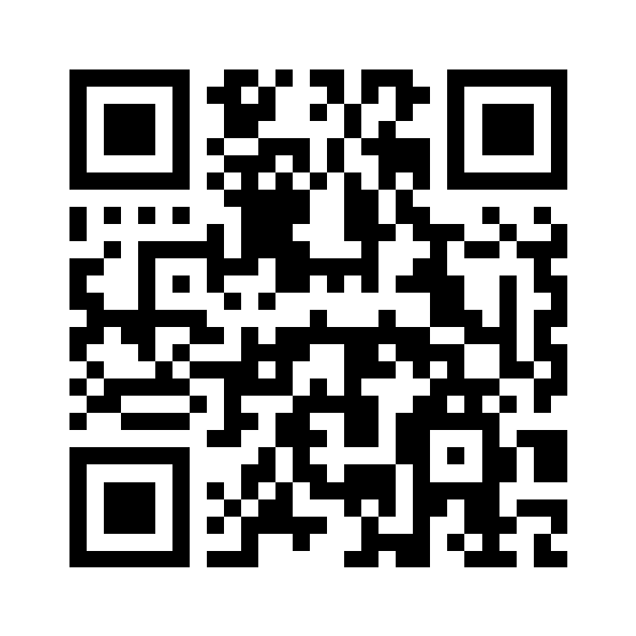

Resources:
QR Code for the Wakelet for session materials and resources covered in today’s session.
“Wakelet is like if Pinterest and Padlet had a baby”- Elisa Wern
https://bit.ly/AT4MHealth

Slide 7

Let’s talk about Mental Health.

Slide 8
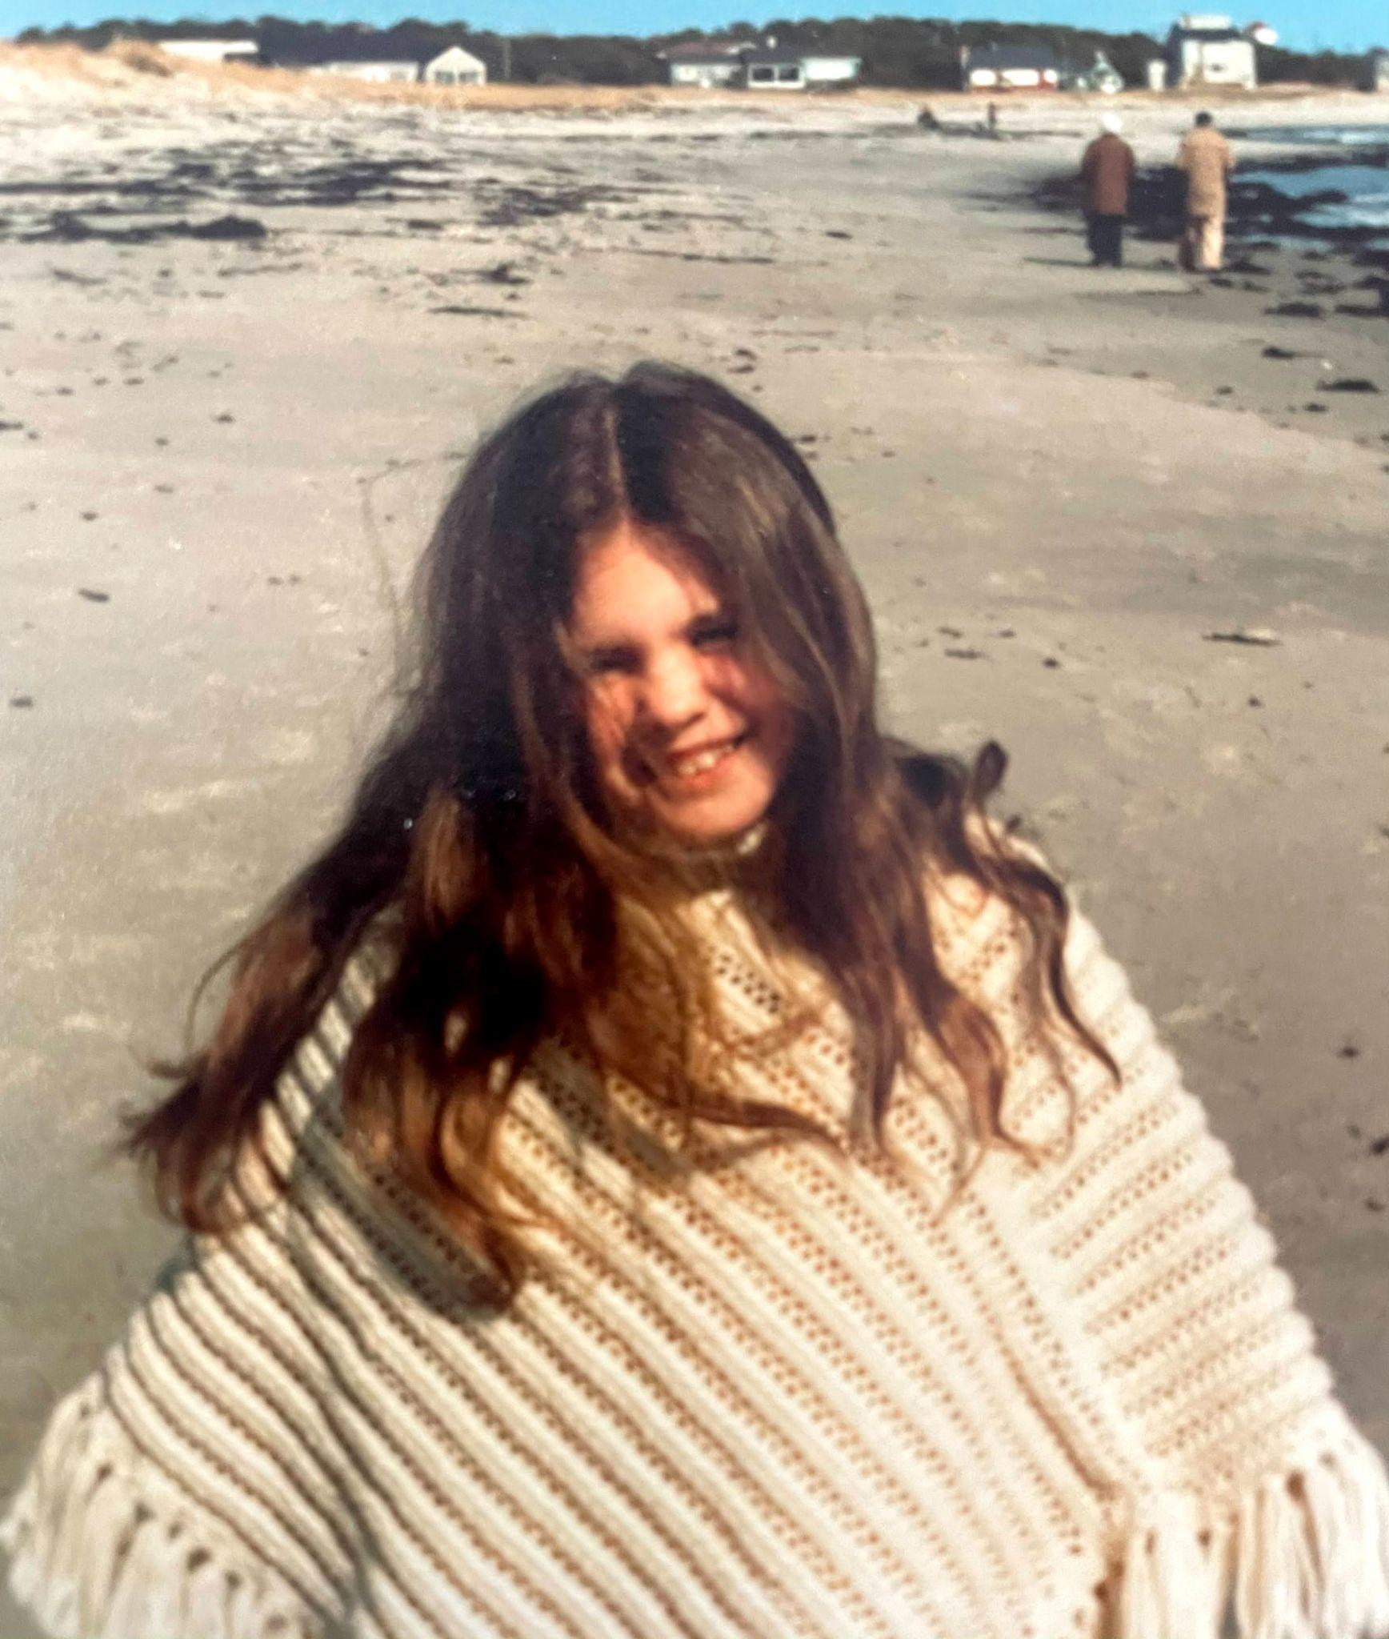
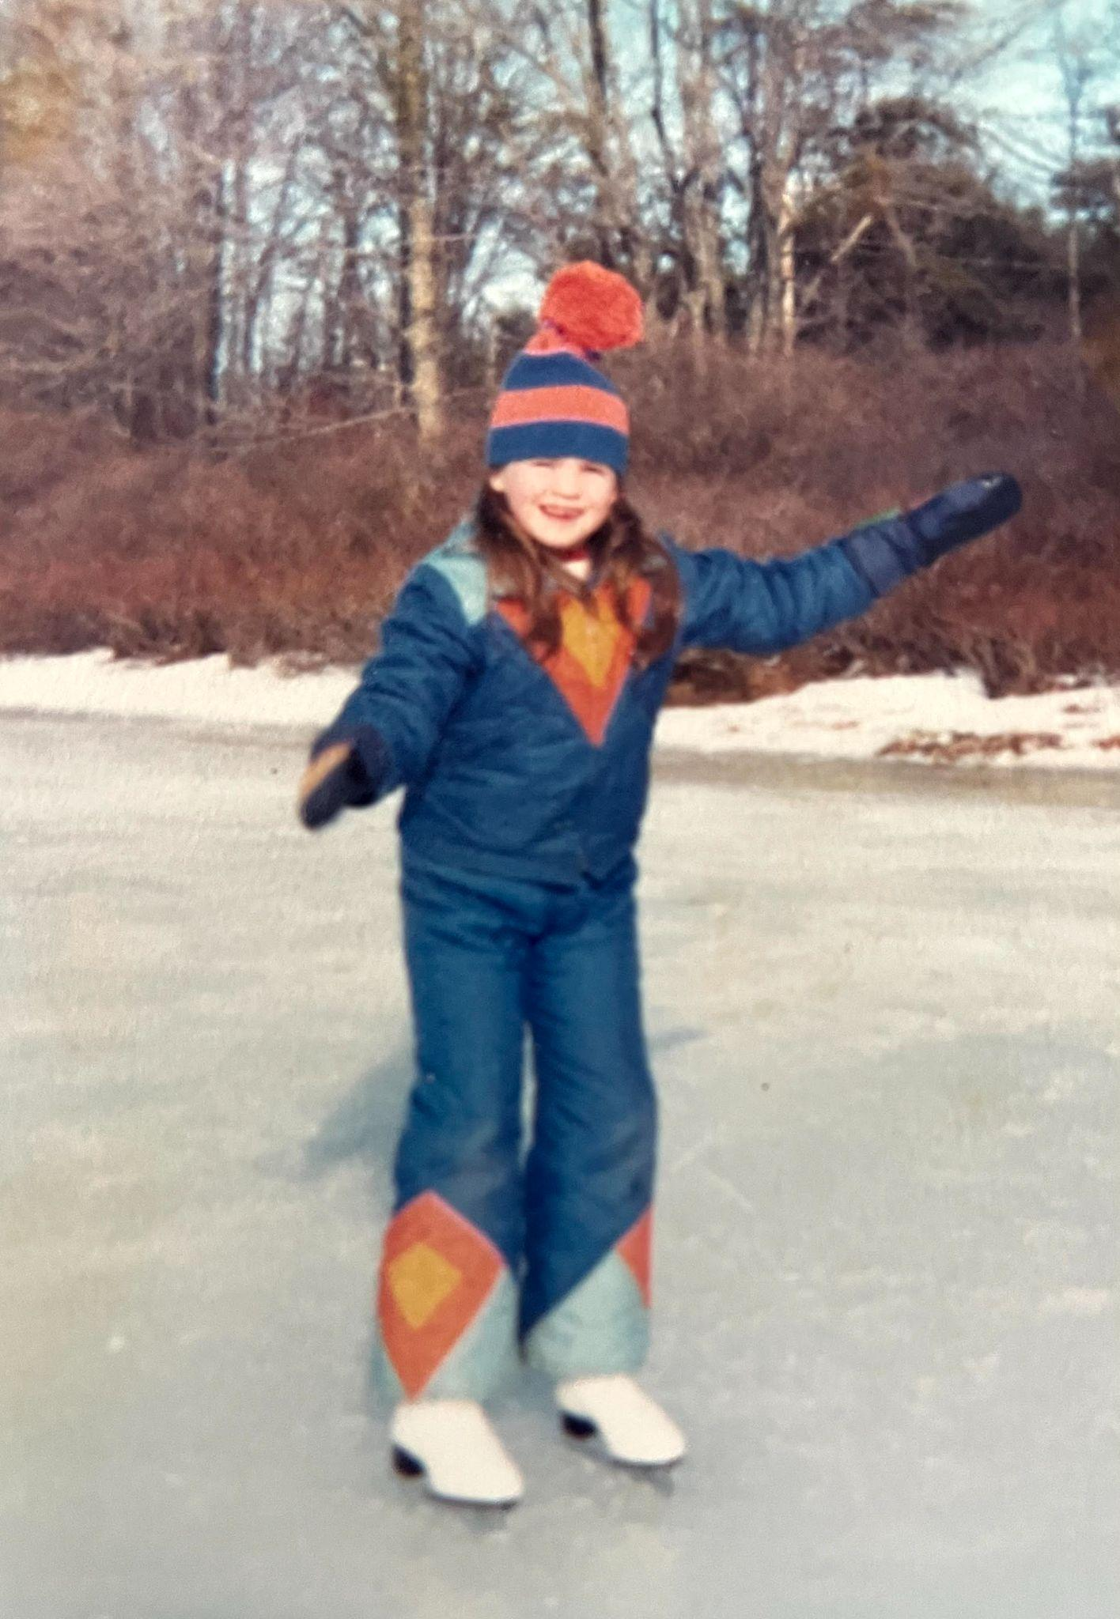
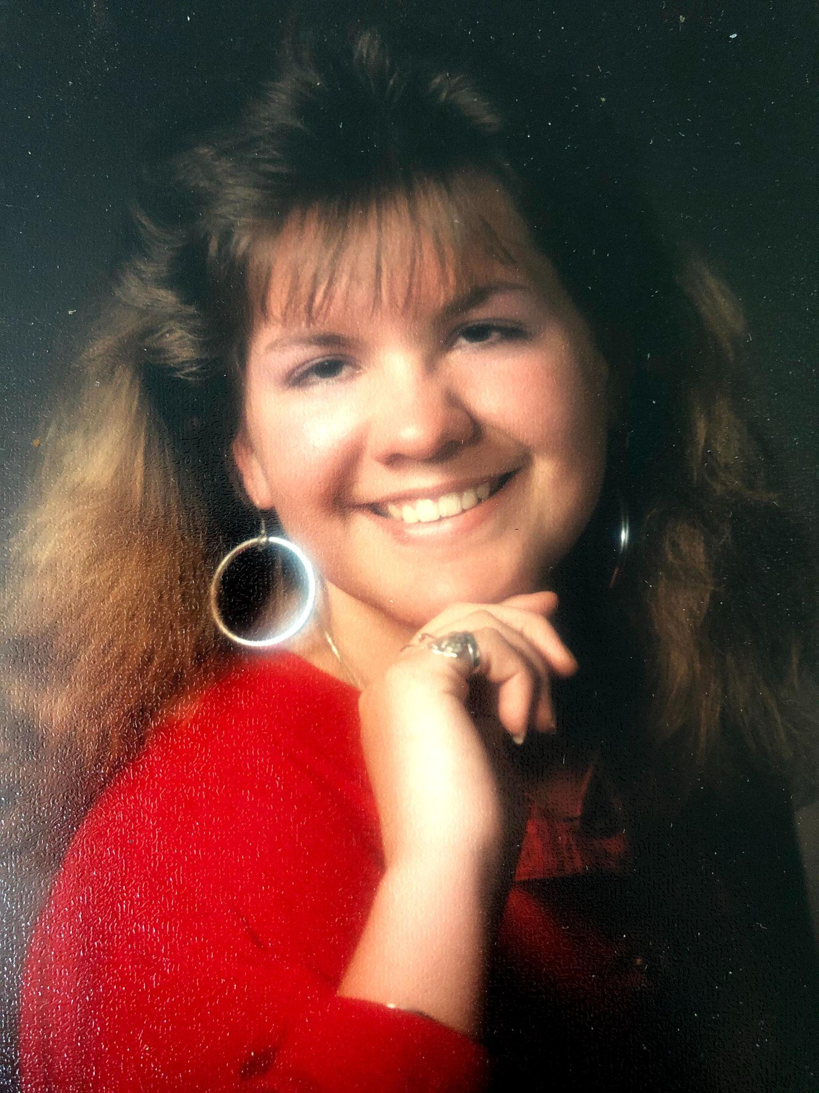
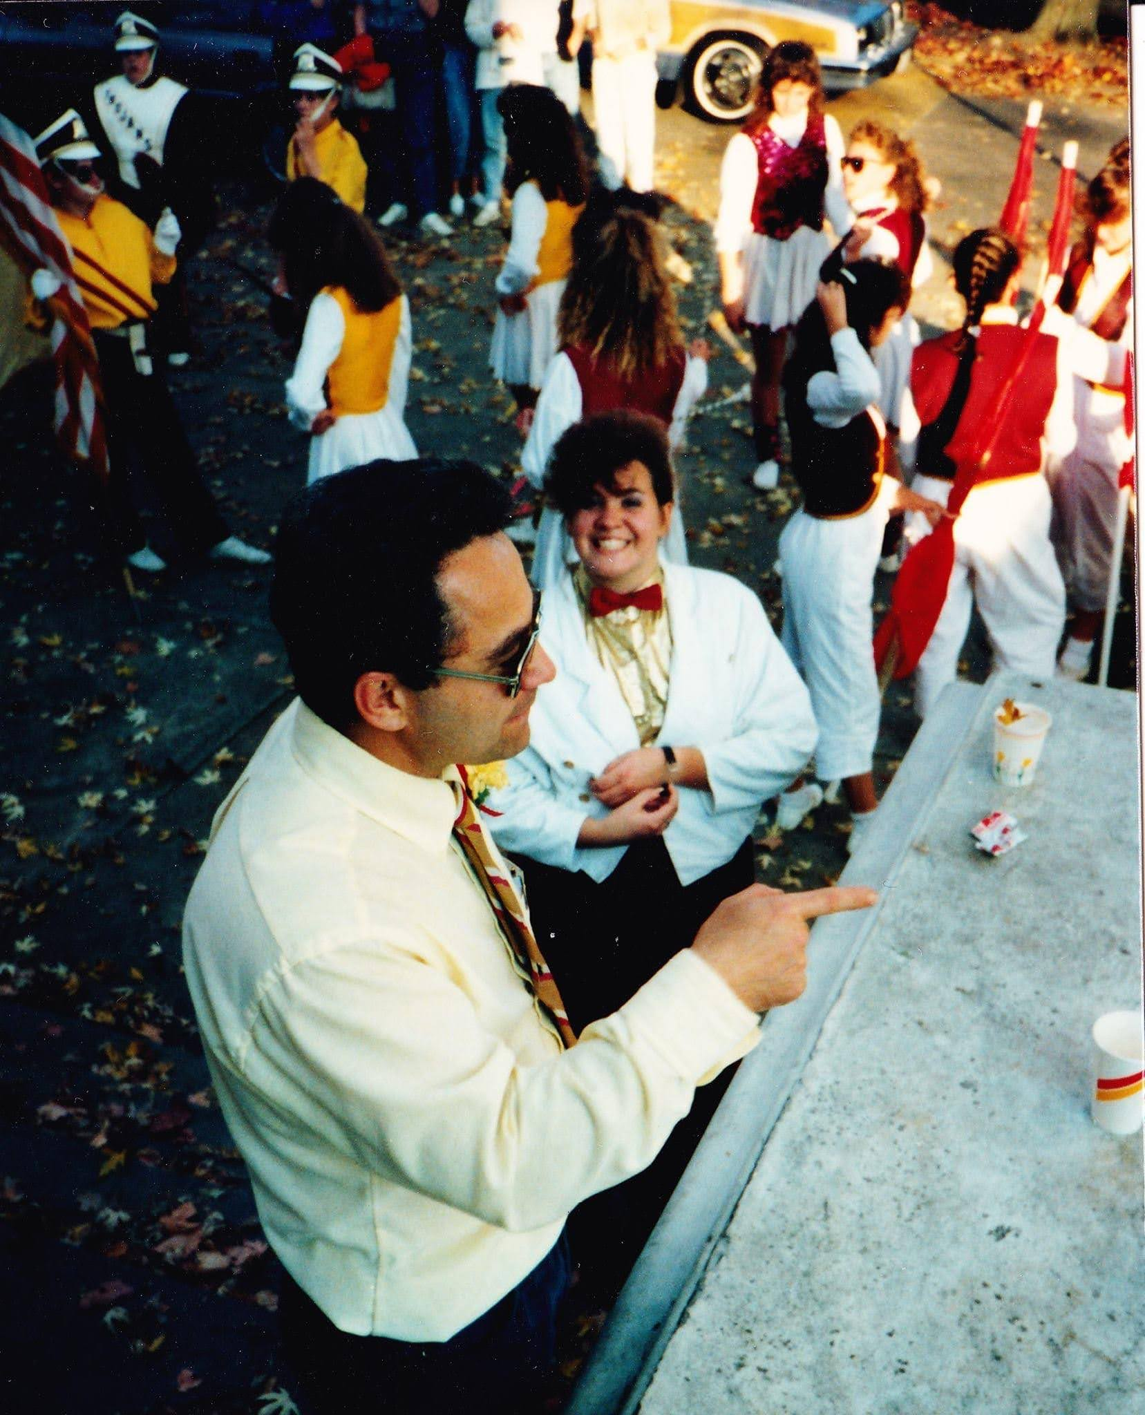
Hi! I’m Hillary
Mental health has affected me both personally and professionally.
It manifests in different ways.
Seeking help is NOT shameful.
Professional help and AT Supports help me to better manage symptoms.
Disclaimer: The statements made in this session about Mental Health are based on the presenter’s experiences. This talk is not intended to diagnose or treat Mental Health, but to share supports that have helped them manage theirs. Please seek medical attention for the diagnosis and treatment of Mental Health
@hillary_atp
Notes:
Read the slide text. Read the disclaimer. Briefly share how each of these pictures speaks to mental health

Slide 9
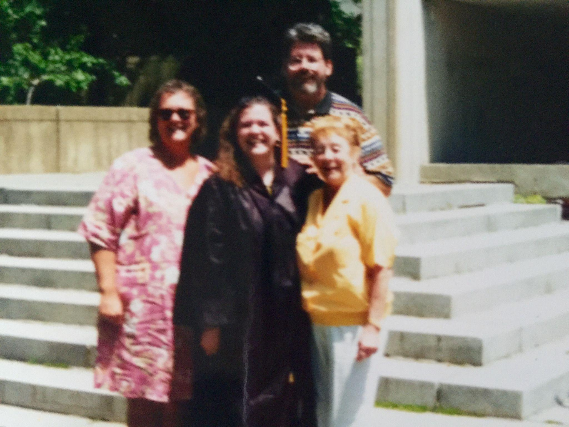
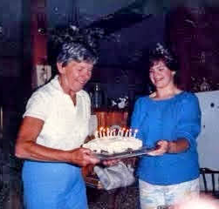

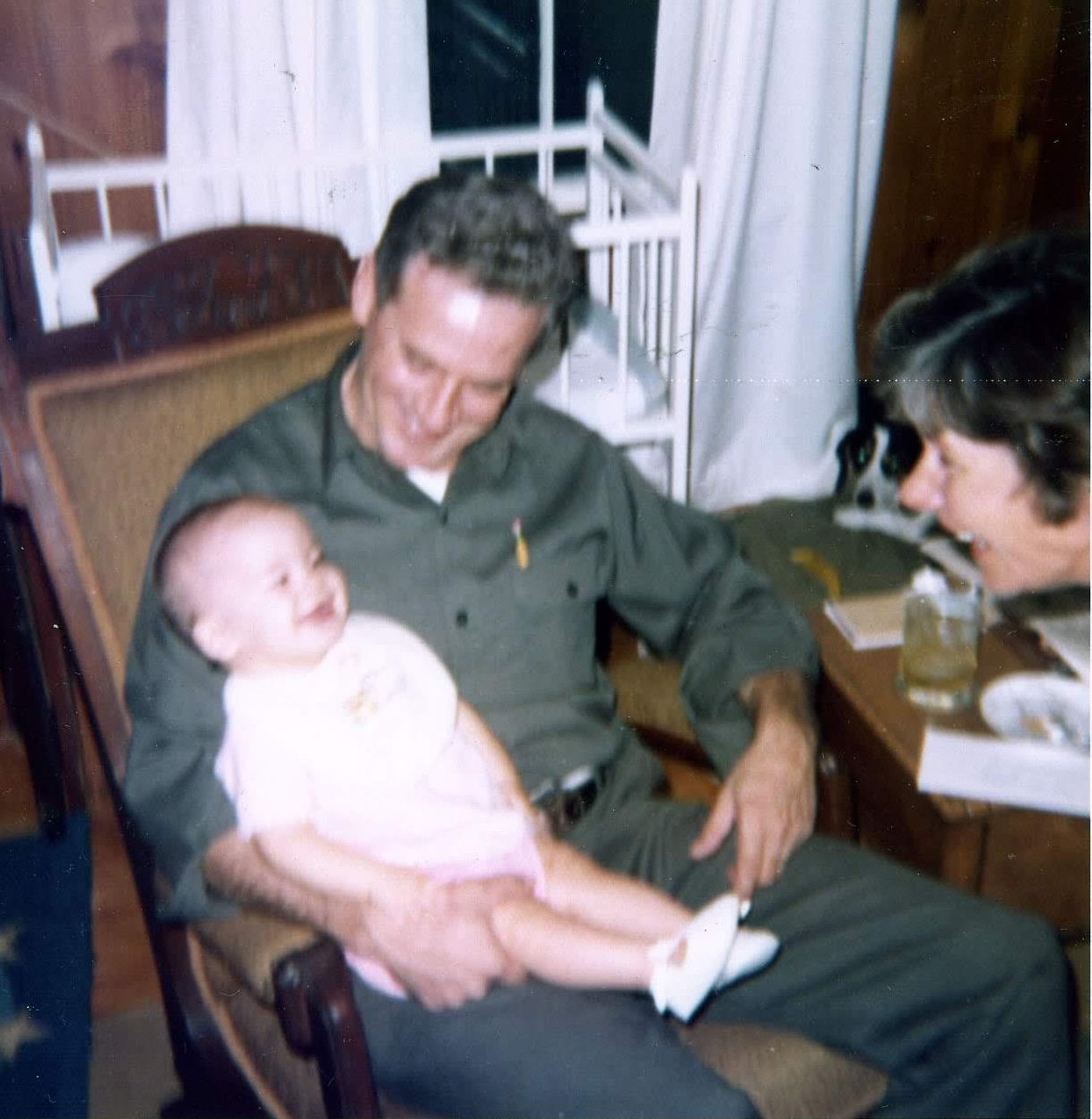
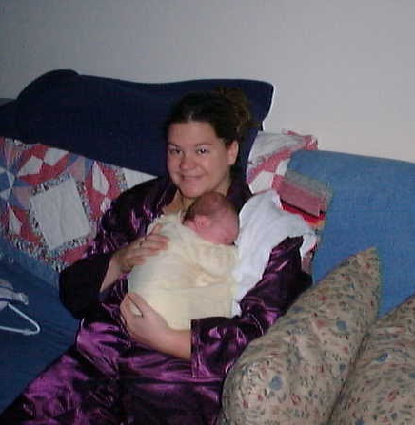
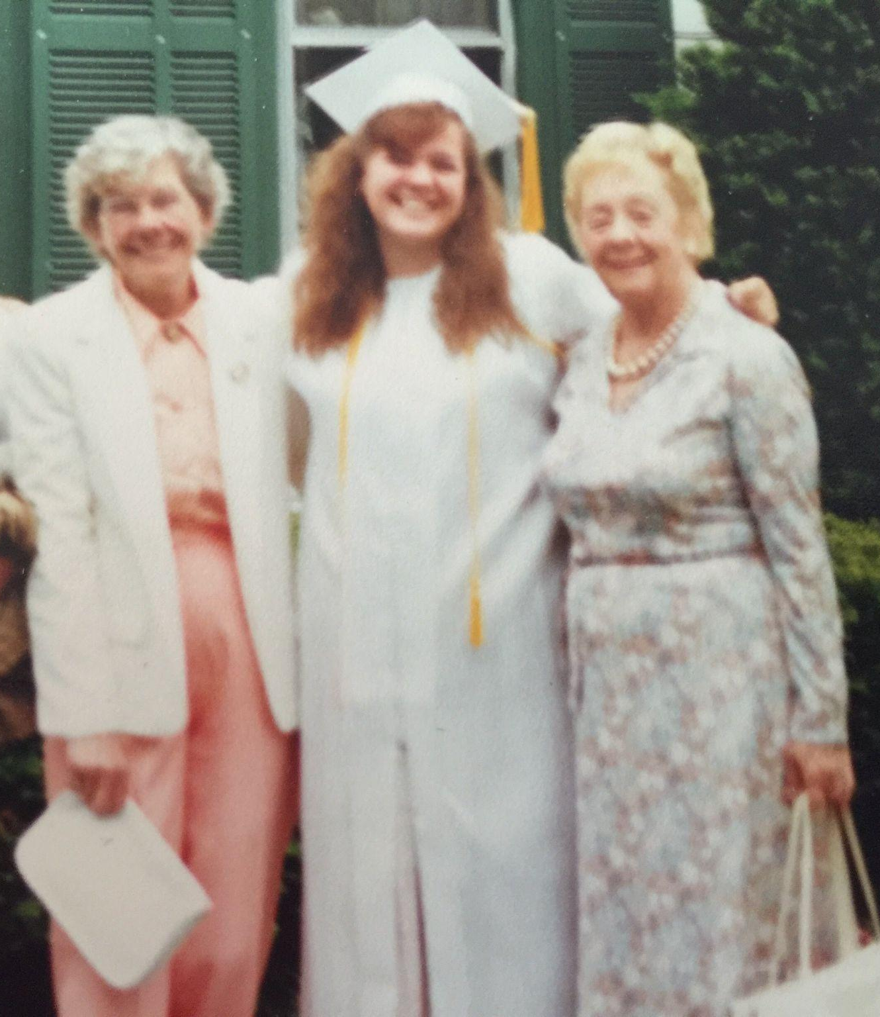
Family Tradition?

Slide 10
You can’t change what you don’t acknowledge.
@hillary_atp
Notes:
Talk about how this is a quote from a famous doctor and how not acknowledging things, over time, can make things worse. There are some things we need to ackolwege today- the mental health of all of us, but most impotantly the relationships between mental health and disability and mental health and other marginalizations

Slide 11

Mental Health Facts
Mental Health Crisis
2020 UN warned of “looming mental health crisis”.
Especially prevalent in young children.
1 in 4 are affected by mental illness.
57% of Americans either lack access to or are not receiving treatment for anxiety and related mental health disorders.
Anxiety among children ages 6 to 17 has increased over time — from about 5.5% in 2003 to 11% from 2022-2023.
U.S. teen girls experiencing increased sadness and violence (CDC)

Slide 12


Mental Health and Disability
Adults with disabilities reports mental distress 5x more than non-disabled adults.
Mental health affects individuals with disabilities in different ways (think variability)!
Ableism, lack of access to services/healthcare/employment/inclusion can be a contributing factor to mental health
Co-occurring mental health conditions DO occur with disability (i.e. ADHD, Autism, Down Syndrome, etc).

Slide 13

Let’s Talk about Suicide
132 people die by suicide daily (CDC)
1.70 MILLION Americans attempted suicide in 2021 (48,183 successful)
Suicide is the SECOND leading cause of death among 10-24 and 20-34.
Suicide is the LEADING CAUSE OF DEATH among girls aged 10-15.
45% of LBGTQ youth seriously considered attempting suicide in 2022.
You can help! Ask, care, support.
September is Suicide Awareness Month
Notes:
Ask- check in- really- you’re not making it worse. If you sense something is up- SAY SOMETHING. Care- show you care and that the person matters- even if they don’t feel like they do (it’s so complex) seek support dialing 988 or mental health providers

Slide 14

Let’s talk about masking
What you see:
Detail-oriented
Outgoing
Active
Extremely helpful
Hardworking
Performs well under pressure
Loyalty
What you don’t see:
Overthinking
People-Pleasing
Can’t slow down
Can’t say no
Fear of Failure
Procrastinating or over planning
Murky boundaries
The Pearl- Celebrating and Supporting Autism

Slide 15


What are some ways you see anxiety showing up in your learners?
ⓘ
Click Present with Slido or install our Chrome extension to activate this poll while presenting.
Notes:
📣 This is Slido interaction slide, please don't delete it.
✅ Click on 'Present with Slido' and the poll will launch automatically when you get to this slide.

Slide 16

Mental Health
Supports Matter!
@hillary_atp
Notes:
Talk about availability to learn here

Slide 17

What are some ways your setting is addressing the mental health of all persons?
ⓘ
Click Present with Slido or install our Chrome extension to activate this poll while presenting.
Notes:
📣 This is Slido interaction slide, please don't delete it.
✅ Click on 'Present with Slido' and the poll will launch automatically when you get to this slide.

Slide 18

Assistive Technology Tools
Mindfulness Apps
Sound Frequencies
Movement
Presentation Anxiety/EF
Gratitude
Art
What about Low Tech?
@hillary_atp
Notes:
State this is the structure

Slide 19
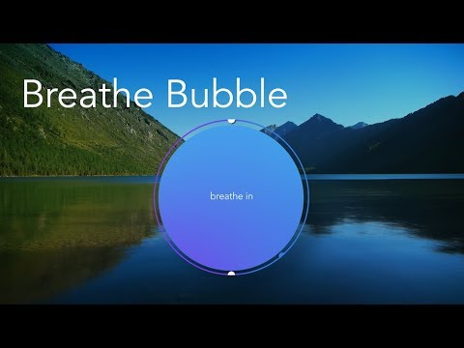
Mindfulness Apps:
Calm
Insight Timer
Mindful Powers
Smiling Mind
Sesame Street: Breathe, Think, DO!
Headspace
MyLife Meditation (Not in U.S. App Store)
Sensa App
@hillary_atp
Notes:
Go though the apps listed then play the video

Slide 20




Mood Tracking:
Viva insights in Microsoft Teams
Sensa Health
Mood Tracker in iOS 17
Status Strong
@hillary_atp
Notes:
Go though the apps listed then play the video

Slide 21

Sound Frequencies
Using sound has been around since ancient times.
Music and sound healing can help us release emotional traumas (Fauble, 2016).
Hillary’s YouTube sound playlist.
@hillary_atp

Slide 22
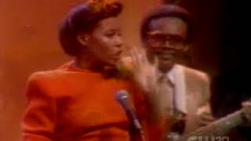
Music
Music and sound healing can help us release emotional traumas (Fauble, 2016).
Listening to music can:
  Help with the nervous system
  Help with emotional release
  Help with coping with stressors
  Helps foster creativity
  Helps foster connection
Lyrics
@hillary_atp

Slide 23




Movement
Super Stretch Yoga HD
FitOn
Apple Health
Go Noodle
Fitness App in iOS or Andriod
@hillary_atp
@hillary_atp

Slide 24


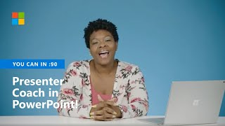
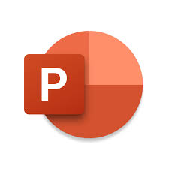

Presentation Anxiety/EF
Present Pal
Speaker Coach in Power Point
Flip
EndeavorOTC
@hillary_atp

Slide 25
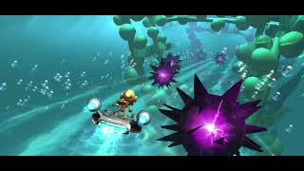
Endeavor OTC

Slide 26





Gratitude
Sensa App
Gratitude Daily Journal
Bliss Gratitude Journal
Built in notes apps
iOS 17: Journal
Reflectly
Affirmations
@hillary_atp

Slide 27



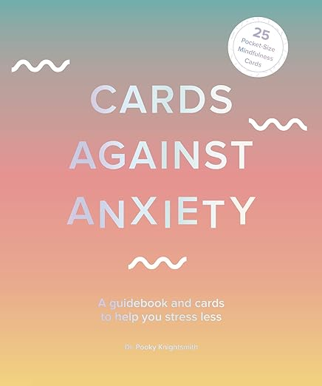
What about Low Tech?
Cards against Anxiety
The Nap Ministry’s Rest Deck
A Heart on Fire: 100 Meditations for Loving Your Neighbors Well
Nature Meditation Cards
NAMI Say it out Loud Card game for Children to end Mental Health stigma
@hillary_atp

Slide 28




Art
Check Wakelet for iPad apps for art and adaptive art supplies and more!
Notes:
How to deal with worry:
Make a plan you can control
Address and accept your worry
Release what you can't control
Make a plan about what you can control
Meditate and heal
Take steps toward action

Slide 29

What is one area of AT for Mental Health that spoke to you?
ⓘ
Click Present with Slido or install our Chrome extension to activate this poll while presenting.
Notes:
📣 This is Slido interaction slide, please don't delete it.
✅ Click on 'Present with Slido' and the poll will launch automatically when you get to this slide.

Slide 30
Resources
QR Code for the Wakelet for session materials and resources covered in today’s session.
“Wakelet is like if Pinterest and Padlet had a baby”- Elisa Wern
https://bit.ly/AT4MHealth

Slide 31
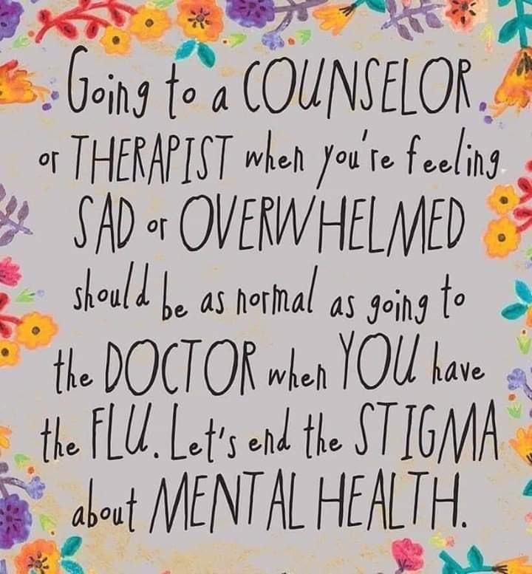


Slide 32
Mental Health Resources: U.S.
National Alliance on Mental Illness (NAMI):
https://www.nami.org/
Call or text 988 for help when in crisis

Slide 33


Thank you!
@hillary_atp
hillary@hillaryhelpsulearn.com
www.hillaryhelpsulearn.com

Slide 34
References
Akimoto, Kaho & Hu, Ailing & Yamaguchi, Takuji & Kobayashi, Hiroyuki. (2018). Effect of 528 Hz Music on the Endocrine System and Autonomic Nervous System. Health. 10. 1159-1170. 10.4236/health.2018.109088.
Centers for Disease Control and Prevention. (2023, February 13). U.S. teen girls experiencing increased sadness and violence. Centers for Disease Control and Prevention. Retrieved February 15, 2023, from https://www.cdc.gov/media/releases/2023/p0213-yrbs.html

Slide 35
References (2 of 2)
Wong, J., & Brown, J. (2017, June 6). How Gratitude Changes You and Your Brain. Retrieved February 21, 2020.
World Economic Forum (2020). U.N. Warns of Global Mental Health Crisis due to COVID-19 Pandemic. Retrieved February 3, 2022.
Psych Central. School Anxiety (2021). School Anxiety. Retrieved April 28. 2022.
Common Sense Media (n.d.) 8 Mindfulness Apps for Kids. Retrieved April 28. 2022.
https://positivepsychology.com/gratitude-apps/

