Slide 1
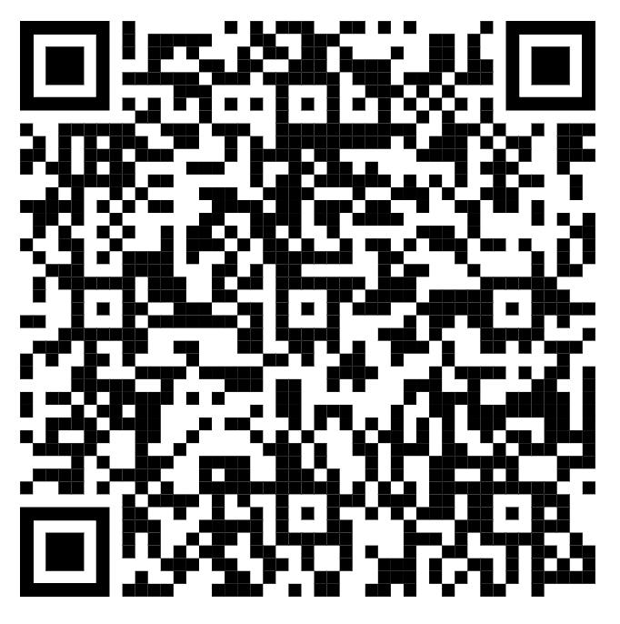

Strong Classroom Routines/Protocols and the What If’s
SOCIAL SERVICES & EDUCATION PROFESSIONALS
Symposium
University of New England
Community, Culture, and Collaborative Classroom Practices

Slide 2



Social Services and Education Professionals Symposium at the University of New England
Who We Are
Assistant Principal K-5 Village School
LCPC and Pre-k -12 School Counselor, Safety Care Trainer 10 years
Jennifer.baker@gorhamschools.org
207-222-1285
Jennifer Sinskie Baker
Brenna Pagliaro
5th grade teacher, Village School
Brenna.Pagliaro@gorhamschools.org
Lexie Caddell, Transitions Teacher Village School
UNE Symposium • Social Services & Education Professionals
2

Slide 3
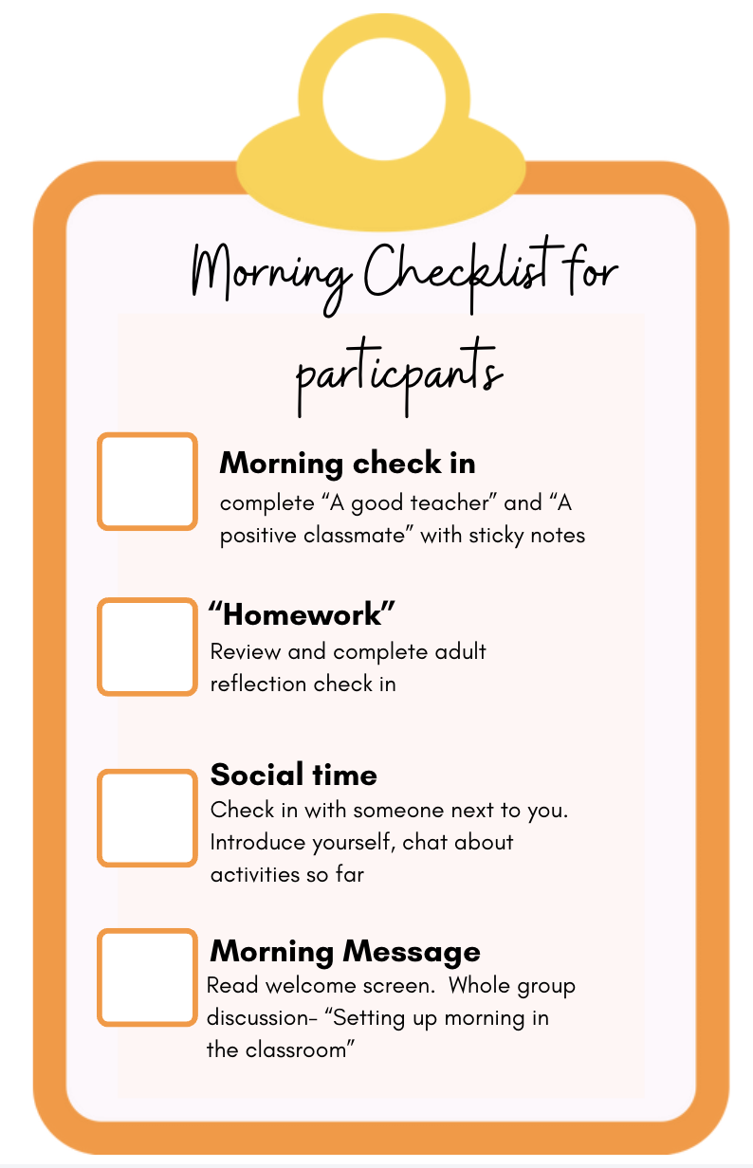
Welcome
Setting Up the Meeting
Greeting / Message — what did you notice entering the room today?
How does the room feel? Sound like?
Activity: the “dinner party” framing for inclusive planning
Close with a shared, welcoming routine
Morning/Afternoon Check-in
"A Good Teacher" and “A Positive Classmate”
Participant reflections
UNE Symposium • Social Services & Education Professionals
2
Notes:
Good

Slide 4


LEARNING INTENTIONS
STRONG CLASSROOM ROUTINES/PROTOCOLS AND WHAT IF’S………
Understand how consistent classroom routines and protocols support both academic learning and social-emotional development.
Identify proactive strategies that create predictable, safe, and engaging learning environments.
Recognize when and how to intentionally reteach classroom expectations throughout the school day and year..
Apply practical de-escalation strategies to support students during moments of dysregulation.
Strengthen collaboration between classroom teachers, counselors, and support staff to promote consistent responses for students.
UNE Symposium • Social Services & Education Professionals
19

Slide 5

Consider Throughout the Workshop- Turn and Talk and Share out
As we learn together, reflect on the following questions:
CONSIDER
CONSIDER
What routines in my classroom are working well, and which could be strengthened?
Do my students clearly know what is expected during every part of the day?
How do I intentionally teach, model, and revisit expectations—not just at the beginning of the year?
How do I respond when a routine breaks down or a student becomes dysregulated?
Are my responses predictable, consistent, and supportive?
What proactive strategies could reduce challenging behaviors before they occur?
How can I partner with colleagues to provide consistent support for students across settings?
What is one practice I can implement immediately to improve classroom structure and student success?
UNE Symposium • Social Services & Education Professionals
7
Notes:
Turn and talk

Slide 6
Social Services and Education Professionals Symposium at the University of New England
AGENDA
Morning routine - Protocols and student voice
Welcome to the dinner party
Establish Turn and talk partnership and quick write activity/check in
Nuts and bolts of Agreements/Protocols/Relationship building
UDL- video- Turn and talk what are your most important protocols
Mindset for all - Learning PIT
Always teaching Problem Solving through restorative lens
De escalation - The What If’s WRAP UP
UNE Symposium • Social Services & Education Professionals
18

Slide 7

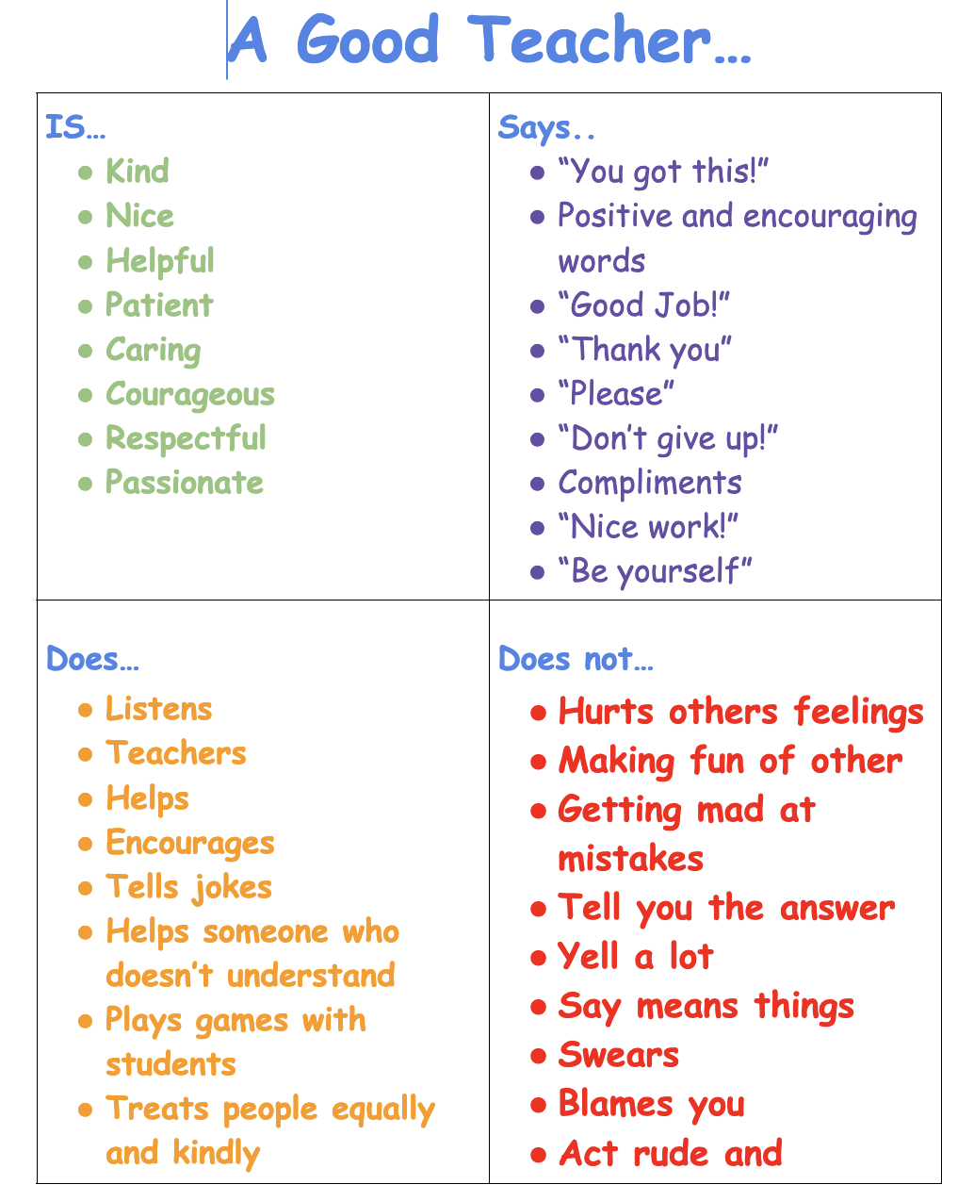
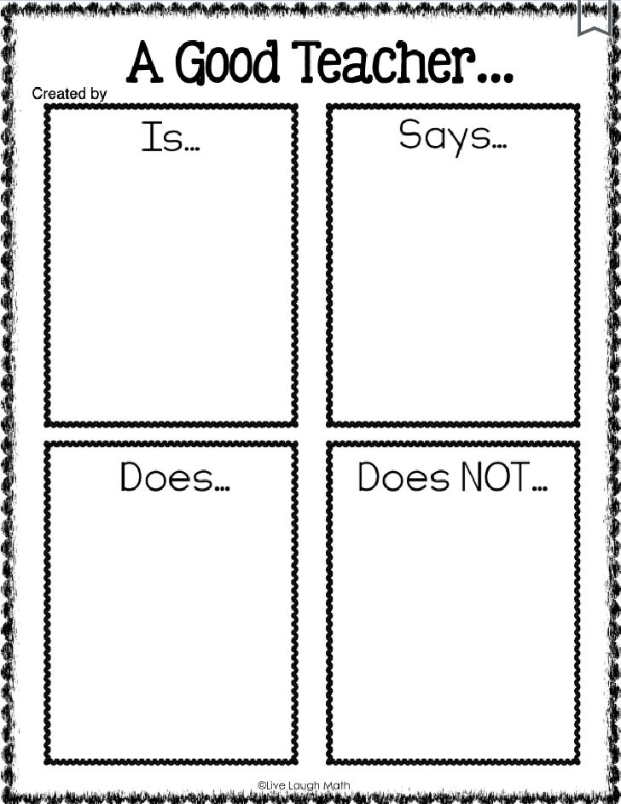
MORNING ACTIVITY
greeting students, what does a teacher do, says and student,
Is…
UNE Symposium • Social Services & Education Professionals
3

Slide 8
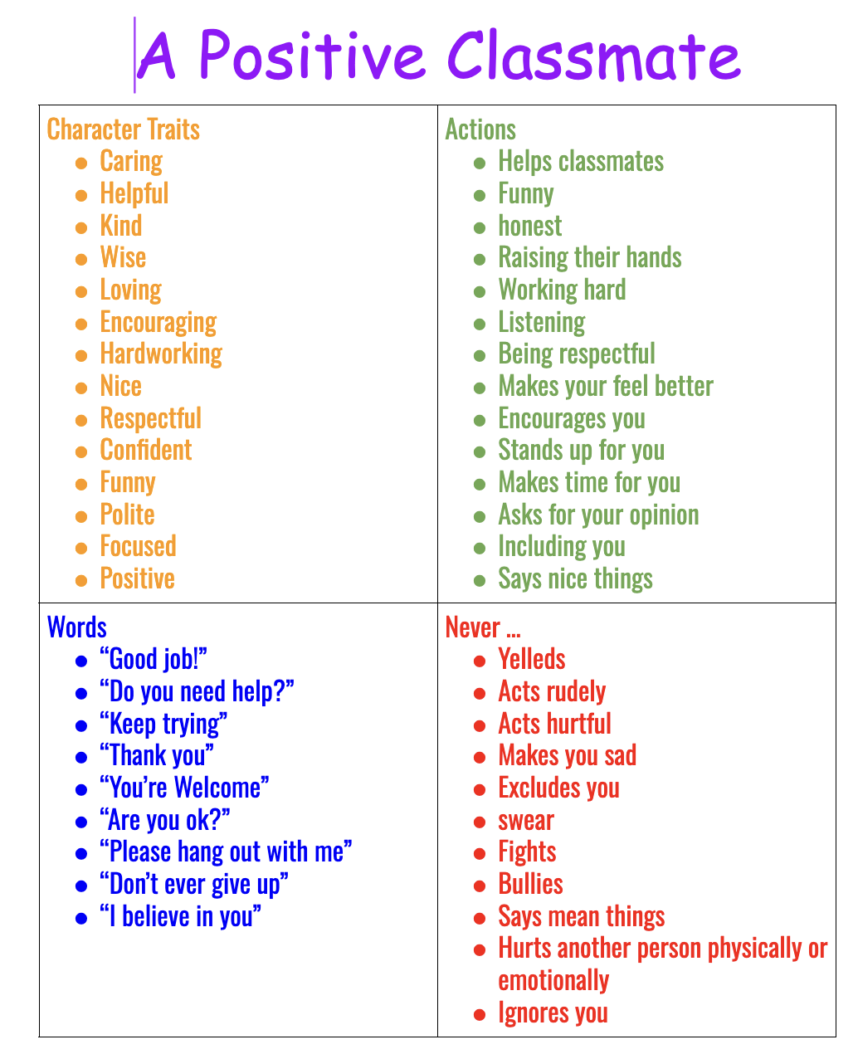
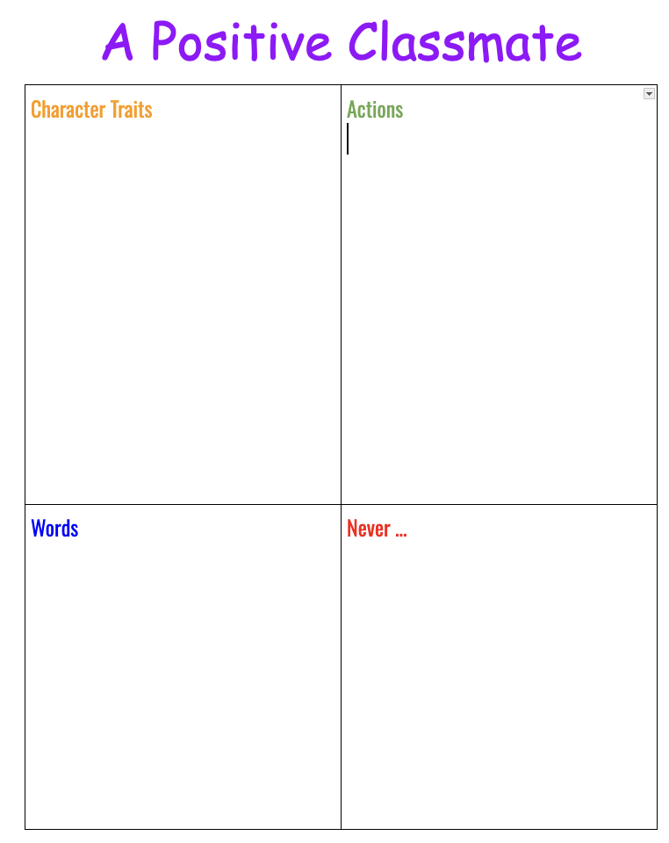
TEACHER-TO-STUDENT AGREEMENTS
A Positive Classmate
UNE Symposium • Social Services & Education Professionals
4

Slide 9

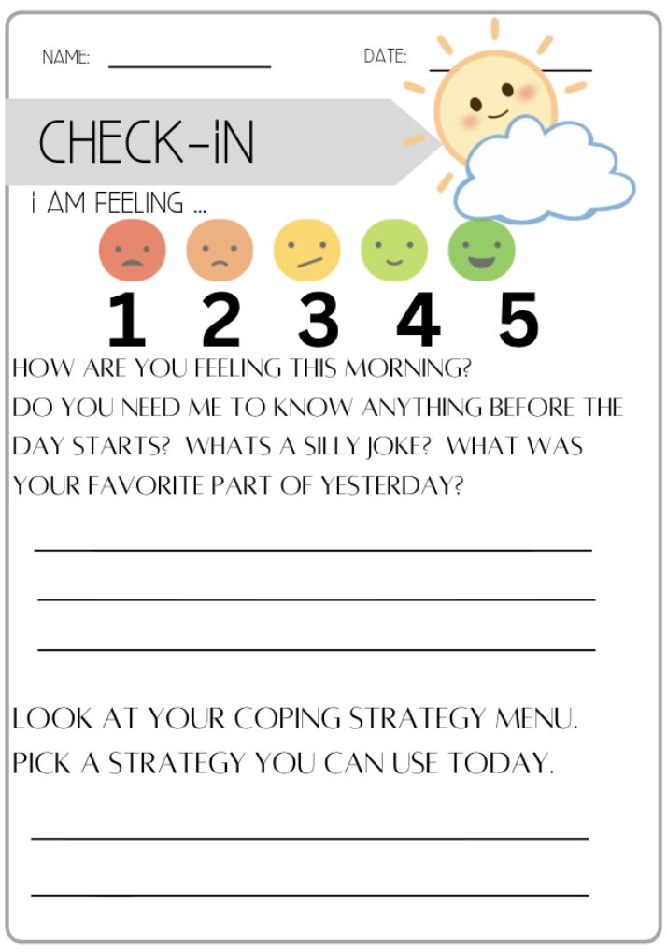
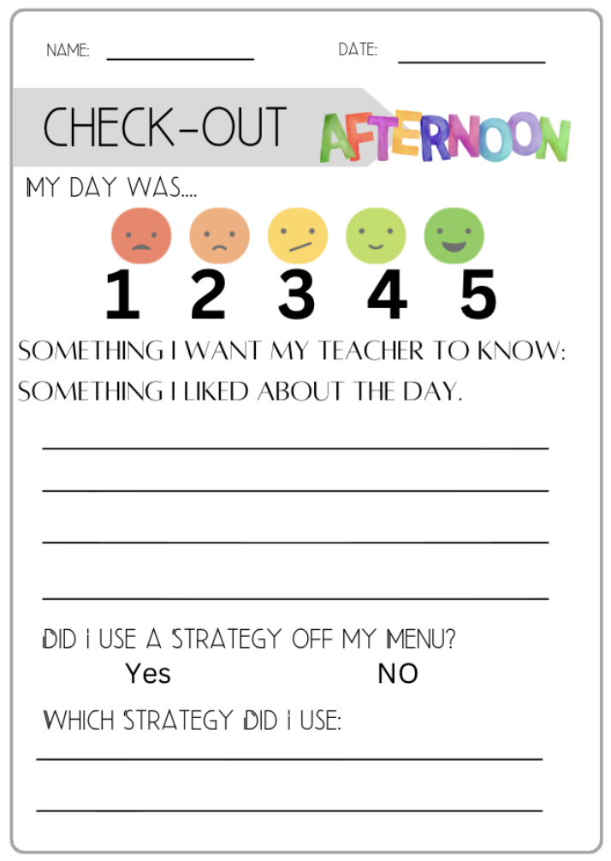
DAILY ROUTINE
Coping Strategies Menu
Check-In & Check-Out
UNE Symposium • Social Services & Education Professionals
5

Slide 10

PROTOCOL EXAMPLES
Lunch & Transitions
Lunch
Transitions / Hallway
Expected
Unexpected
Expected
Unexpected
Calm voice with friends
Eating food
Raising hand for help
Cleaning up
Staying in your space
Yelling / screaming
Getting out of seat
Food fights
Dancing on tables
Slamming the tables
Calm body, quiet
Listening to directions
Line up; whole-body listening
Quiet greetings (waving)
Push in chair; stay with group
Yelling / talking
Cutting in / out of line
Out of control of body
Going into other classrooms
Following own plan, not group’s
UNE Symposium • Social Services & Education Professionals
8

Slide 11

UDL & the Dinner Party Analogy
https://www.novakeducation.com/blog/udl-vs-di-dinner-party-analogy
If you were hosting a dinner party, what would you do ahead of time so every guest could participate and enjoy themselves?
What are the “dietary restrictions” in our classrooms we should anticipate rather than react to?
How do we offer multiple options without a separate lesson for every learner?
Which parts of our instruction already plan for learner variability?
Is equity the same as giving everyone the same thing?
When does flexibility improve learning for everyone — not just a few?
What barriers could we remove before students encounter them?
Reference: novakeducation.com — UDL vs. DI Dinner Party Analogy
UNE Symposium • Social Services & Education Professionals
6

Slide 12
FIRST TWO MONTHS OF SCHOOL & OVER AND OVER AND OVER AGAIN
Building Community & Setting the Dinner
Getting Started
Need-to-Know Procedures
Model examples and resources — pick two a day
Greeting students, check-in, early problem solving together
Teacher-to-student agreements
Share visuals; build the list together as a class
Anchor chart for students to reference and cross off
Unpacking backpack
Entering the classroom
Morning routine & work
Restroom sign-in / expectations
Transitions & rug time
Whole-body listening
Turn & talk / elbow partner
Flexible seating & table jobs
Noise levels & lining up
Fire drill & dismissal
UNE Symposium • Social Services & Education Professionals
7

Slide 13

ACADEMIC MINDSET
The Learning Pit
Nurturing Academic Mindset by Building…
Introduced at the start of the year to build information-processing skills
“It’s ok to struggle, make mistakes, and not know the answer — I want you to struggle!”
Framed like a muscle: struggle at school is how the brain “works out”
Students support each other: “You got this” instead of giving the answer
Goal: students feel they belong, their work is valued, and they can succeed even when it’s hard
Student self-awareness & self-regulation strategies
Individual tolerance for productive struggle
A community that welcomes challenges and supports one another through them
Stages: Content → Confused → Frustrated → Try → Working → I made it!
UNE Symposium • Social Services & Education Professionals
9

Slide 14
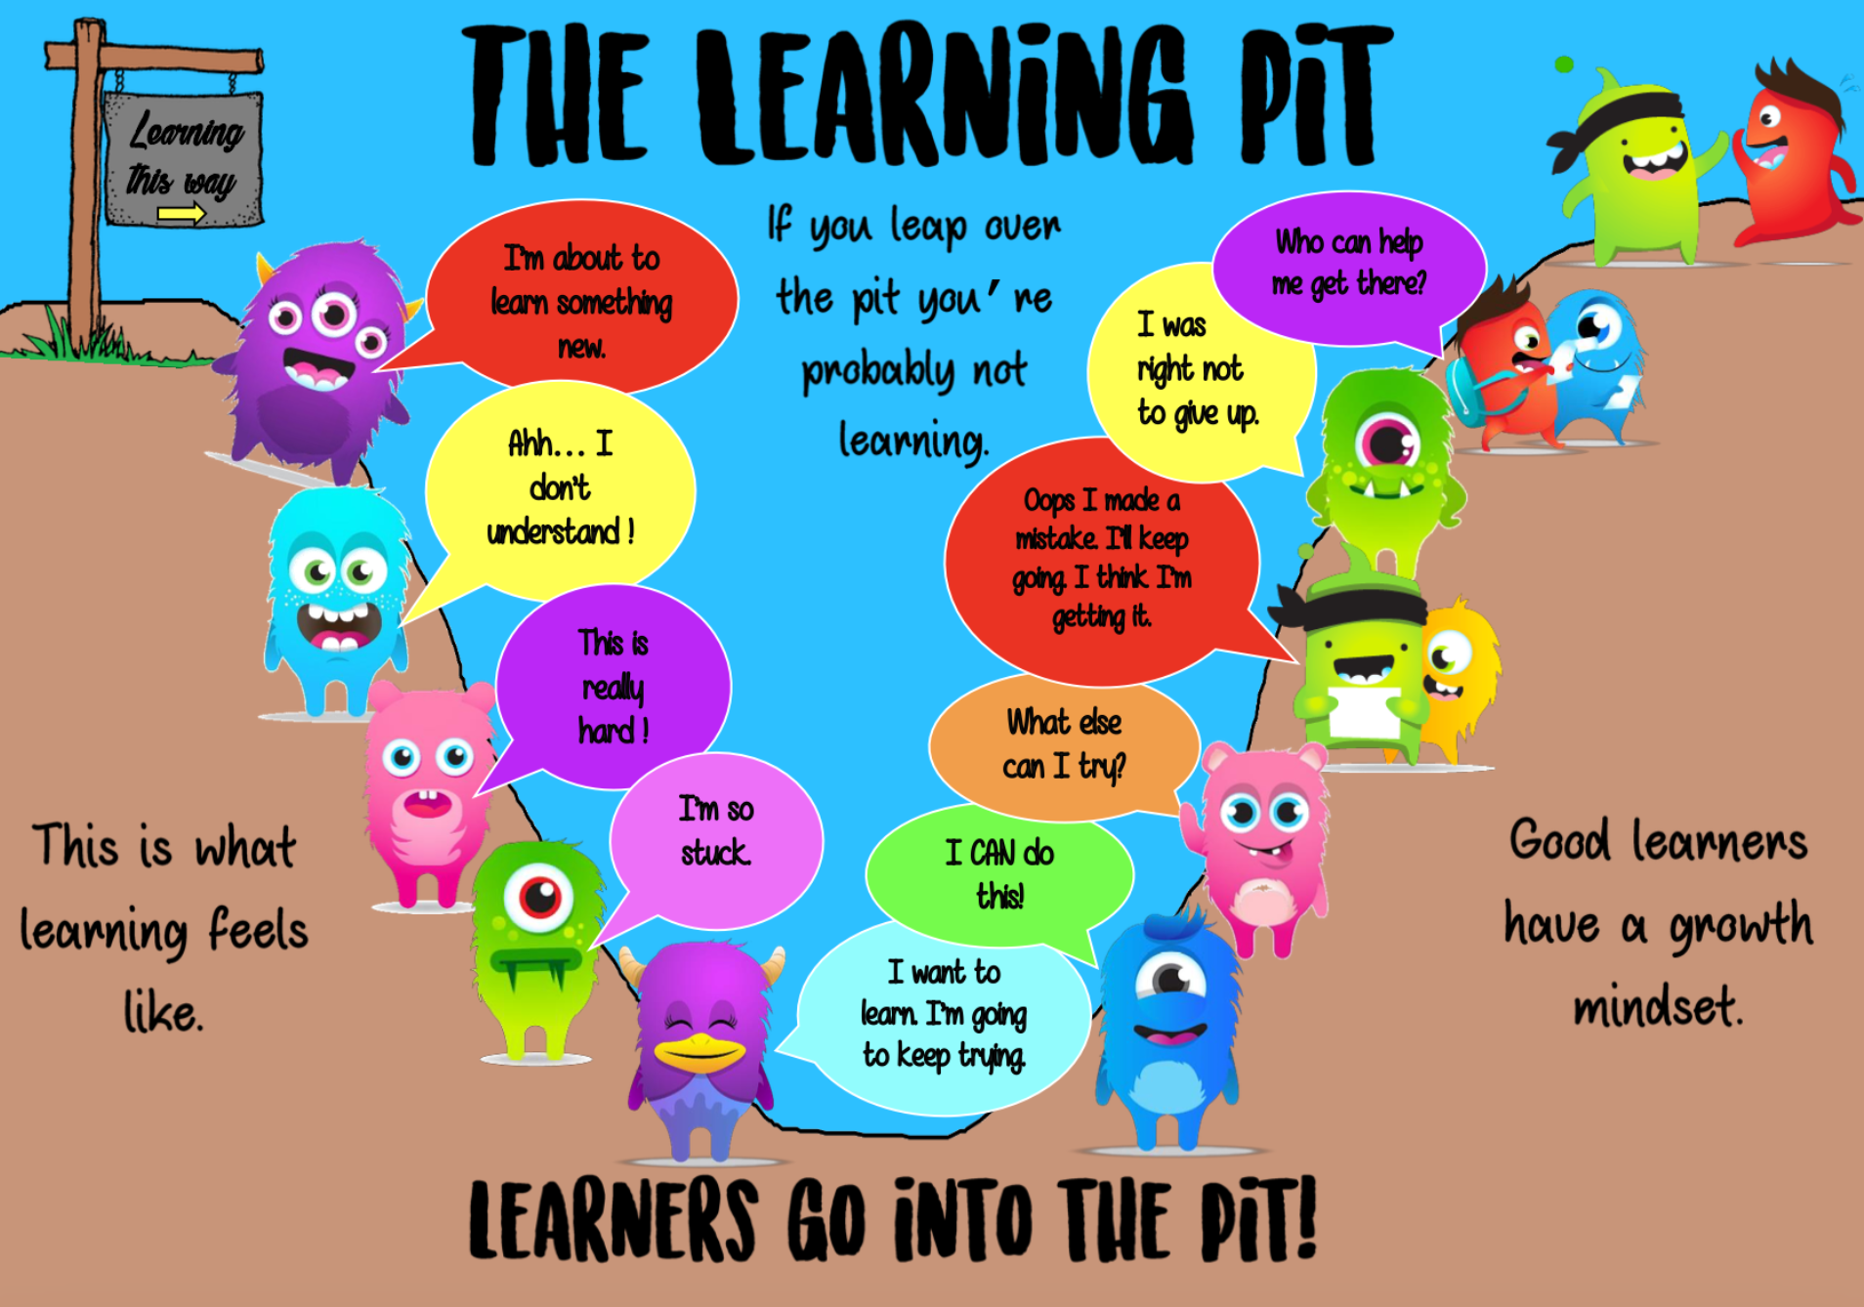
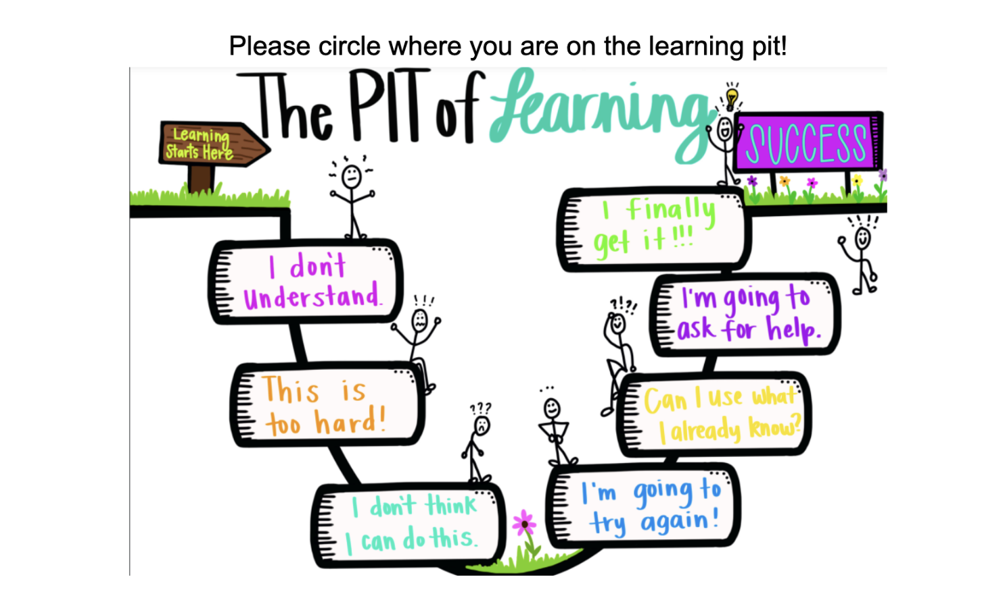
ACADEMIC MINDSET
The Learning Pit
Nurturing Academic Mindset by Building…
UNE Symposium • Social Services & Education Professionals
9

Slide 15

GETTING OUT OF THE PIT
“Rope Strategies”
Feeling overwhelmed
Take deep breaths, take a break, take a walk, draw, use positive self-talk
Working on an assignment
Ask a teacher, ask a classmate, or reread directions
Struggling with vocabulary
Use context clues, try a similar word, use visuals, or look it up
Struggling with a reading response
Think back to the lesson, use an anchor chart, verbalize ideas first, draw it out
Struggling with comprehension questions
Read the question again; cross out answers that don’t make sense
Struggling with math
Underline key numbers or draw a place-value model
UNE Symposium • Social Services & Education Professionals
10

Slide 16
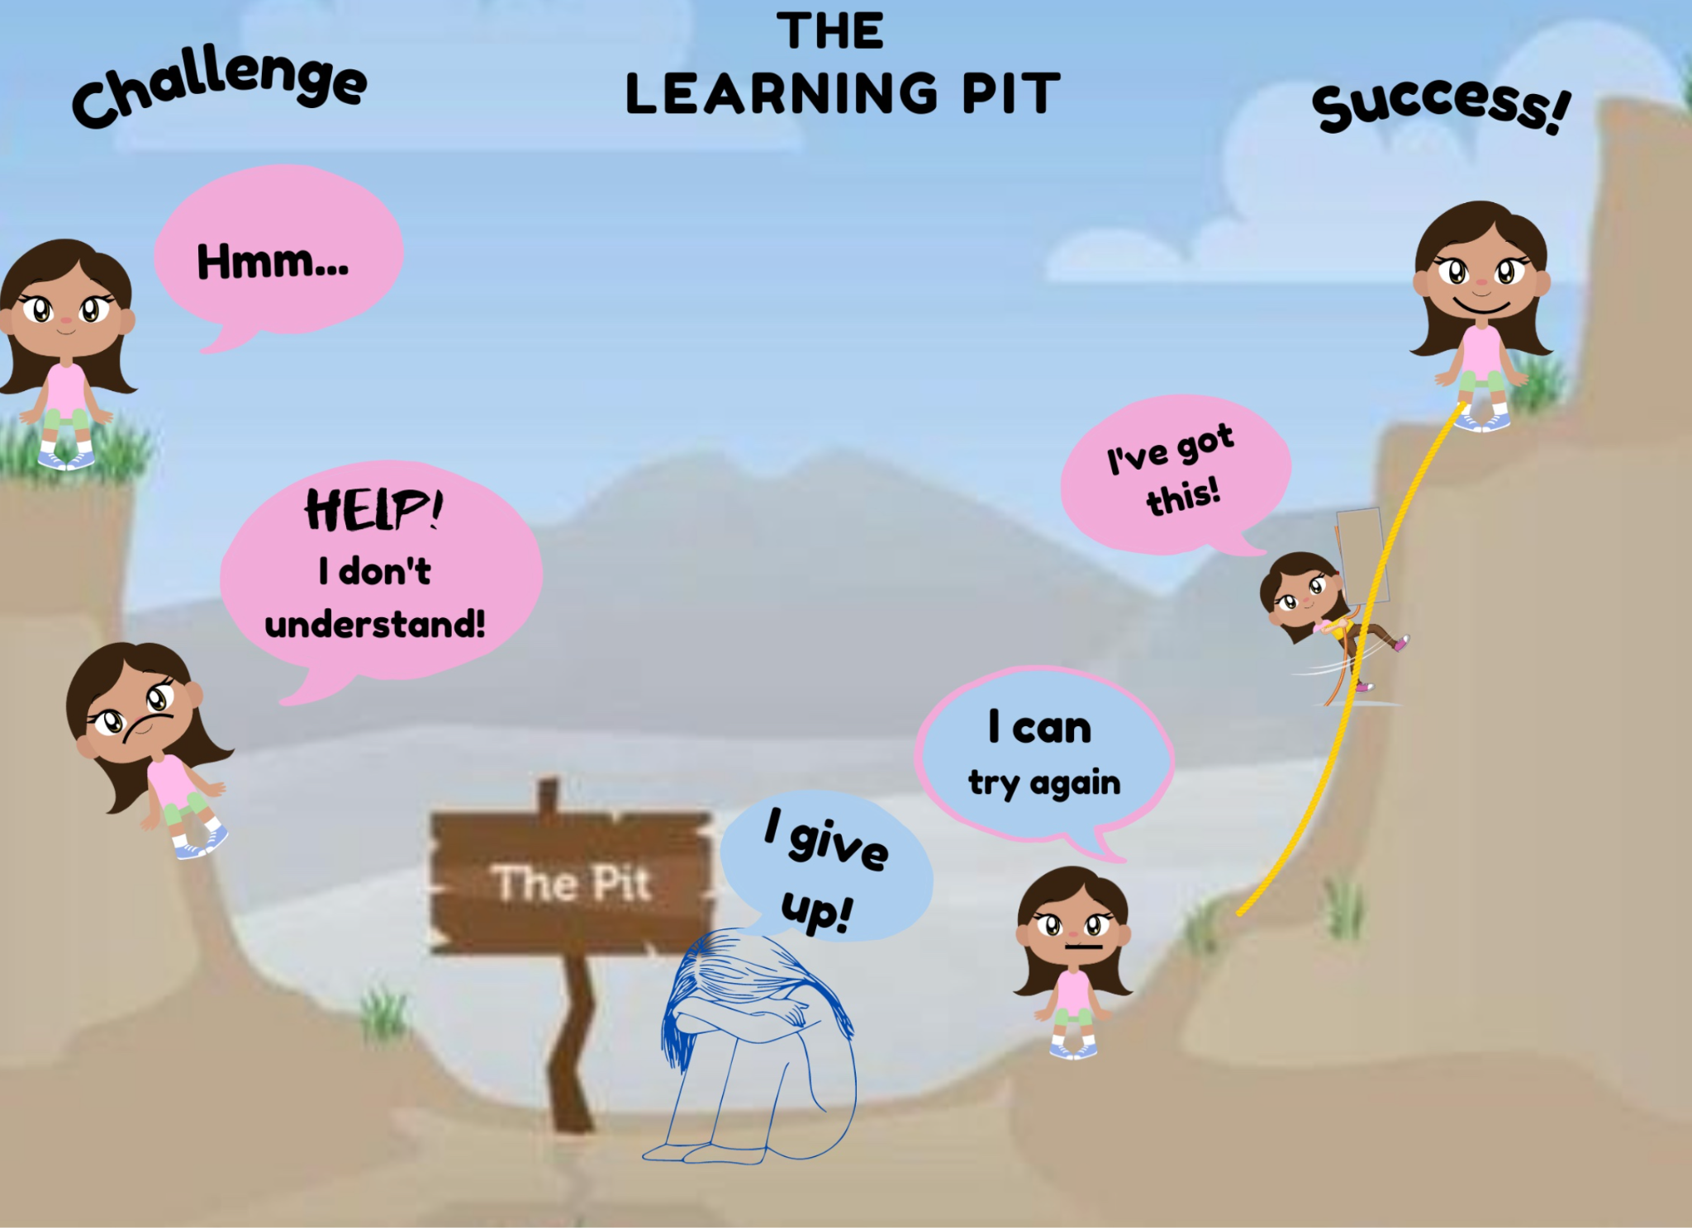
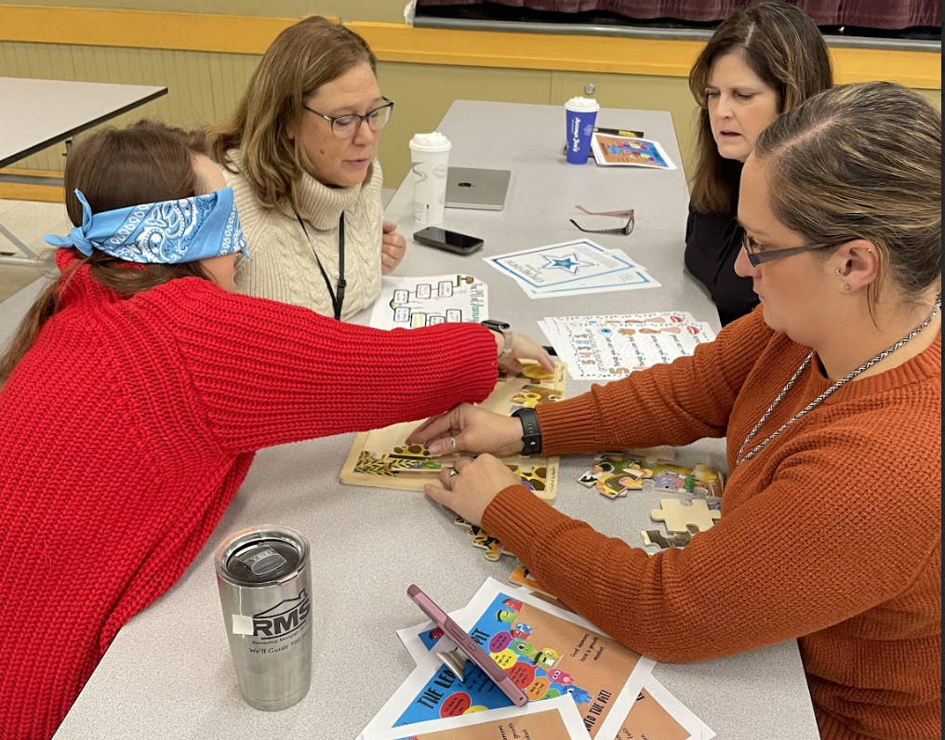

Slide 17
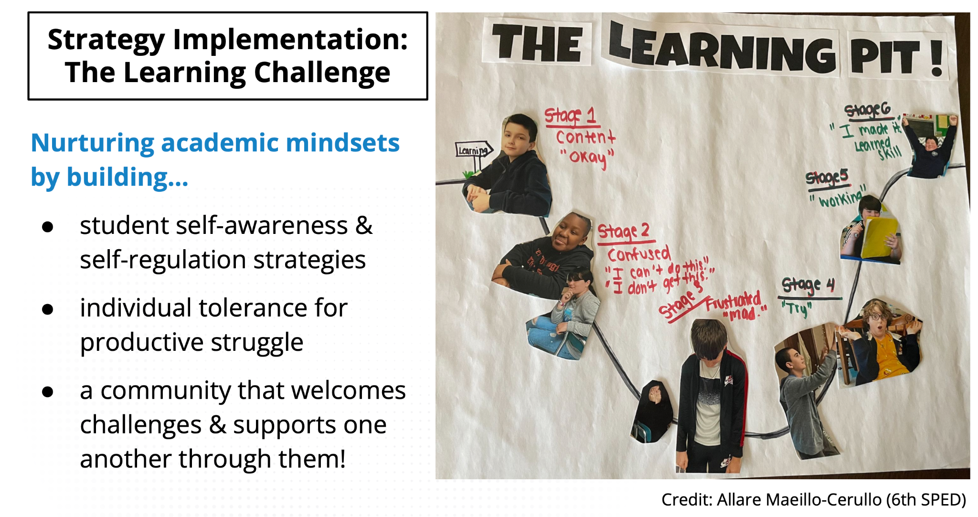

Slide 18
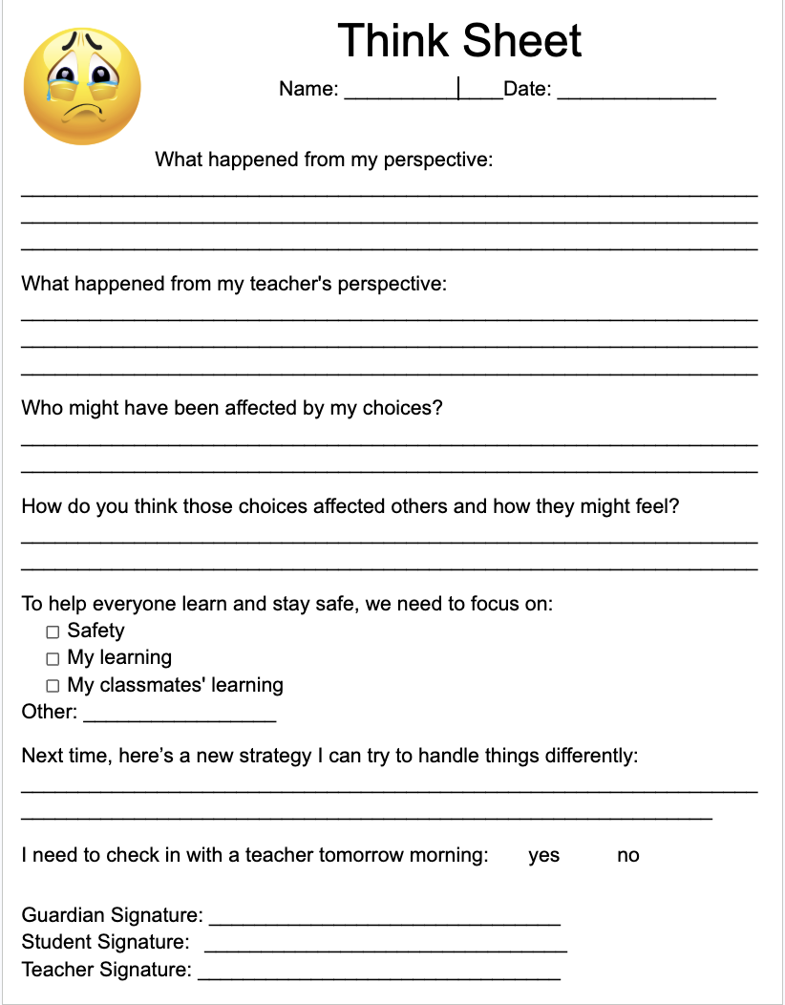

Copy of Think sheet
EARLY PROBLEM SOLVING TOGETHER
The Think Sheet
What it captures
Every Year Is Different
Student concerns
Teacher concerns (learning, safety, classmates’ learning)
Who was impacted by the behavior, and how
Next time: what could be done instead (“Plan B” strategies)
Check-in with a teacher tomorrow morning: yes / no
Guardian, student, and teacher signatures
Expectations and protocols shift with each new group of students
Teacher and admin roles work together on the Think Sheet
Seek out others’ thoughts on the student as a team
Frame what’s needed to support the student as educators
UNE Symposium • Social Services & Education Professionals
11

Slide 19
COLLABORATION
Working Together as a Student Support Team
Why bring in others?
It’s important to hear from others — how do you best communicate as a team?
Knowing when it’s time to get together matters as much as who is in the room
Collaborate with any service providers: Mental Health, Speech, OT, and outside providers
Teacher
Admin (as needed)
Student Team
Brings daily classroom context and relationship with the student
Supports Think-Sheet follow-through and school-wide consistency
Seeks out others’ thoughts on the student to build a full picture
UNE Symposium • Social Services & Education Professionals
12

Slide 20

FACING THE HARD MOMENTS
“What Ifs” & De-Escalation
It’s ok to struggle — to be in the learning pit — which means we sometimes need help de-escalating.
Scenarios educators face:
A student says “no”
Not coming to school; poor hygiene
Crying or screaming in class
Asking to go to the bathroom over and over
Yelling in class or at others
What does de-escalation look like to you?
UNE Symposium • Social Services & Education Professionals
13

Slide 21

IN THE MOMENT
Your Nervous System & Helpful Scripts
It’s not a weakness — it’s your nervous system trying to protect you.
Scripts & Prompt Phrases
When a student says “no,” notice what happens in your body — and what meaning you place on the moment (“I’ve lost control,” “They don’t respect me”). That stress response can lead to Snap, Shut Down, or Accommodate.
“I can see you’re not ready to talk. We’ll come back to this.”
“Let’s take a moment to reset, then talk.”
“Let’s pick this up in five minutes when we’re both calm.”
“You’ve got some choices. I’ll give you space to think.”
Holding the emotional system for a whole class is a lot.
UNE Symposium • Social Services & Education Professionals
14

Slide 22

GUIDING PRINCIPLES
De-Escalation Goals
Honesty
Compassion
Responsibility
Respect
Courage
Maintain transparency and clear communication to foster trust.
Approach students from understanding to foster a supportive environment to thrive.
Keep the agitated student, staff, and peers safe; teach emotional regulation.
Preserve the student’s dignity and privacy.
Have courage to ask for help, ask questions, and make mistakes.
UNE Symposium • Social Services & Education Professionals
15

Slide 23

FRAMEWORK
Three Categories of Behavior
Dangerous
Disruptive
Inconvenient
Difficult to manage; may interfere with the student’s learning or others’. Includes aggression, self-injury, or behavior that deviates from social norms.
Interrupts the normal flow of activities, causing disturbance in the classroom or learning environment.
Inappropriate or unwanted in a specific setting; may disrupt the individual student’s learning, but not the entire environment.
UNE Symposium • Social Services & Education Professionals
16

Slide 24

FRAMEWORK
Examples of Behaviors by Severity
Disruptive
Interfere with learning and functioning, but not directly harmful.
Swearing, teasing, door slamming, repetitive questions, hiding, making noises, pacing, throwing items (not targeted)
Dangerous
Potentially harmful.
Scratching, slapping, biting, running away, pushing, hitting, throwing items (targeted)
Very Dangerous
Significant likelihood of causing serious, potentially lethal harm.
Using dangerous weapons, suicide attempts, forceful head-banging
UNE Symposium • Social Services & Education Professionals
17

Slide 25
DEFINITION
What Is De-Escalation?
De-escalation is a “calming” procedure
It involves moving from a state of heightened emotion back to a state of calm
This calm state can be seen as a return to how the student “typically” presents — their “baseline”
UNE Symposium • Social Services & Education Professionals
18

Slide 26
STAYING REGULATED
Calm Adult Behaviors
Voice
Body
Support
Calm, neutral tone, low volume
Relaxed, neutral posture and facial expression — stand at a distance from the student
Call for assistance when needed
Environment
Communication
Scan the room for dangerous objects or materials and have them removed
Only one adult speaks to the student at a time
UNE Symposium • Social Services & Education Professionals
19

Slide 27

BEFORE ESCALATION HAPPENS- Set the dinner party up
Proactive Strategies
Positive Reinforcement
Around the Classroom
Whole-class incentives
“Catch them being good”
Structured reinforcement plan
Be specific and individualized
Opportunities for peer recognition
Predictable routines and visual expectations
Movement breaks
Role play and modeling
Embedded social-emotional learning opportunities
Reduced stimuli and mindful organization of materials
UNE Symposium • Social Services & Education Professionals
20

Slide 28

COLLABORATIVE & PROACTIVE SOLUTIONS
Plan B Cheat Sheet Plan B Cheat Sheet- Ross Greene
Problems get solved — livesinthebalance.org
1
Empathy Step
2
Define Adult Concerns
3
Invitation Step
GOAL
GOAL
GOAL
Gather information about, and reach a clear understanding of, what’s making it hard for a kid to meet a given expectation.
Share the second party’s (often the adult’s) concern about why the expectation matters — usually health, safety, or learning.
Generate a solution that is realistic and mutually satisfactory — truly addressing both parties’ concerns.
TRY
TRY
TRY
“I’ve noticed that… (insert unsolved problem)… what’s up?”
“The thing is…” or “My concern is…”
“I wonder if there’s a way for us to do something about… and also…”
AVOID
AVOID
AVOID
Don’t skip Empathy, assume you know the concern, or rush to solutions.
Don’t start talking about solutions yet, sermonize, or lecture.
Don’t enter with a preordained solution or sign off on one party can’t perform.
UNE Symposium • Social Services & Education Professionals
26

Slide 29

UNDERSTANDING FUNCTION
What Is the Student Trying to Get or Avoid?
GET
AVOID
Attention from staff or peers
Something to eat or drink
Help with a task or activity
Access to a person, object, activity, or location
A task or activity
Pain or discomfort
Loud or irritating noise
A chaotic environment
Being teased or bothered by another
A task or activity
UNE Symposium • Social Services & Education Professionals
21

Slide 30

PROCEDURE
The Help Strategy
1
2
3
Ask
Model Communication
Praise Immediately
Ask the student to tell you what he or she needs or wants. Sometimes this will be apparent.
“You can say… ‘I want help, please.’” or “Tell me what you need right now” / “What can I do to help?”
As soon as the student communicates their needs: “I would love to help you with your work, thank you for asking!”
Try it out: work in pairs — one student, one teacher. Scenario: student has refused math work and put their head down.
UNE Symposium • Social Services & Education Professionals
22

Slide 31
MID-LEVEL ESCALATION
The Prompting Procedure
Verbal or non-verbal cues that guide a student toward an incompatible or high-probability behavior, replacing a less desirable one. Use when a student is at mid-level escalation (yelling, ripping paper, posturing).
Incompatible Behaviors
High-Probability Behaviors
Yelling → speaking quietly / drink of water
Rocking in chair → walking, standing, delivering an item
Banging on wall → hands in pockets, going for a walk
Pacing → sitting down, jumping jacks, wall sits
Take a breath • Hand you a safe object
Drink some water • Sit down
Tell you something (score, time, a fact)
Put an item away • Walk to the end of the hallway
Source: Lennox, Rourke & Green, Safety-Care Behavioral Safety Training Trainee Manual (5.5th ed.), QBS
UNE Symposium • Social Services & Education Professionals
23

Slide 32


HIGH-LEVEL ESCALATION
Waiting & Power Struggles
The Waiting Procedure
Navigating Power Struggles
Give the student time and space to calm down without immediate intervention — pausing demands, interactions, or instructions so they can self-regulate, while staying nearby to support.
Don’t get stuck on one demand — it’s okay to shift
Provide controlled choice
Prioritize demands; re-evaluate what matters in the moment
Use empathy and active listening
Reframe: “Let’s find a way to get you back to class”
Know when to step back — rely on colleagues
Use when: escalation is high, or other procedures are ineffective.
UNE Symposium • Social Services & Education Professionals
24

Slide 33
WRAP-UP DE ESCALATION
Final Takeaways
Ask for help
Remain calm, neutral, and compassionate
Take a break
Don’t forget to reinforce desired behaviors
It’s okay to readjust the plan
Thoughts, Questions?
UNE Symposium • Social Services & Education Professionals
25

