Slide 1

Influencing Public Policy
“Top Issues for Youth in Coming Years”
Michael F. Brennan, LCSW
Lori K. Gramlich, LMSW
Tuesday August 18, 2026
University of New England
Summer Symposium
Copyright New England Center for Social Work & Justice

Slide 2
INTRODUCTIONS
Michael F. Brennan, M.A., MSW, LCSW, was the first popularly elected Mayor for the City of Portland in nearly nine decades. Prior to his election as mayor, Michael worked as a Policy Associate with the Cutler Institute of Child and family Policy at the Muskie School for Public Service, specializing in education and health. Michael also served as a State Representative from Portland for eight (16) years where he chaired the Education Committee and the Joint Select Committee on Substance Use and currently serves on the Appropriation Committee. He also served five (5) years in the State Senate where he chaired the Health and Human Services Committee and the Joint Select Committee on Health Care Reform. He was Senate Majority leader. He had previously served as NASW ME Board President, and currently works at Common Dreams, a nonprofit independent news service in Portland.

Slide 3
INTRODUCTIONS
Lori K. Gramlich, LMSW received her Master’s Degree in Social Work from the University of New England in 1997. She has over 35 years of experience in nonprofit prevention based social work, advocacy, and social justice. She has worked with the Maine Department of Health Human Services, served as Communications Director for Senate President Beverly Daggett in Maine State Legislature, and was elected to Portland School Committee in 2005 where she served as Chair of the Legislative Affairs Committee and the Policy Committee.
Lori is in her fourth term serving in the ME House, where she is currently Assistant House Majority Leader. She previously served 6 years on the Environment and Natural Resources Committee, where she was House Chair for the last 2 years. Prior to her legislative serve, Lori was Executive Director of NASW ME Chapter.
Lori is currently teaching Social Welfare Policy and Social Justice classes at the University of Southern Maine Social Work Department, where she has been adjunct faculty for the past 11 years.

Slide 4
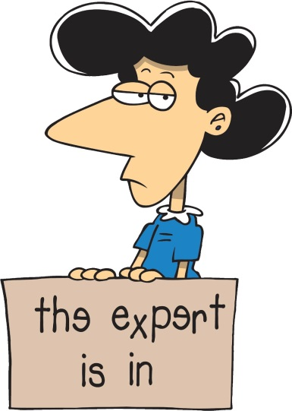
OVERVIEW
Policymakers needs YOUR expertise
in order to understand the issues and
make informed decisions that affect
organizations.
This workshop is intended to participants in navigating how to influence public policy in Augusta.
Notes:
Why are we here & overview (Michael & Lori)

Slide 5
How Does a Bill Become a Law
You have an idea of something important to you
Find a Legislator to Submit a Bill
Public Hearing
Work Session
Floor Debates & Votes in both House & Senate
Governor signs into LAW

Slide 6
Role Play
Licensing - Social Work bill
Certification – Mandatory Curriculum
Institutionalization – Mental Health & Unhoused populations

Slide 7
Tips for Effective Lobbying
🧠 1. Know Your Issue Cold
Do your homework: Understand every angle—facts, data, stakeholders, counterarguments.
Stay current: Be aware of recent developments and opposition views.
🎯 2. Be Clear on Your Objective
Know exactly what you want: a vote, funding, regulatory change, public support, etc.
Avoid vague asks—be specific, measurable, and actionable.

Slide 8
Tips for Effective Lobbying
🏛️ 3. Target the Right People
Identify decision-makers and influencers.
Understand their interests, constituencies, and voting record.
Don’t overlook staffers—they’re gatekeepers.
🕵️ 4. Understand the Political Landscape
Timing is everything: Know legislative calendars, budget cycles, and election timelines.
Consider public sentiment and media attention.

Slide 9
Tips for Effective Lobbying
🗣️ 5. Craft a Compelling Narrative
Facts matter, but stories persuade.
Tie your issue to human impact, economic consequences, or local relevance.
📄 6. Provide Solutions, Not Just Problems
Offer practical, implementable policy options.
Be prepared to show costs, benefits, and precedent.

Slide 10
Tips for Effective Lobbying
💼 7. Build Relationships, Not Transactions
Be respectful and reliable, not just when you need something.
Follow up, say thank you, and keep them informed year-round.
🤝 8. Form Coalitions
Join forces with allies, even unlikely ones.
Numbers, diversity, and unified messaging increase credibility and reach.

Slide 11
Tips for Effective Lobbying
📝 9. Prepare Materials
Leave a 1-pager or executive summary—clear, concise, branded.
Have FAQs and fact sheets ready for different audiences.
📣 10. Use Multi-Channel Advocacy
Pair direct lobbying with public campaigns: media, social media, grassroots efforts.
Constituents speaking out = pressure that matters.

Slide 12
Tips for Effective Lobbying
🔁 11. Be Persistent, Not Pushy
Follow up regularly but respectfully.
Change is slow—keep showing up.
*Remember to THANK your Legislator*

Slide 13

GROUP DISCUSSION

Slide 14
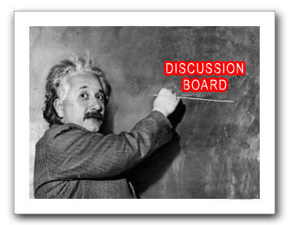

Wrap-up
Discussion
Evaluation

